Slide 1


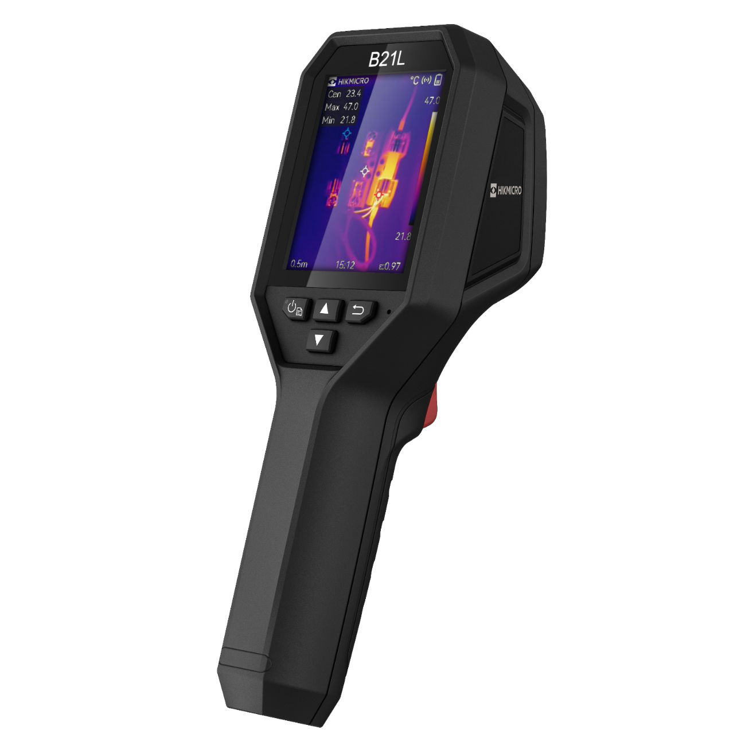

HIKMICRO B SERIES
PRODUCT INTRODUCTION
COMPACT AND EASY TO USE THERMAL CAMERA FOR DAILY OPERATION.
INDUSTRIAL PRODUCT | 2023.Q3
1
Notes:
Compact Explosion Proof Thermal Camera for use in Hazardous Areas

Slide 2
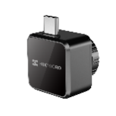
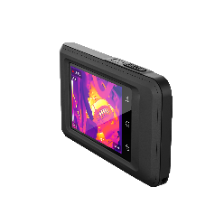
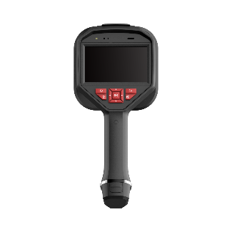
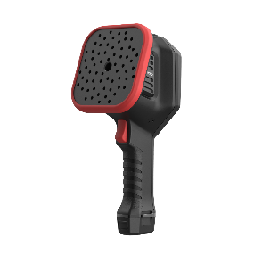
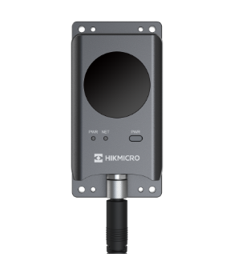

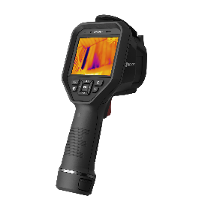
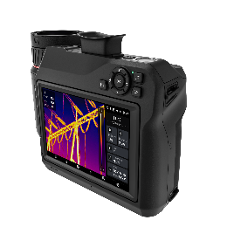
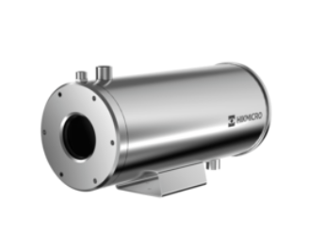
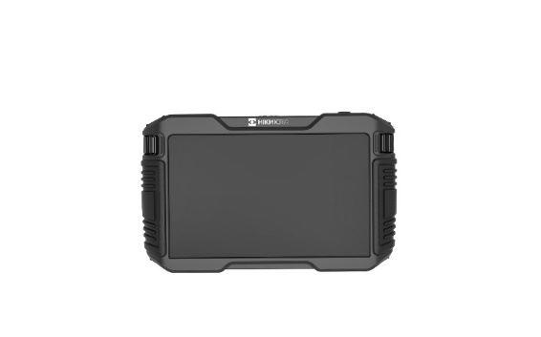
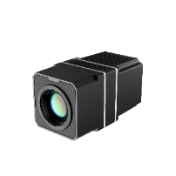

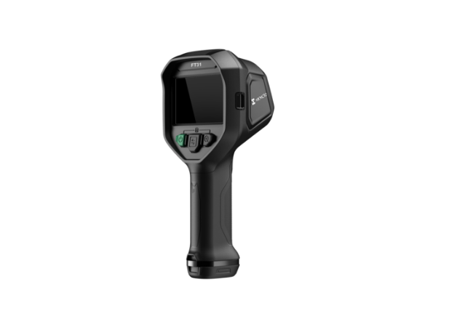


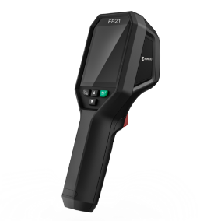
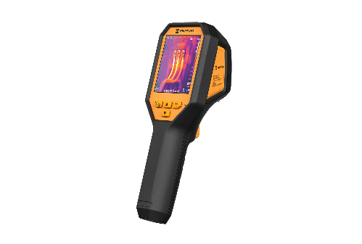


PRODUCT CATEGORY
PRODUCT CATEGORY
Thermal
Handheld
Fixed
Acoustic
New
Acoustic
New
Explosion-proof
New
Firefighting
Software

Slide 3
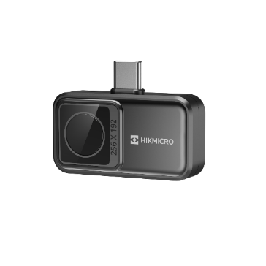
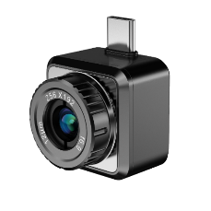
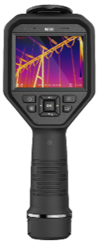
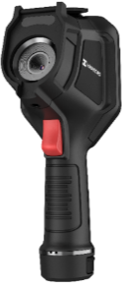
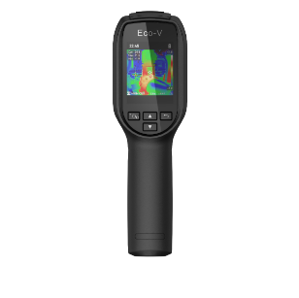
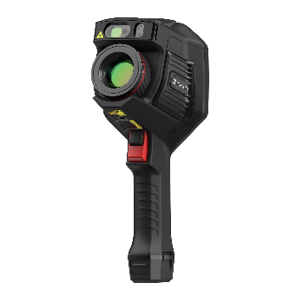
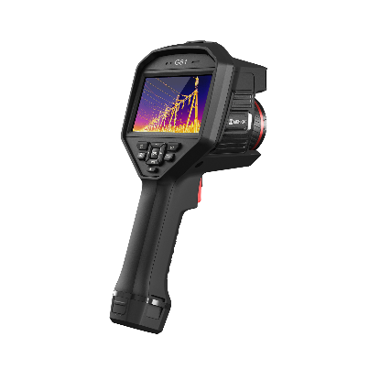
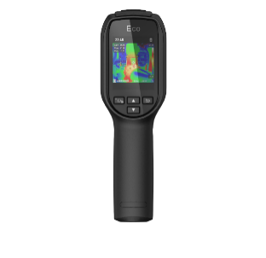
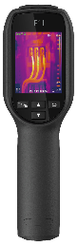
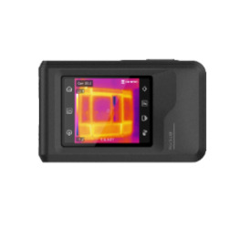

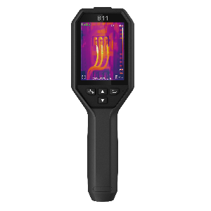
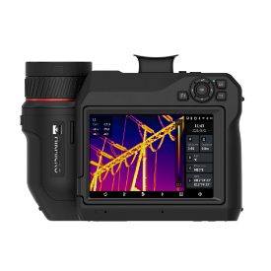
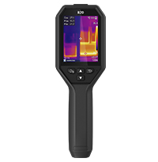
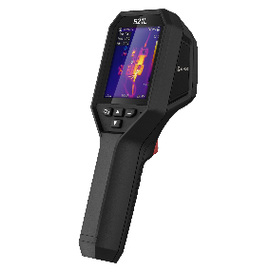
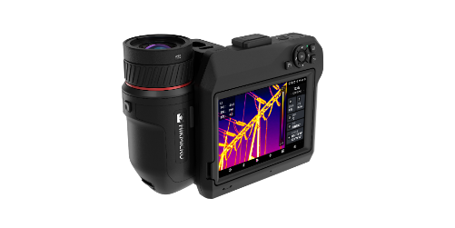

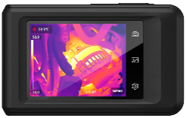
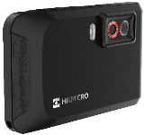
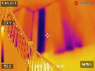
PRODUCT MATRIX - HANDHELD
Entry & Middle level
Middle & High-end Level
256
Smartphone
Attachment for Android
160 / 192 / 256 / 384 / 640
Wi-Fi
Manual Focus
Removable Batteries /Memory Card
Mini2Plus:
Manual Focus
Mini2:
Focus Free
Mini Series
M Series
384 / 480 / 640
Wi-Fi
Auto Focus
Removable Batteries /Memory Card
Optional Lenses
96 / 160
Focus Free
Eco Series
E Series
G Series
480 / 640
Wi-Fi
Auto Focus
Removable Batteries /Memory Card
Optional Lenses
DV Form Factor
192 / 256
Wi-Fi
Focus free
B Series
Pocket Series
SP Series

Slide 4
PRODUCT POSITIONING
The B series is our hot-selling handheld thermal camera for quick troubleshooting. B21L, B11, and B20 3 models are available in this series, which is a single IR camera and an IR, visible light dual-lens camera. Powered by SuperIR image enhancement technology, the B series can optimize the thermal image quality of products without increasing the budget. Supports full-screen temperature measurement, automatically tracks the highest, lowest, and center points, and quickly locates problems. Wireless connect with the HIKMICRO Viewer App to quickly transfer and share your on-device images.
Model | E1L | B11 | B21L | B20 | Pocket2
IR Resolution | 160 x 120 (19,200 Pixels) | 192 × 144 (27,648 Pixels) | 256 x 192 (49,152 Pixels) | 256 x 192 (49,152 Pixels) | 256 x 192 (49,152 Pixels)
SuperIR | × | Yes, on Captured Thermal Images |  |  | TBD
FOV (H × V) | 37.2° × 50° | 27.8° × 37.2° | 37.2° × 50.0° | 37.2° × 50.0° | 50° × 37.2°
Temperature Range | -20 °C to 550 °C (-4°F to 1022°F） | -20 °C to 550 °C (-4°F to 1022°F） |  |  | -20 °C to 400 °C (-4°F to 752°F）
Operation Time | 8 Hours | 6 Hours |  |  | 4 Hours
Display | 2.4" LCD Screen | 240 × 320 Resolution, 3.2”LCD Screen |  |  | 640 × 480 Resolution, 3.5" LCD Touch Screen with Auto-rotation
Visual Camera | × | 1600 × 1200 (2 MP) | × | 1600 × 1200 (2 MP) | 3264 × 2448 (8 MP)
LED Flashlight | × | √ | × | √ | √
Wi-Fi | × | √ |  |  | √
Notes:
✓

Slide 5
CONTENTS
01 FORM FACTOR
02 KEY FEATURES
03 APPLICATIONS
04 SCOPE OF DELIVERY
05 SPECIFICATIONS
06 APP AND SOFTWARE
07 COMPETITION
08 IMAGES QUALITY COMPARISON

Slide 6

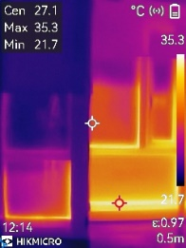


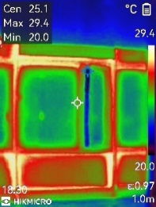
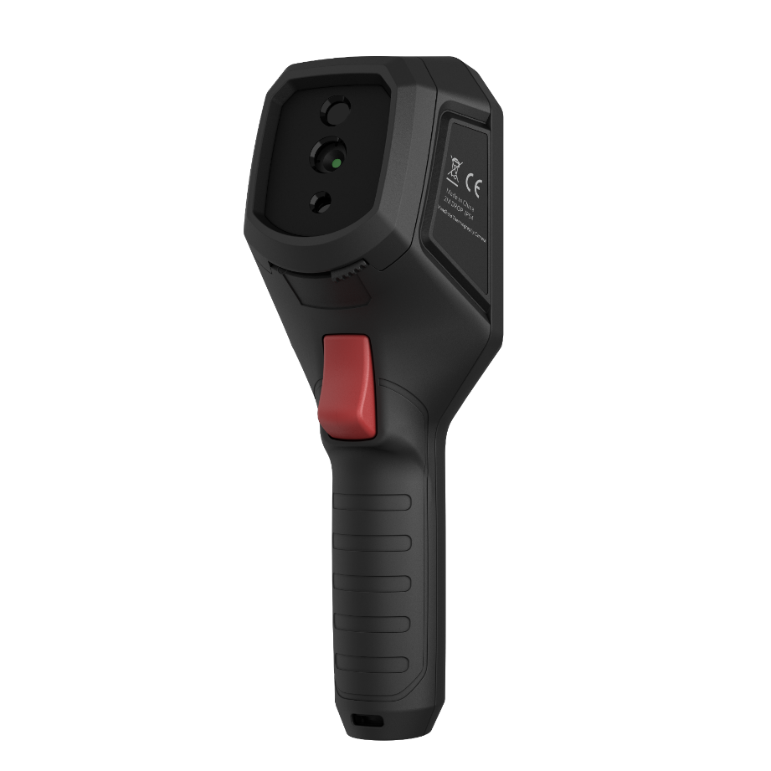
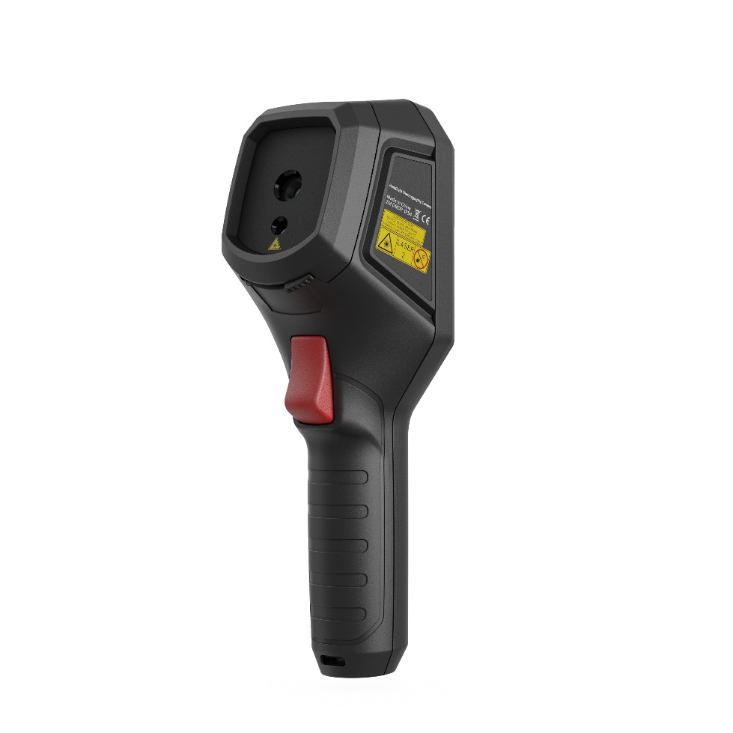
B SERIES – FORM FACTOR
B11/B20
B21L
Visible Camera
Thermal Camera
Led Flashlight
Thermal Camera
Laser Pointer

Slide 7

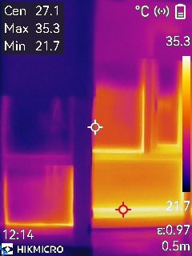



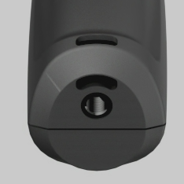
B SERIES – FORM FACTOR
3.2” LCD Screen with 240x320 Resolution
Keypad Controls for use with Gloves or PPE
Rugged Design with 2m Drop Test and IP54 Water & Dust Protection
Built-in Rechargeable Li-ion Battery System for up to 6 hours of runtime
Wrist Strap Hole, and UNC ¼”-20 Tripod Mounting Hole

Slide 8

B11/B20 – FORM FACTOR
USB-C Connection for Transferring Images and Charging
1600 × 1200 (2 MP) Visual Camera
B11: 192 × 144 (27,648 pixels) IR Resolution
B20: 256 x 192 (49 125 pixels) IR Resolution
LED Lamp for Lighting Dark Environments
Trigger for Capture and Laser Pointer, and for 1 Click Thermal and Visual Image Storage

Slide 9
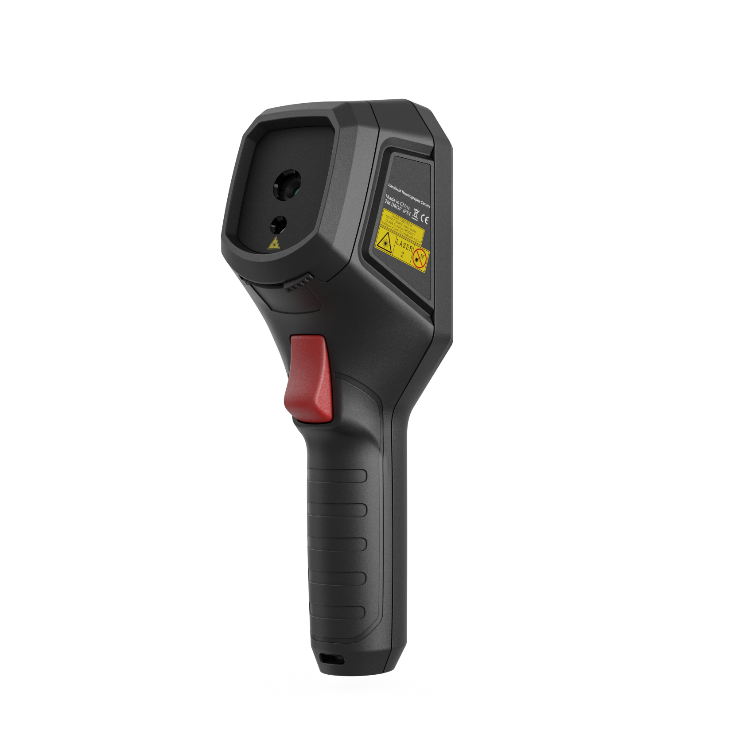
B21L – FORM FACTOR
Removable Micro SD Card, and USB-C Connection
B21L: 256 x 192 (49 125 pixels) IR Resolution
Laser Pointer
Trigger for Capture and Laser Pointer, and for 1 Click Thermal and Visual Image Storage

Slide 10
CONTENTS
01 FORM FACTOR
02 KEY FEATURES
03 APPLICATIONS
04 SCOPE OF DELIVERY
05 SPECIFICATIONS
06 APP AND SOFTWARE
07 COMPETITION
08 IMAGES QUALITY COMPARISON

Slide 11
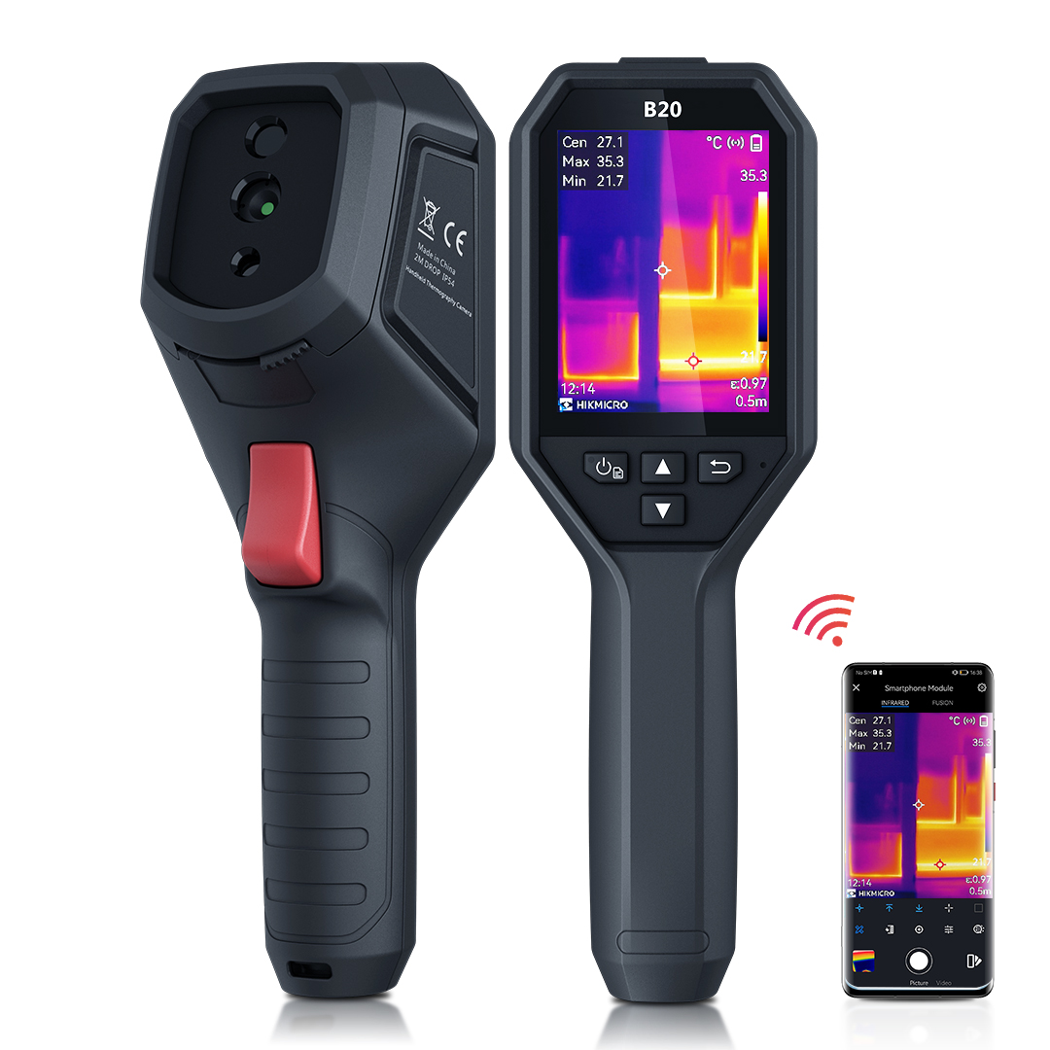
B SERIES - OVERVIEW
Compact and easy to use camera for daily operation
Basic Parameters | B11 | B21L | B20
IR Resolution | 192 × 144 (27,648 Pixels) | 256 x 192 (49 125 pixels)
SuperIR | Yes, on Captured Thermal Images
FOV (H × V) | 27.8° × 37.2° | 37.2° × 50.0°
Visual Camera | 2 MP | × | 2 MP
Laser Pointer | × | √ | ×
Led Flashlight | √ | × | √
Wi-Fi | √
Display | 240 × 320 Resolution, 3.2”LCD Screen
Object Temperature Range | -20 °C to 550 °C (-4 °F to 1022 °F)
Focus | Focus-free, 0.3 m (0.98 ft) Min. Focusing Distance
Storage Media | Built-in EMMC (16 GB)
Battery Operating Time | 6 Hours
Weight | 380 g (0.84 lb)

Slide 12
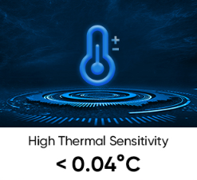
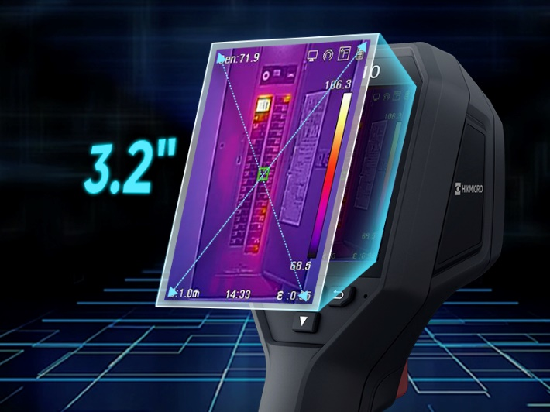
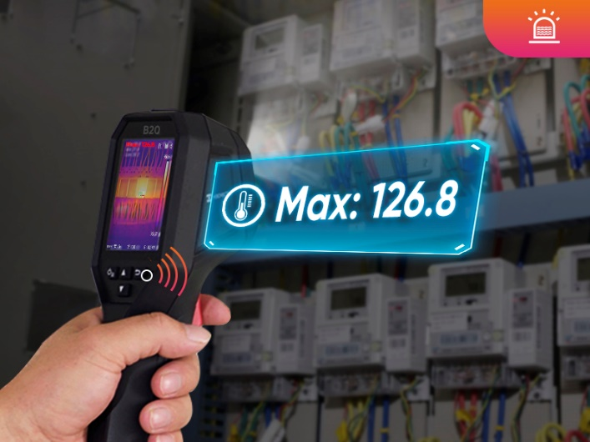
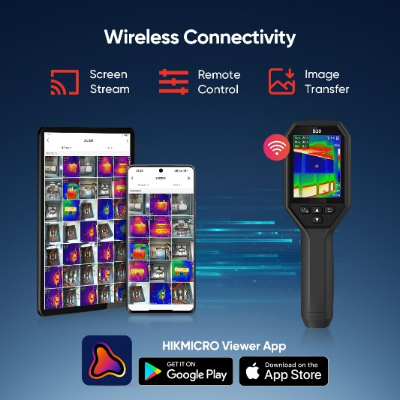
B SERIES - KEY FEATURES
Compact and easy to use camera for daily operation
256
High Image Quality
Features a highly sensitive (NETD < 40 mK) VOx detector, along with optimized image enhancement algorithms to provide clear thermal images.
3.2”
3.2” Color LCD
View the details of your images on the large, class-leading LCD screen
Wi-Fi
Wi-Fi Connectivity
Connect to mobile devices via built-in Wi-Fi and the HIKMICRO Viewer App to quickly share your images.
Temp
High Temperature Alarm
Built-in speaker and flash light give the operator audio and visual alerts to high temperatures

Slide 13
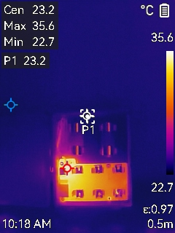
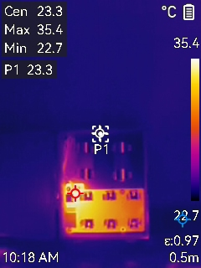
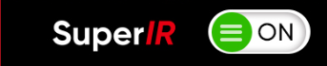
B SERIES - KEY FEATURES
Compact and easy to use camera for daily operation
256
Enhanced Thermal Clarity with SuperIR
Powered by HIKMICRO SuperIR image enhancement technology, it upscales the resolution of captured thermal images to 320 x 240 (76,800 Pixels).
Upscaled IR Resolution
Reduced Image Noise
Enhanced Edge Details
Note: Update the firmware of your B series cameras to V5.5.50 and above.

Slide 14
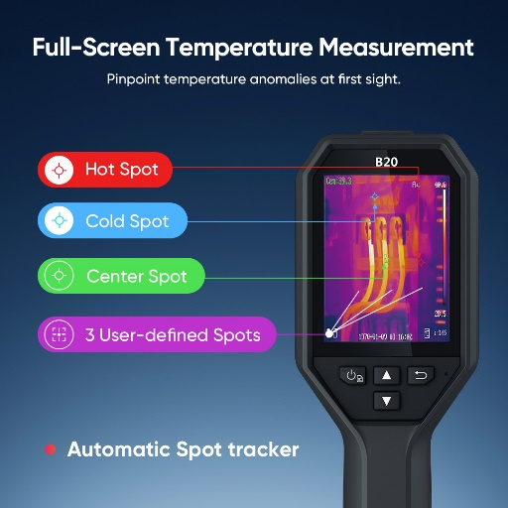
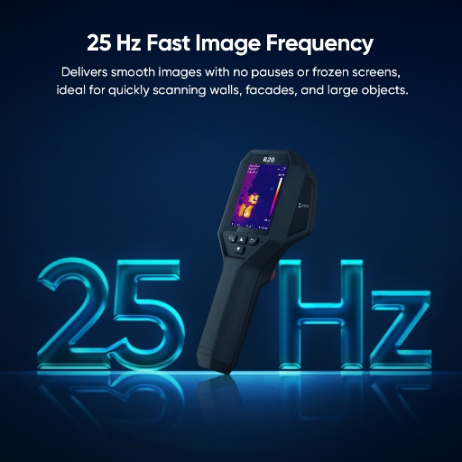
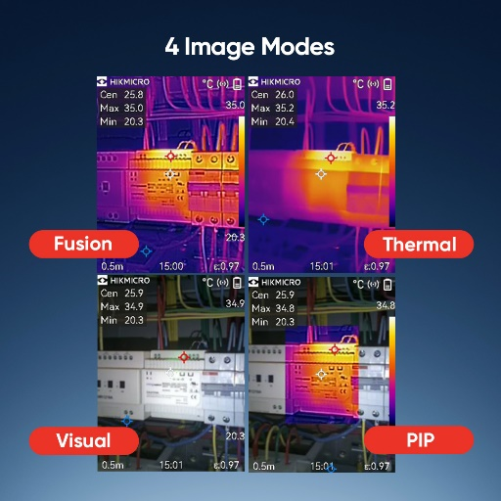

B SERIES - KEY FEATURES
Compact and easy to use camera for daily operation
Full-screen Precise and Wide
Temperature Measurement
Supports capture of full-screen radiometric images and automatically tracks max/min/center spots to pinpoint temperature anomalies at a glance. Accurately measures temperatures from -20°C to 550°C ( -4°F to 1022°F) with a temperature accuracy up to +/-2°C (+/-3.6°F) or +/-2% of reading.
25 Hz Fast Image Frequency
25 Hz fast image frequency delivers smooth video while panning across scenes or viewing moving targets.
Durable and Rechargeable Batteries
Built-in 3350mAh Li-Ion rechargeable battery and thoughtful auto power-off settings (10/20/30/40/50/60 minutes) allow the camera up to 6 hours of continuous operation.
4 Images Modes
Thermal, Fusion, PIP and Optical modes to suit your preferred view. (Except B2L/B21L)

Slide 15
CONTENTS
01 FORM FACTOR
02 KEY FEATURES
03 APPLICATIONS
04 SCOPE OF DELIVERY
05 SPECIFICATIONS
06 APP AND SOFTWARE
07 COMPETITION

Slide 16




B SERIES – APPLICATIONS
Mechanical Predictive Maintenance
Electrical Inspection
Electrical problems can relate to problems such as loose or over-tight connections, shorted or overloaded circuits, load imbalances, and components that have failed or are fatigued, such as fuses, circuit breakers, transformers, etc. Most electrical problems exhibit a gradual rise in temperature prior to their failure.
And thermal imaging can recognize this heat. By detecting these early, you can prevent the possibility of fire.
Thermal imaging is great for spotting a lack of uniformity in equipment by indicating hot and cold spots in surface temperature, through infrared image capture. Heat is often an early symptom of equipment damage or malfunction, making it important to monitor preventive maintenance programs. Monitoring equipment performance with thermal imaging cameras can reduce the likelihood of unplanned downtime due to equipment failure, reduce reactive maintenance fees and equipment repair costs, and extend the lifespan of machine assets.
Building Inspection
HVAC
In building inspections, missing or damaged insulation, building envelope air leaks, and moisture intrusion can be very difficult to find before they become serious enough to damage or destroy building contents. Thermal cameras can and have been utilized in the discovery of otherwise undetectable heat, air, and moisture anomalies in all types of structures.
With thermal imaging technology, technicians and heating engineers can make doubly sure that a central heating system has been thoroughly maintained. Not only does this provide peace of mind for the operator themselves, and it also allows them to show clients the results of their work and even help convince them of the need for maintenance in the first place. Thermal technology stands out as the only way to provide a comprehensive, visual, and quantitative assessment of the efficacy of maintaining HVAC Radiators.

Slide 17



B SERIES – APPLICATIONS
HVAC Inspection
A handheld thermal imager can be used to troubleshoot HVAC problems effectively and efficiently. It can find blocked registers, broken junctions, condenser units, electrical problems, radiant floor heating, and coil temps in a flash.
Water Leak Inspection
Find Air Leakage
Hidden water can wreak havoc on insulation, wood, electrical components and, eventually, finishes when it does reveal itself. As long as the conditions are right, thermal imaging will find the leakage area though showing the temperature variances between water and surrounding materials.
When insulation is missing in walls or rafters, it can cause energy loss and increase heating and cooling costs. As long as the conditions are right, a thermal imaging camera can help identify areas with energy loss, especially those in hard-to-reach locations or behind walls.

Slide 18
CONTENTS
01 FORM FACTOR
02 KEY FEATURES
03 APPLICATIONS
04 SCOPE OF DELIVERY
05 SPECIFICATIONS
06 APP AND SOFTWARE
07 COMPETITION
08 IMAGES QUALITY COMPARISON

Slide 19

B SERIES - SCOPE OF DELIVERY
Compact and easy to use camera for daily operation
Thermal Camera with Wrist Strap
Power Supply
International Use Plugs (US/EU/UK/AU/CN) for Power Supply
USB 2.0 A to USB Type-C Cable
Calibration Certificate
Quick Start Guide
Calibration Certificate
Quick Start Guide
Thermal Camera with Wrist Strap
USB Cable
Charger and International Adapters

Slide 20



B SERIES - OPTIONAL ACCESSORIES
POUCH
( HM-B01-POUCH )
Soft carrying case
Bracket
（ HM-2925ZJ-TM01-BRACKET ）
PCB Testing Bracket
UNC ¼”-20 Tripod Mounting Bracket
Macro Lens for B Series
(HM-B201-MACRO)
Compatible with B Series camera
Magnification: 0.12X
Focus Distance: 30 mm
Minimum Target Size for Accurate Temperature Measurement: 500 μm
Accurate Temperature Range: -20~150 ℃(-4~302℉), Max(±3℃, ±3%)

Slide 21






B SERIES - MACRO LENS
Macro Lenses Solution for Imaging Small Targets
Item | Model Name | Key Features | Picture
Macro Clip-on Lens | HM-B201-MACRO | Compatible with B Series camera Magnification: 0.12X Focus Distance: 30 mm Minimum Target Size: 100 μm Accurate Temperature Range: -20~150 ℃(-4~302℉), Max(±3℃, ±3%)
Without Macro Lens
With Macro Lens
B20
Features above 2: Imaging the chip on the PCB with the HIKMICRO B Series camera with or without a macro lens.

Slide 22
CONTENTS
01 FORM FACTOR
02 KEY FEATURES
03 APPLICATIONS
04 SCOPE OF DELIVERY
05 SPECIFICATIONS
06 APP AND SOFTWARE
07 COMPETITION
08 IMAGES QUALITY COMPARISON

Slide 23
B SERIES - SPECIFICATIONS
Camera Highlights |  | B11 | B21L | B20
Infrared Image | IR Resolution | 192 × 144 (27,648 Pixels) | 256 x 192 (49,152 Pixels)
 | SuperIR | Yes, on Captured Thermal Images
 | NETD | <0.04°C / NETD< 40mK
 | Image Frequency | 25 Hz
 | Field of View (FOV) | 27.8° × 37.2° | 37.2° × 50.0° | 37.2° × 50.0°
 | Focus Mode | Focus Free
Image Display | Visual Camera | 1600 × 1200 (2 MP) | × | 1600 × 1200 (2 MP)
 | Image Modes | Thermal/Visual/PIP/Fusion | Thermal | Thermal/Visual/PIP/Fusion
 | Display | 240 × 320 Resolution, 3.2”LCD Screen
Measurement and Analysis | Object Temperature Range | -20 °C to 550 °C (-4°F to 1022°F）
 | Accuracy | Max (± 2°C/3.6°F, ± 2%), for ambient temperature 15°C to 35°C (59°F to 95°F) and object temperature above 0°C (32°F)
Data Storage and Communication | Storage Media | Built-in 16 GB flash memory
 | File Format | Radiometric JPEG
 | Storage Capacity | Approx. 90,000 Images
General | Wi-Fi | 802.11 b/g/n ( 2.4 GHz )
 | Battery Operating Time | Approx. 6 hours
 | Led Flashlight | √ | × | √
 | Laser Pointer | × | √ | ×
 | Durability | IP54, 2 m (6.56 ft) drop protection
 | Weight | Approx. 380 g (0.84 lb)

Slide 24
CONTENTS
01 FORM FACTOR
02 KEY FEATURES
03 APPLICATIONS
04 SCOPE OF DELIVERY
05 SPECIFICATIONS
06 APP AND SOFTWARE
07 COMPETITION

Slide 25









MOBILE APPLICATIONS - HIKMICRO VIEWER
WIRELESS ANALYSIS, REPORTING AND SHARING
HIKMICRO Viewer App is A powerful and intuitive APP designed for industrial thermal cameras. It allows thermal inspector to view and capture live streaming infrared video and still images from select HIKMICRO thermal imaging cameras using a mobile device. With the HIKMICRO Viewer, the thermal camera can be placed in an area and operated wirelessly from a distance - helping infrared detection work safely in hard-to-reach locations and harsh work environments. Streaming video and remote access also provide opportunities for decision-makers and others on the team to observe and collaborate during IR surveys. With a powerful reports function, you can efficiently generate reports for your clients in the field.
Free license
Scan and Connect Easily
Download On-Device Images and Video to share
Live View and Remote Control
Advanced measurement and image analysis
Quick reporting and sharing
Firmware Upgrade
After-sales contacts and online support services
Turn screen rotation on and off
Learn more:
https://www.hikmicrotech.com/en/industrial-products/hikmicro-viewer-software/

Slide 26





PC SOFTWARE - HIKMICRO ANALYZER
EFFICIENT, POWERFUL THERMAL ANALYSIS AND REPORTING
HIKMICRO Analyzer is a powerful and free licensed PC software designed to help users manage and analyze thousands of thermal images and videos and quickly create professional reports. Compatible with files from HIKMICRO handheld thermal cameras, providing the features you need to simplify your workflow and increase your productivity.
Free license
Import, edit and manage files
View, edit and analysis radiometric images and videos
Advanced measurement and image analysis
Batch processing with all image and measurement controls
Quick reporting with pre-defined or customized templates
THERMAL IMAGE ON SITE
ANALYSIS ON COMPUTER
EXPORT REPORT
Download at:
https://www.hikmicrotech.com/en/industrial-products/hikmicro-analyzer-software/

Slide 27
CONTENTS
01 FORM FACTOR
02 KEY FEATURES
03 APPLICATIONS
04 SCOPE OF DELIVERY
05 SPECIFICATIONS
06 APP AND SOFTWARE
07 COMPETITION

Slide 28



B20 - COMPETITIVE ANALYSIS
FEATURE/PRODUCT | HIKMICRO B20 |  | FLIR TG267 | Fluke TiS20+
Thermal Resolution | 256 x 192 |  | 160 × 120 | 120 x 90
SuperIR | Yes, on Captured Thermal Images
Temperature Range | -20 °C to 550 °C (-4 °F to 1022 °F) |  | -25°C to 380°C (-13°F to 716°F) | -20 °C to 150 °C (-4°F to 302°F)
Accuracy | Max (±2 °C, ±2%) |  | ±1.5°C (2.7°F) for 50°C to 100°C (122°F to 212°F); up to ±3°C (±5.4°F) for -25°C to 50°C (-13°F to 122°F) and 100°C to 380°C (212°F to 716°F) | Accuracy: ± 2 °C or ± 2 % at 25 °C, whichever is the greater.
Field of View | 37.2° × 50.0° |  | 57 ° х 44° | 50° H x 38° V
Focus | Fixed |  | Fixed | Fixed
Frame Rate | 25Hz |  | 8.7Hz | 30 Hz or 9 Hz versions
NETD | < 40mK |  | <70 mK | 60 mK
Display | 3.2” LCD Screen |  | 320 × 240 pixel, 2.4 in color LCD | 320 x 240 3.5" LCD touchscreen (landscape)
Measurement Rules | Max/Min/Center/preset points |  | Center Point | Max/Min/Center
Optical Camera | 1600 × 1200 (2 MP) |  | 2 MP (1600 × 1200 pixels) | 5MP resolution
Wifi | Yes |  | No | Yes
High Temperature Alarm | Yes |  | No | No
Battery Operating Time | 6 hours operating time |  | 5 hours operating time | ≥ 5 hours continuous
Warranty | 3 Years |  | 2 Years | 2 Years
HIKMICRO Advantages:
Fully Radiometric
SuperIR
25 Hz Video
40 mK NETD
Wi-Fi
Auto Hot/Auto Cold
Warranty

Slide 29




THANK YOU
See the World in a New Way
HIKMICRO Thermography
hikmicro_thermography
HIKMICRO Thermography
HIKMICRO
Public Email Address: info@hikmicrotech.com
Official Website: www.hikmicrotech.com/en/industrial/

