Slide 1
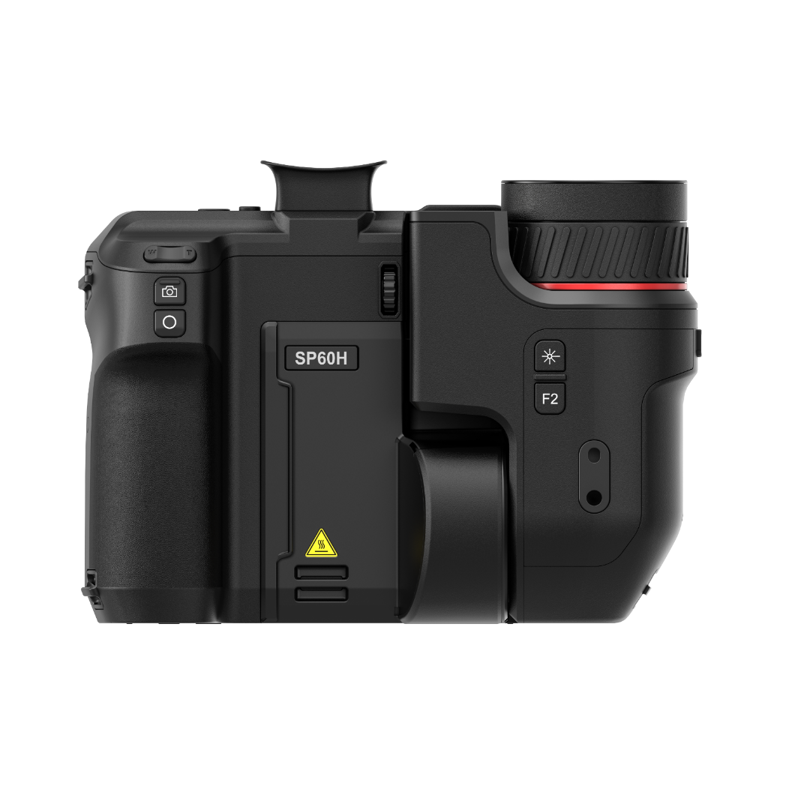

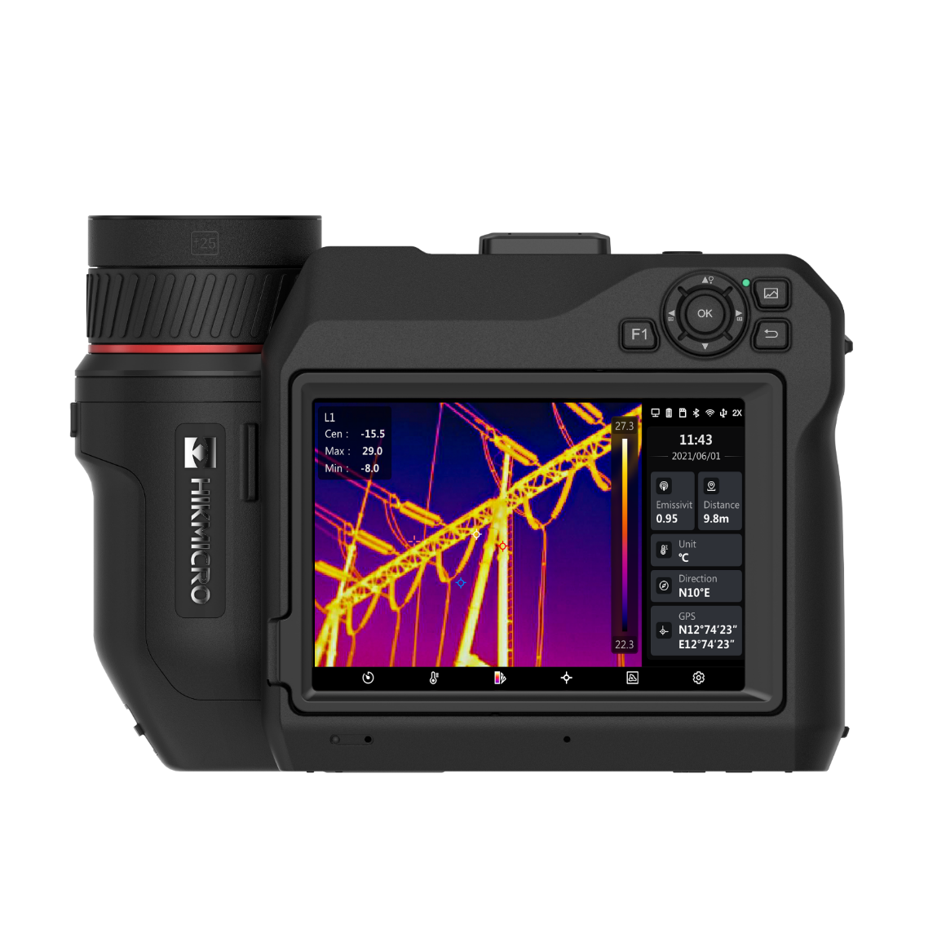

SP Series
PRODUCTs Introduction
SP40, SP40H, SP60, SP60H,SP120H

Slide 2
CONTENTS
Product Overview
Key Features
Software and APPLICATIONS
COMPETITION

Slide 3
01.
Product Overview

Slide 4


Naming Rules
SP 4 0 H - L19
Product Series
Resolution
Generation
Extended Features
Interchangeable lens
G: G Series
SP: SP Series
4: 480×360
6: 640×512
12：1280×1024
Default/0: 1st Gen.
1: 2nd Gen.
H: High Temp. Series
W: Wide FOV
L: Thermal only
L50: 50 Degree Lens
L25: 25 Degree Lens
L12: 12 Degree Lens
L8: 8 Degree Lens
L37: 50 Degree Lens
L19: 37 Degree Lens
L9: 12 Degree Lens
L6: 8 Degree Lens
SP40/SP40H
SP60/SP60H/SP120H

Slide 5
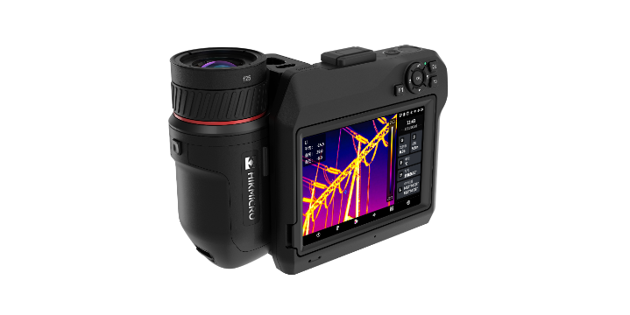
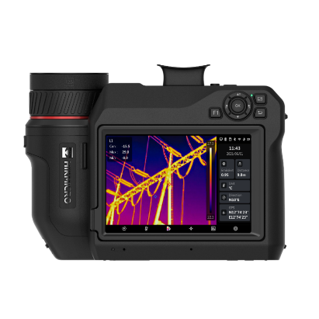
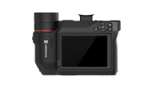
Product Overview
Basic Parameters | SP40 | SP40H | SP60 | SP60H |  | SP120H
IR Resolution | 480 × 360 (172,800 pixels) | 480 × 360 (172,800 pixels) | 640 × 480 (307,200 pixels) | 640 × 480 (307,200 pixels) |  | 1280 x 1024 (1 310 720 pixels)
SuperIR | 960 x 720 (691,200 pixels) | 960 x 720 (691,200 pixels) | 1280 x 960 (1,228,800 pixels) | 1280 x 960 (1,228,800 pixels) |  | 2560 × 2048 (5,242,880 pixels)
NETD | < 30 mK (@ 25 °C, F#=1.0) |  |  |  |  | ＜ 20mK (@ 25 °C, F#=1.0)
Image Frequency | 25 Hz |  |  |  |  | 30Hz
Focal Length | 25 mm | 25 mm | 25 mm |  | 25 mm | 35 mm
Field of View (FOV) | 18.7° × 14° | 18.7° × 14° | 24.8° × 18.7° |  | 24.8° × 18.7° | 25° × 20°
Spatial Resolution (IFOV) | 1.13 mrad | 0.68 mrad | 0.68 mrad |  | 0.68 mrad | 0.34 mrad
Focus Mode | Laser Assisted AF/Continuous AF/AF/Manual Focus/Touch AF
Focus Speed | Approx. 1 second
Visual Camera | 3264 × 2448 (8 MP) |  |  |  |  | 4208 × 3120 (13 MP)
Digital Zoom | 1.x to 12.x continuous
Object Temperature Rang | -20 °C to 650 °C (-4 °F to 1202 °F) | -40°C to 2200°C (-4°F to 3992°F) | -20 °C to 650 °C (-4 °F to 1202 °F) |  | -40°C to 2200°C (-4°F to 3992°F) | -40°C to 2200°C (-40°F to 3992°F)
Accuracy | Max. (± 2°C/3.6°F, ± 2%) | ±1°C (±1.8°F): 0 to 100°C (32 to 212°F); ±1%: 100 to 150°C (212 to 302°F); ±2°C (±3.6°F): -40 to 0°C (-40 to 32°F); ±2%: 150 to 2200°C (302 to 3992°F) | Max. (± 2°C/3.6°F, ± 2%) |  | ±1°C (±1.8°F): 0 to 100°C (32 to 212°F); ±1%: 100 to 150°C (212 to 302°F); ±2°C (±3.6°F): -40 to 0°C (-40 to 32°F); ±2%: 150 to 2200°C (302 to 3992°F) | Max. (± 2°C/3.6°F, ± 2%)
Viewfinder | N/A | N/A | Yes |  | Yes | Yes
HDMI Interface | Yes
GPS & Compass | Yes
SP40/SP40H
SP60/SP60H
SP120H

Slide 6
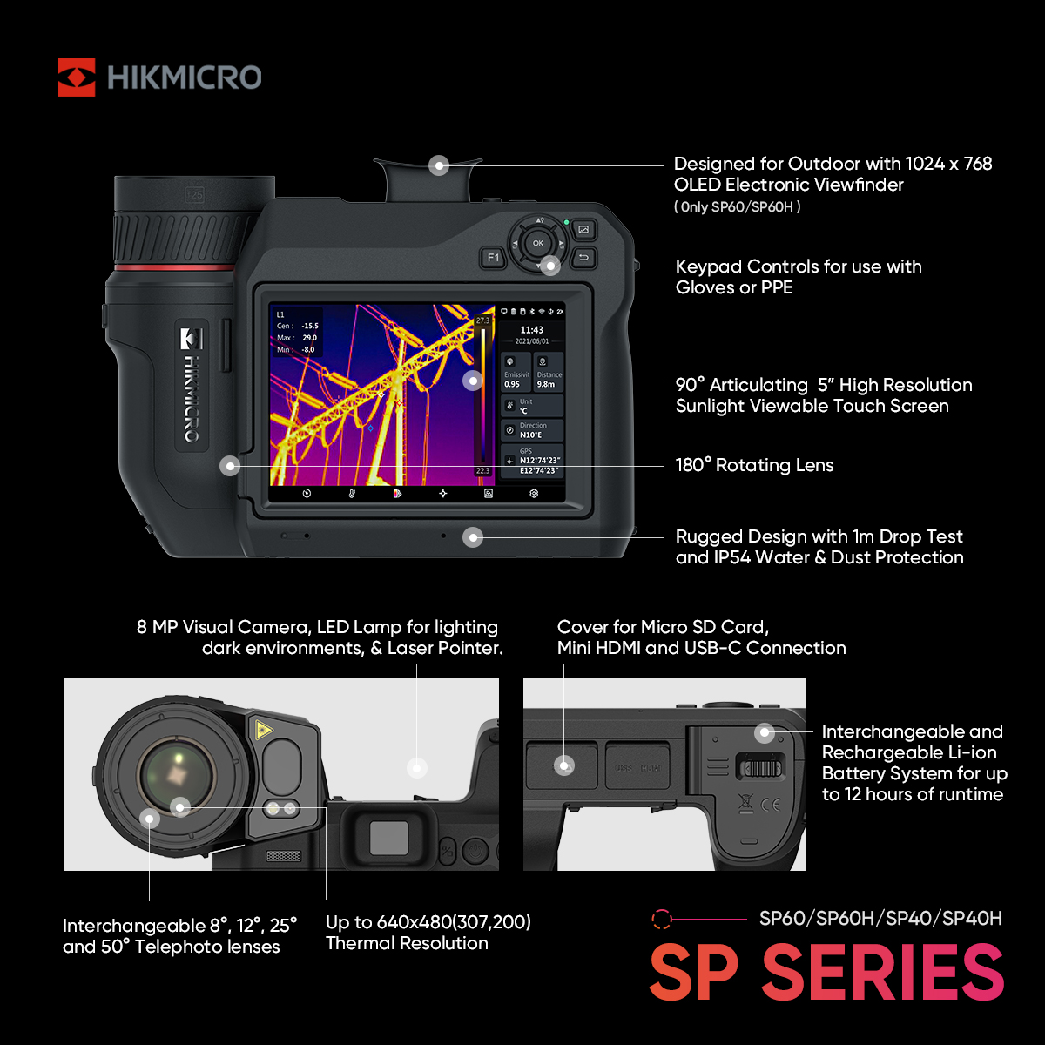
SP Series - Callouts

Slide 7
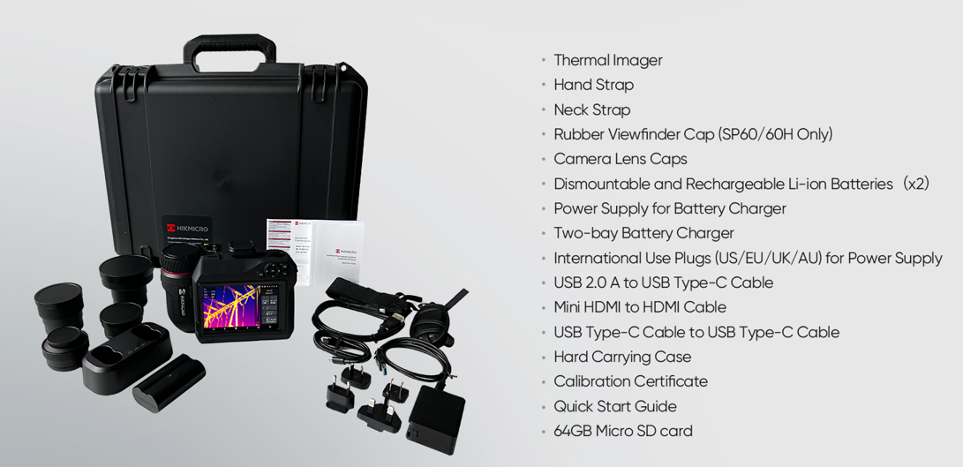
SP Series - Packing Lists

Slide 8
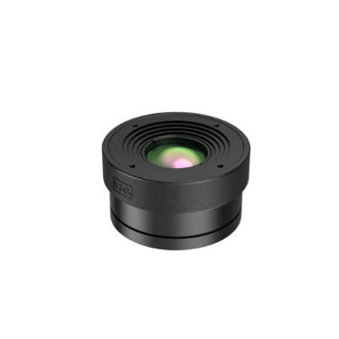
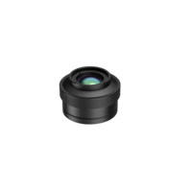
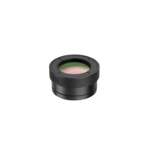
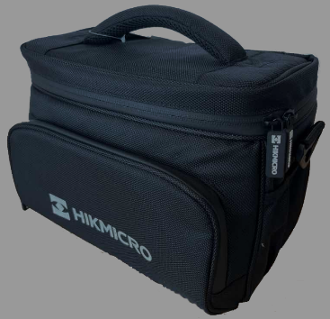
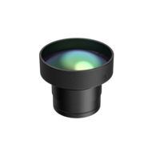
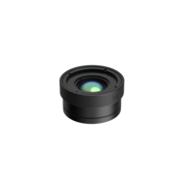
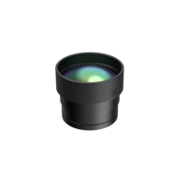
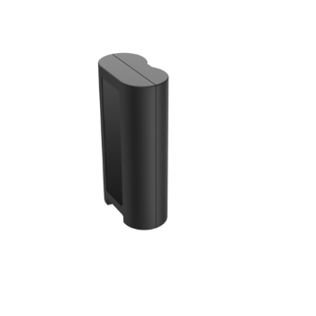
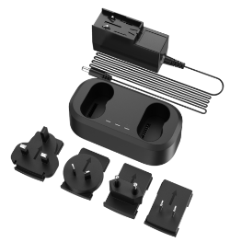
SP Series - Optional
Lenses
Accessories
Pouch
( HM-SP01-POUCH )
100% Polyester
27.5 cm c 13 cm × 21 cm
(10.8” × 5.1” × 8.3”)
HM-SP650-MACRO
HM-SP605-LENS
HM-SP620-MACRO
SP40/SP40H: 9.9 mm x 7.48 mm
SP60/SP60H: 13.02mm x 9.9mm
SP40/SP40H: 37.3°(H) x 27.8°(V)
SP60/SP60H: 50°(H) x 37.3°(V)
SP40/SP40H: 23.4 mm x 17.44 mm
SP60/SP60H: 31.54mm x 23.4mm
Replacement Battery
（ HM-7250DC(O-STD)）
4800 mAh, 7.2 V
Replacement 2-Bay Battery Charger
(HM-20322ZC)
Input 100~240 V / 1.6 A
Output 20 V / 3.25 A
HM-SP610-LENS
HM-SP620-LENS
HM-SP630-LENS
SP40/SP40H: 18.7°(H) x 14°(V)
SP60/SP60H: 24.8°(H) x 18.7°(V)
SP40/SP40H: 9°(H) x 6.8°(V)
SP60/SP60H: 12°(H) x 9°(V)
SP40/SP40H: 6°(H) x 4.5°(V)
SP60/SP60H: 8°(H) x 6°(V)
The SP series comes with two batteries in the box, and optional batteries are also available

Slide 9
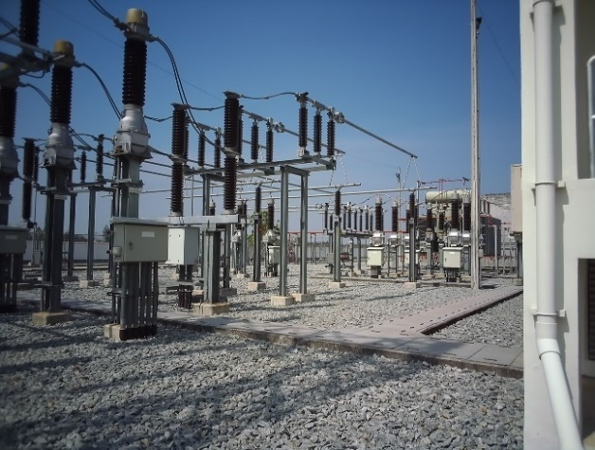
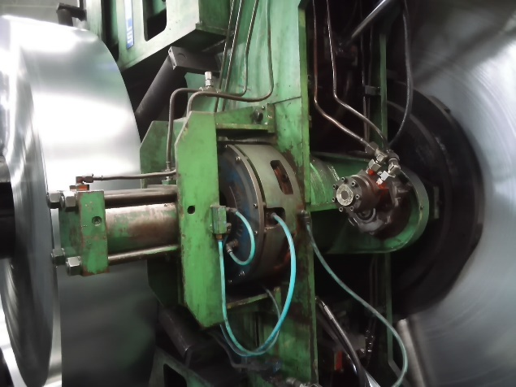
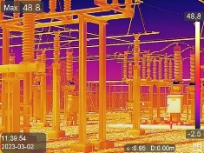
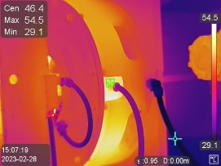
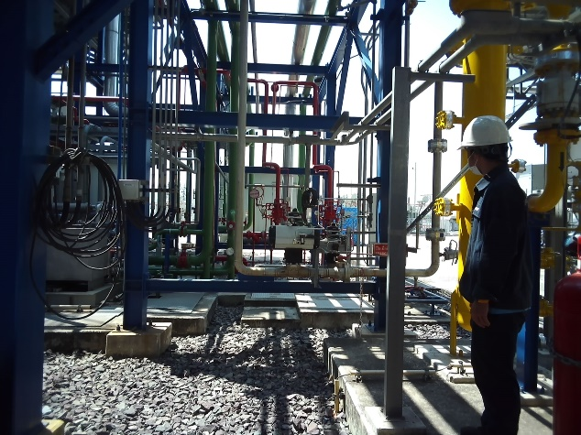

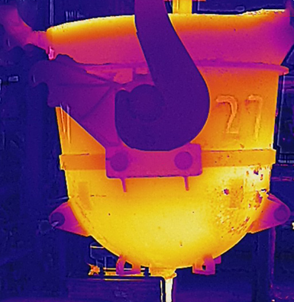
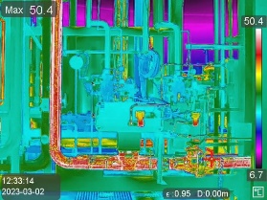
SP Series - Application Scenarios
Electric Utilities
Manufacturing
Facility Maintenance
Kilns
Building Professionals/ Inspectors/ Engineers/ Researchers/ Facility Maintenance Personnel

Slide 10
02.
Key Features

Slide 11

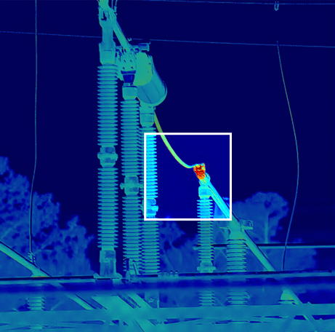
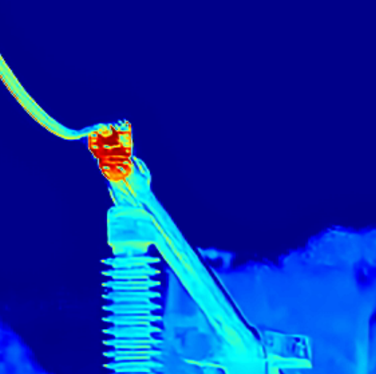
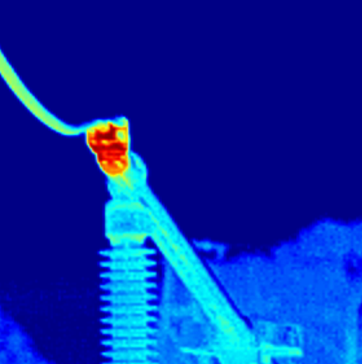
SP Series - Ultra-high performance
Powered by HIKMICRO SuperIR image enhancement technology, it upscales thermal images from 640 × 480 (307,200 pixels) to 1280 x 960 (1,228,800 pixels)resolution when viewing live with 25 Hz fast image frequency and capturing photos.
High-quality image quality to enhance user experience. Clear images allow users to find equipment faults more accurately, increased resolution and sharper images for better inspections.
SuperIR
Original
* Above images captured by SP60

Slide 12
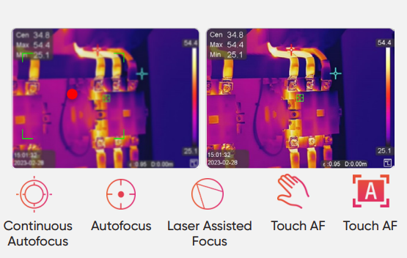
SP Series - Ultra-high performance
One-second fast focusing
Support for 5 focus modes (Laser-Assisted AF, Continuous AF, AF, Manual Focus, Touch AF) with a fast focus speed of 1 second to match your workflow, optimize image clarity, and ensure measurement accuracy.
One-second fast focusing allow users won’t be limited by the scene, no matter whether large area scanning or complex machinery system, can quickly complete the inspection work.
Laser Assisted AF: For complex devices, the laser will accurately select the measurement area for you.
Continuous AF: Quickly scan the area to improve efficiency.
AF: New upgrade of fast focus, faster to find the location of the problem.
Manual Focus: Not limited by distance.
Touch AF: Supports focusing in five different areas of the screen for more accurate focus on the target.

Slide 13
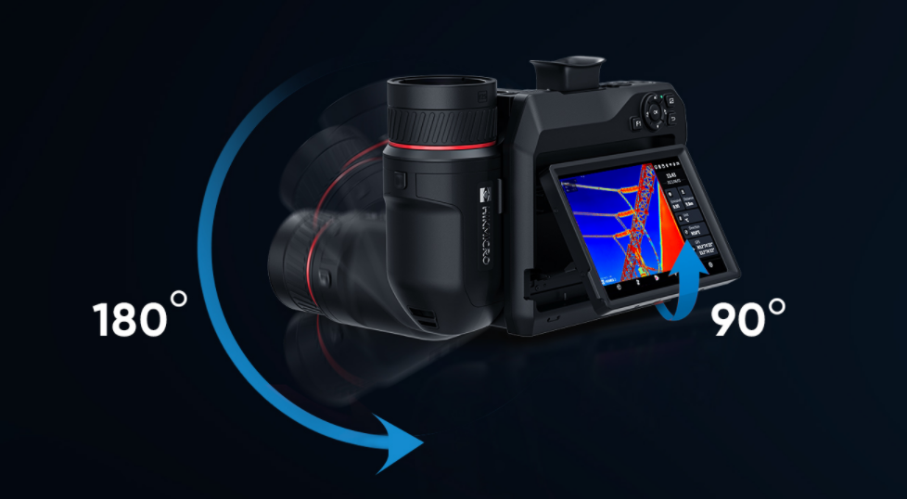
SP Series - Maximum Flexibility
Flexible Rotating Lens and Screen
The 90° rotating screen and the 180° rotating lens design help to easily view the area around, between, above, or below the target. Keeping a safe distance allows for equally flexible inspections.

Slide 14
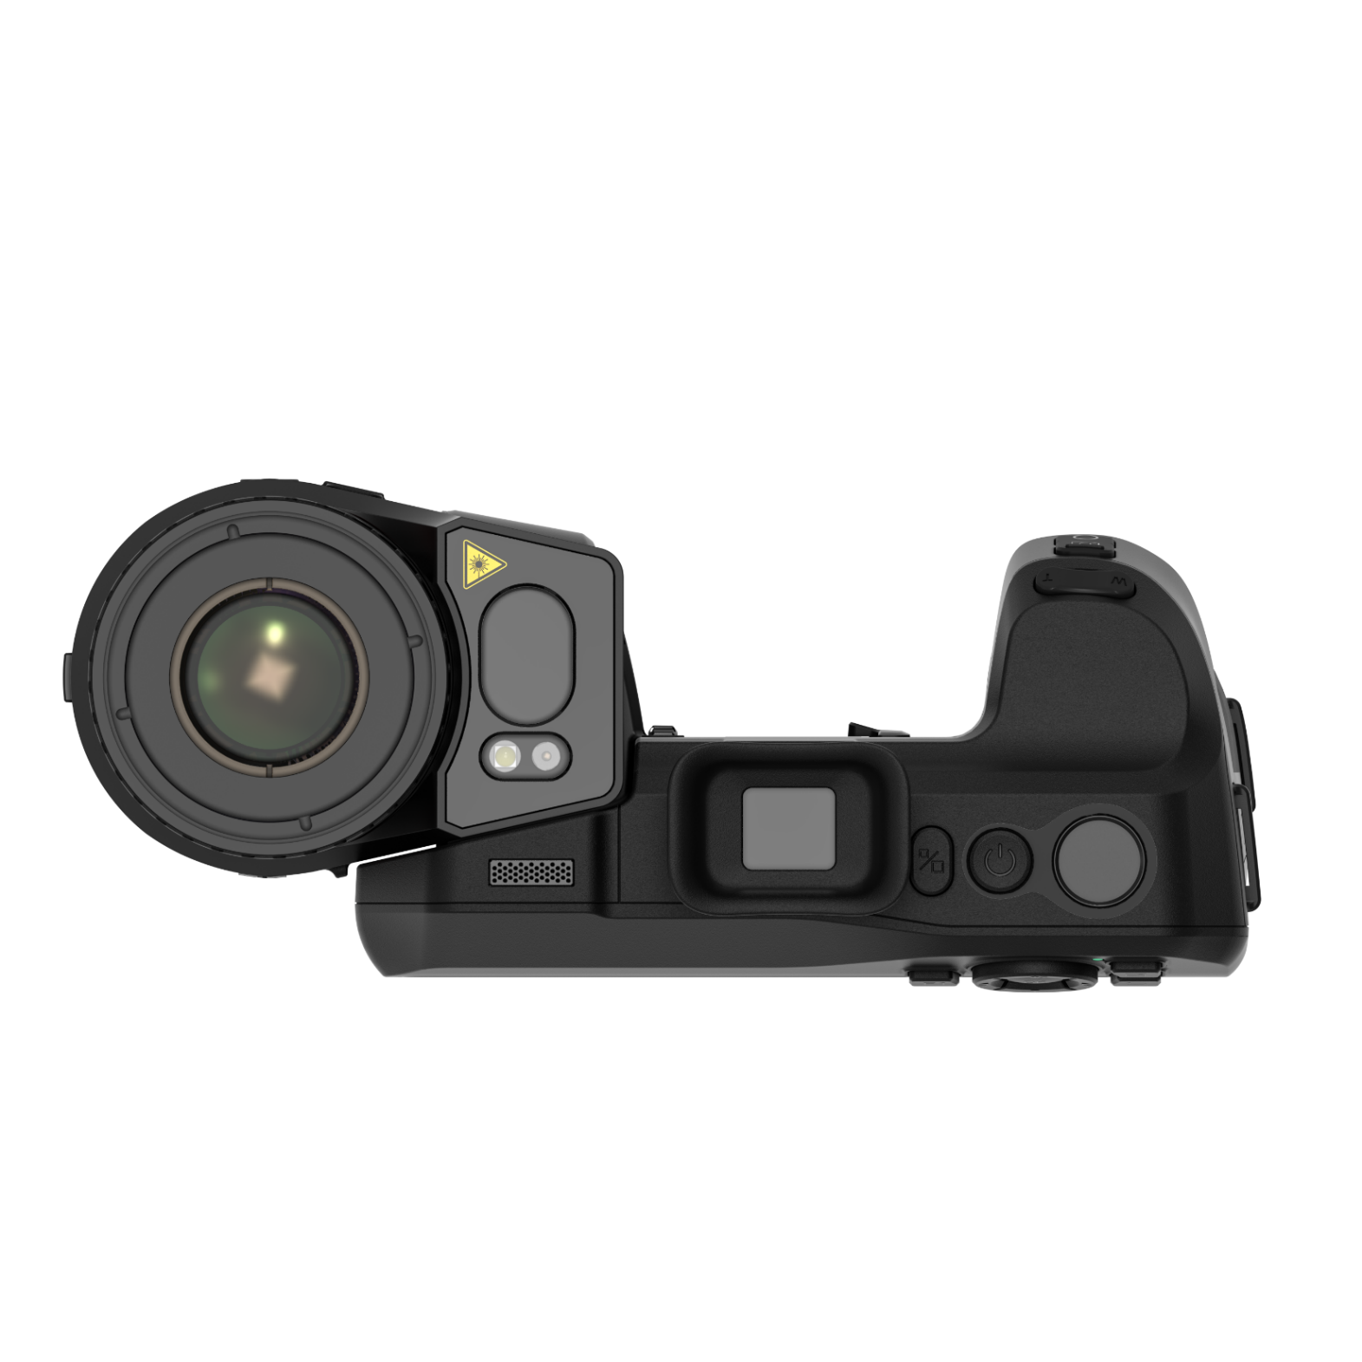


SP Series - Maximum Flexibility
Designed for Outdoors
Features IP54 rugged housing, 1024 x 768 OLED electronic viewfinder, and auto-brightness 5“ color LCD touch display make it easy to conduct outdoor inspections under bright, challenging light and tough conditions. (*SP60/SP60H)
SP60/SP60H only

Slide 15
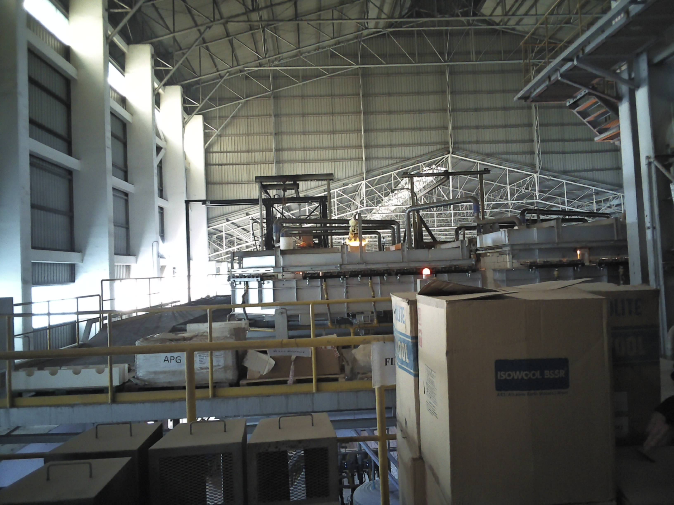
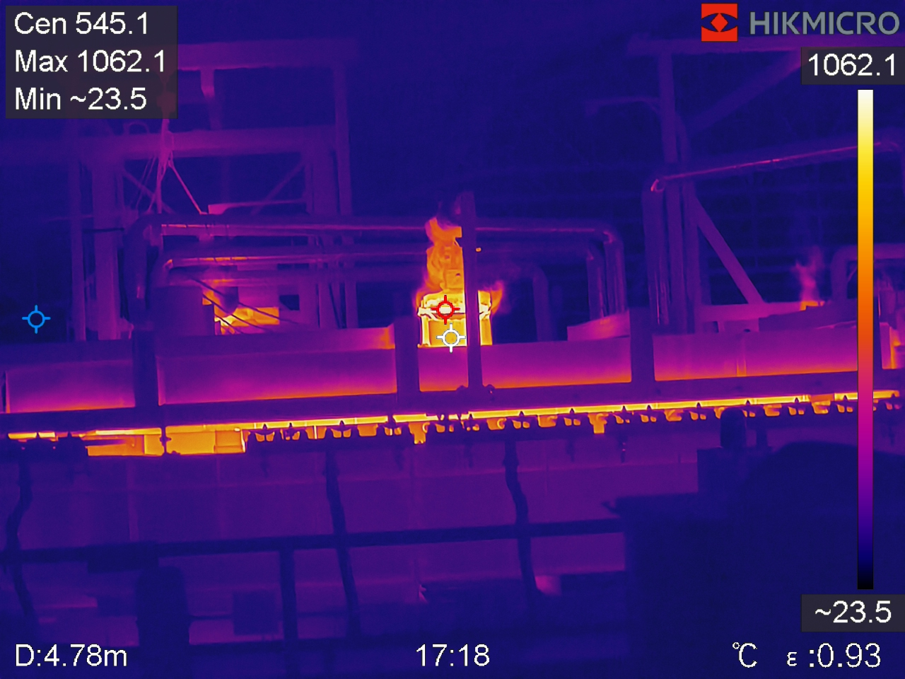
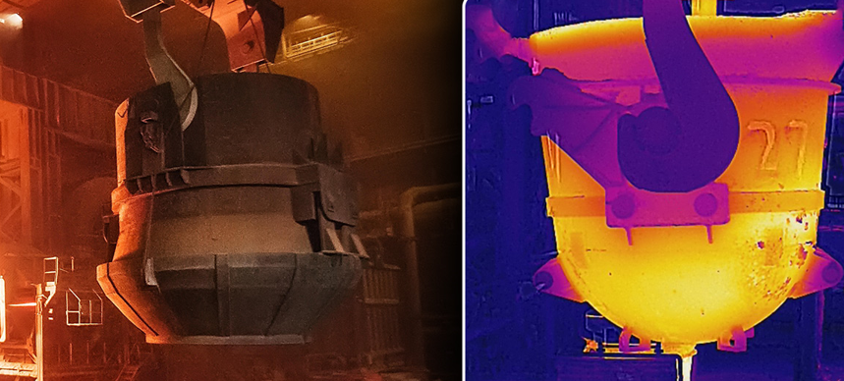
SP Series – Ultra High Temperature
Up to 2200°C Temperature Range
With a measurement range of up to 2200°C (3992°F), it can handle industrial furnace applications, refractory, and inspecting tools/fixtures in metal smelting at these extreme temperatures. The higher temperature range makes it perform well in high-temperature, and can be detected in harsh industrial environments to help work smoothly.
(*SP40H/SP60H only)

Slide 16
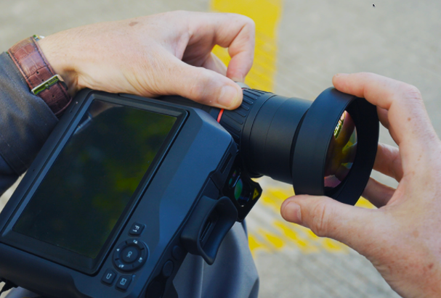
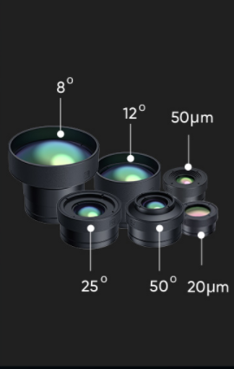
SP Series – Extensive Range of Interchangeable Lenses
Interchangeable lenses allow you to pick the field of view for your inspections. Different lenses have different fields of view, giving you more options for different scenarios to see and capture more detailed images and to measure small problems more accurately
 | HM-SP630-LENS | HM-SP620-LENS | HM-SP610-LENS | HM-SP605-LENS | HM-SP620-MACRO | HM-SP650-MACRO
Focal Length | 77.4 mm（0.25 ft） | 51.4 mm（0.16 ft） | 25 mm（0.08 ft） | 12.6 mm（0.04 ft） | 31.6 mm（0.11 ft） | 18.8 mm（0.06 ft）
FOV (Field of View) | SP40/SP40H: 6°(H) x 4.5°(V) SP60/SP60H: 8°(H) x 6°(V) | SP40/SP40H: 9°(H) x 6.8°(V) SP60/SP60H: 12°(H) x 9°(V) | SP40/SP40H: 18.7°(H) x 14°(V) SP60/SP60H: 24.8°(H) x 18.7°(V) | SP40/SP40H: 37.3°(H) x 27.8°(V) SP60/SP60H: 50°(H) x 37.3°(V) | SP40/SP40H: 9.9 mm x 7.48 mm SP60/SP60H: 13.02mm x 9.9mm | SP40/SP40H: 23.4 mm x 17.44 mm SP60/SP60H: 31.54mm x 23.4mm
IFOV | 0.22 mrad | 0.33 mrad | 0.68 mrad | 1.35 mrad | 20 µm/pixel | 50 µm/pixel
Min. Target Size for Imaging | N/A | N/A | N/A | N/A | 20 μm | 50 μm

Slide 17
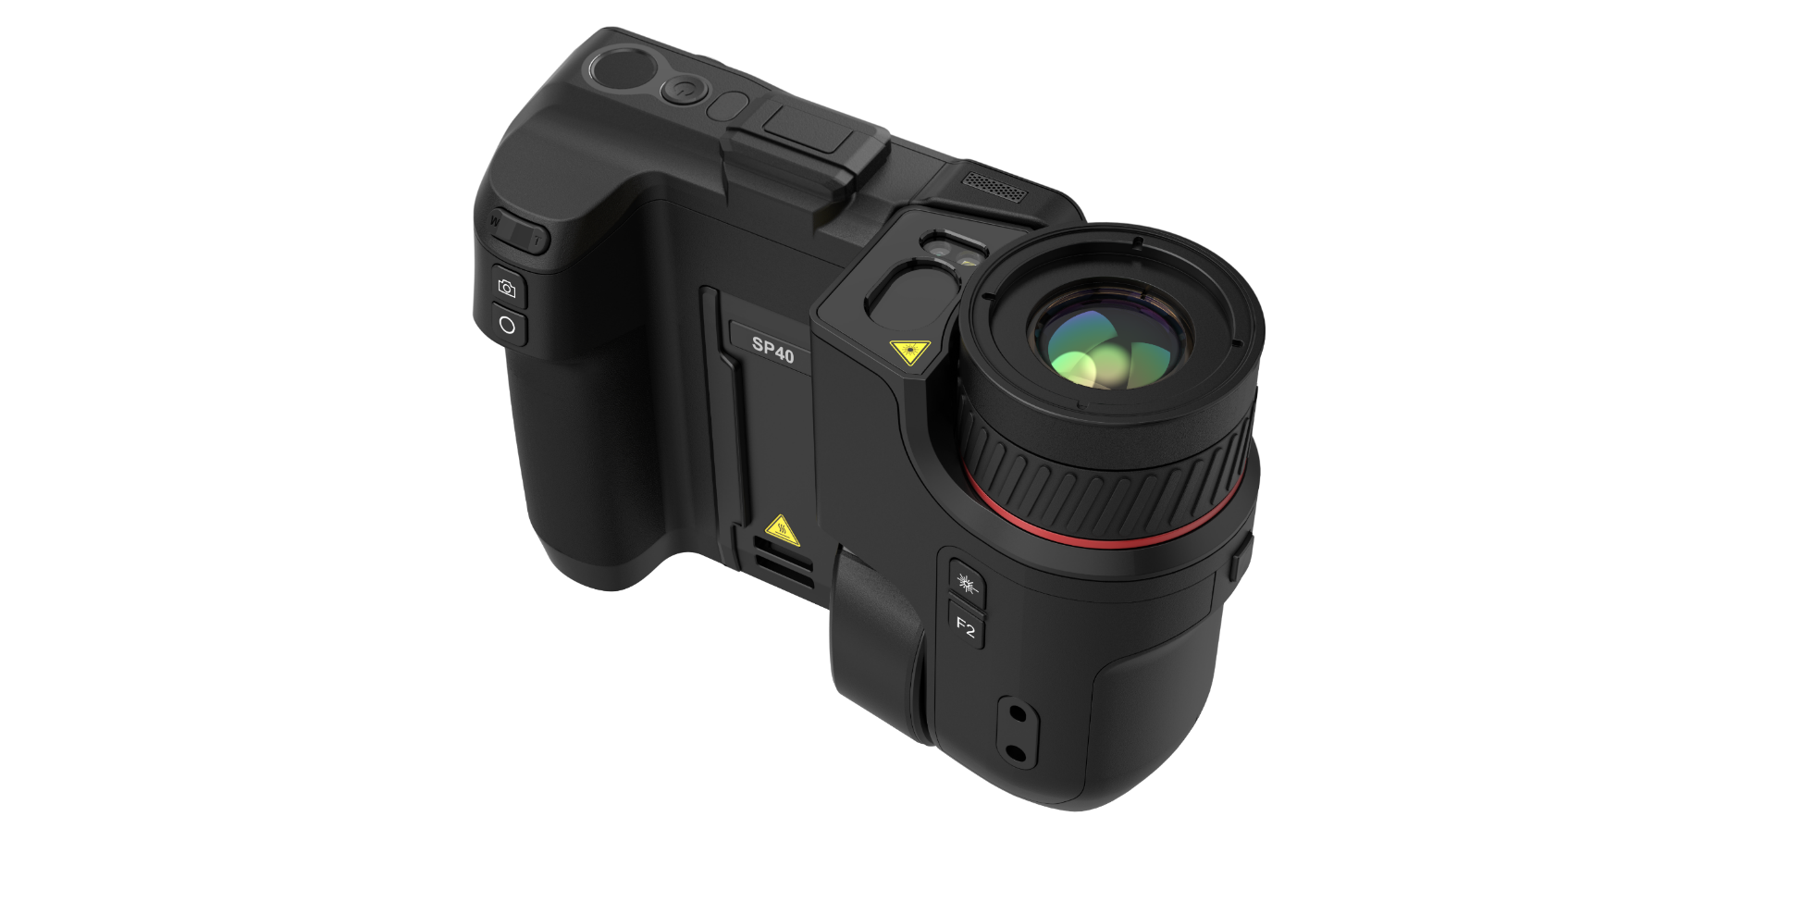
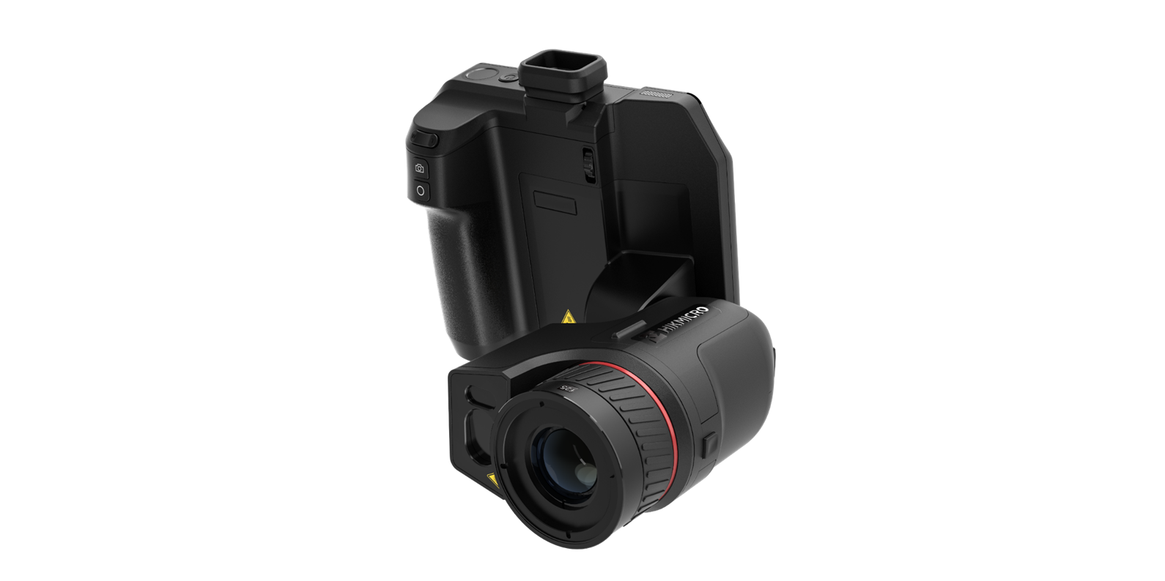
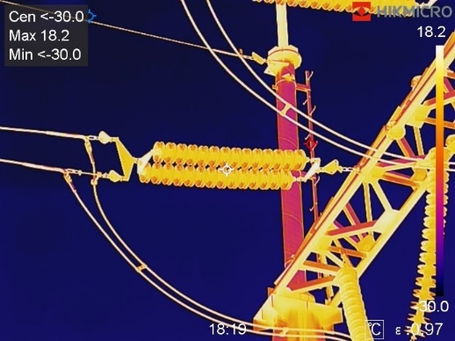
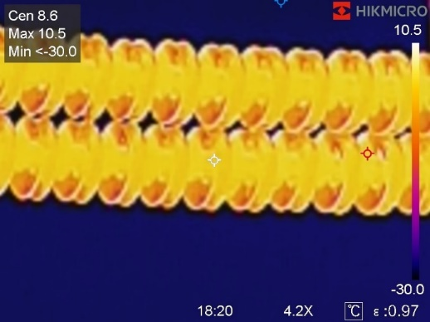
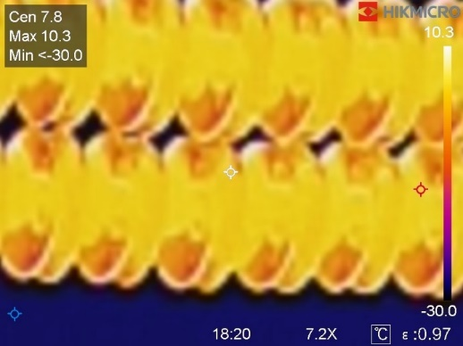
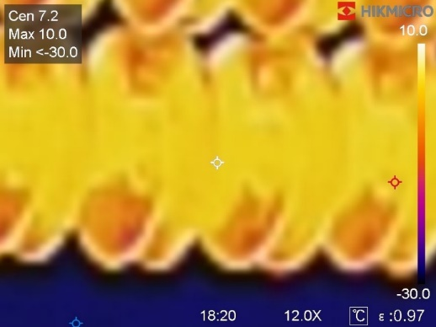
SP Series – Continuous Digital Zoom
1.0x to 12.0x continuous digital zoom provides more image details.
Notes:
集成的激光测距仪提供远距离的精确距离和面积测量，在设置参数和生成报告方面更加方便。

Slide 18
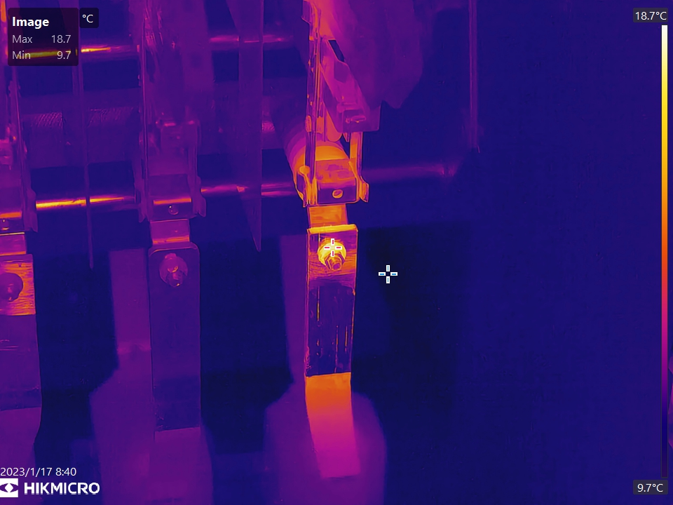
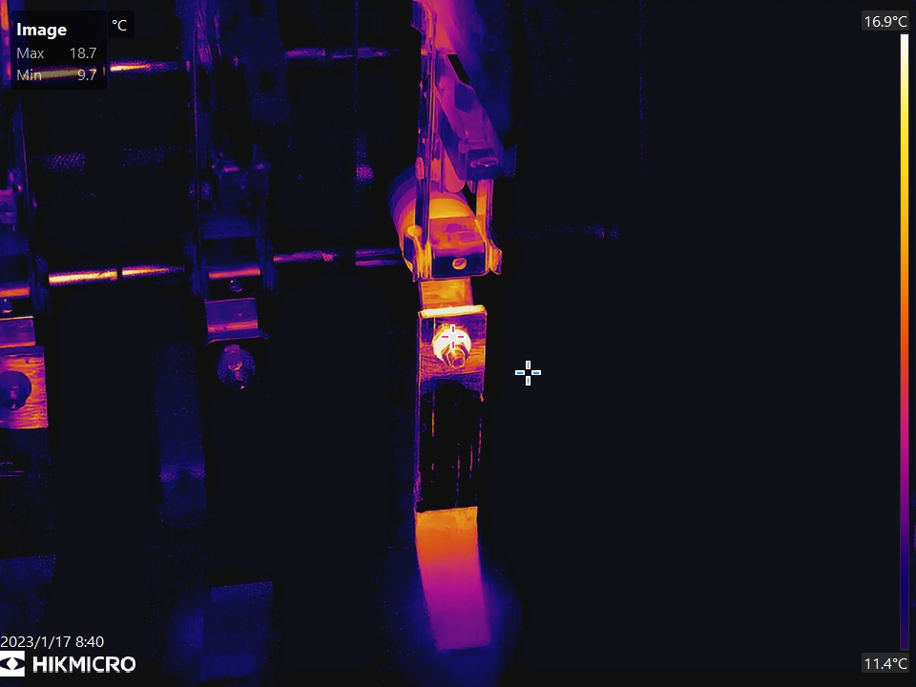
SP Series – 1-Tap Level & Span
Supports 3-level/span modes (manual, automatic, and 1-Tap) to help to instantly improve image contrast and highlight potential problems.
1-Tap

Slide 19
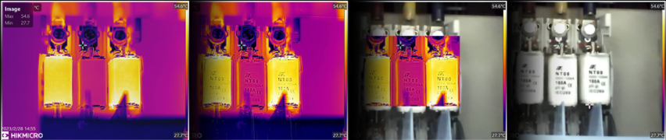

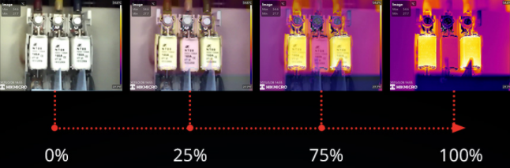
SP Series – 5 Image Mode
Thermal, Fusion, PIP, Blending and Optical modes to suit your preferred.
Thermal
Fusion
PIP
Optical
Blending

Slide 20

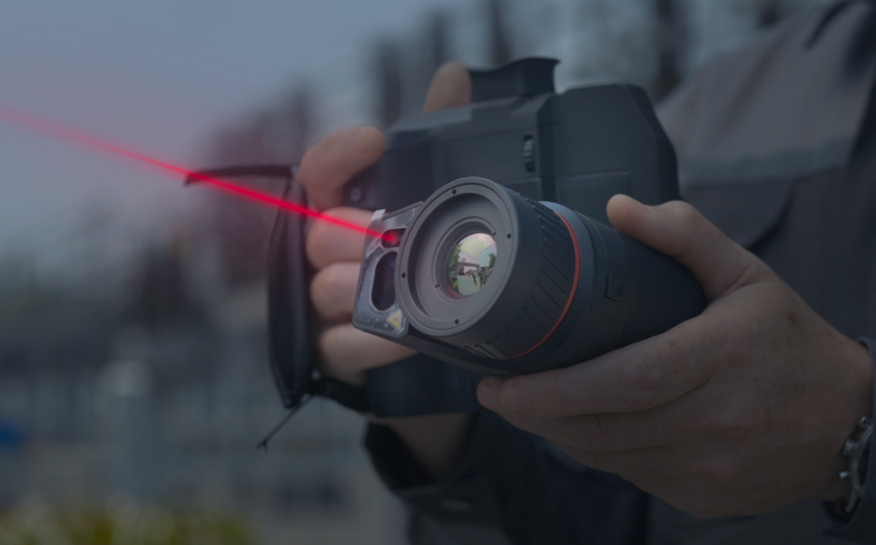





SP Series – Key Features
Complete Image Annotations
Embedded Laser Distance Meter
In addition to supporting voice, text and QR Code Scan annotations, GPS and compass functions automatically add location and direction information to the image, helping to improve inspection efficiency and productivity.
An integrated laser distance meter provides accurate distance and area measurement from long distances, more convenient in setting parameters and generating the report.
Location
QR Code Scan
Voice
Text

Slide 21
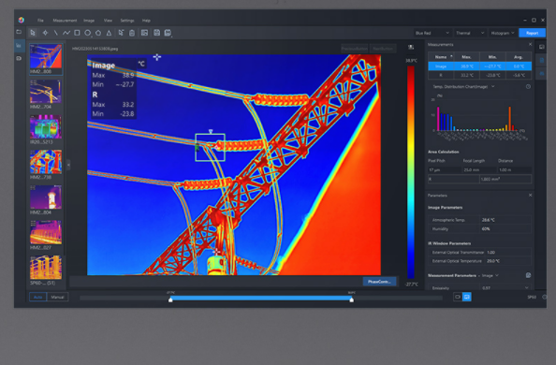


SP Series – Key Features
Interchangeable Battery System
Radiometric Video Analysis
Includes 2 interchangeable Li-ion batteries and a dual bay charger to provide you with up to 8 hours of operation. You can stay powered up for even the longest inspections.
Supports recording of radiometric video in-camera SD card storage, including all temperature data, for post analysis on PC software. Works seamlessly with HIKMICRO Analyzer software for intuitive viewing, advanced analysis, and processing of thermal data.
8 Hours
(4 hours x 2)
4 International Use Plugs
(US/EU/UK/AU) for Power Supply

Slide 22




03.
Software and
Applications
HIKMICRO
Analyzer
HIKMICRO Viewer

Slide 23
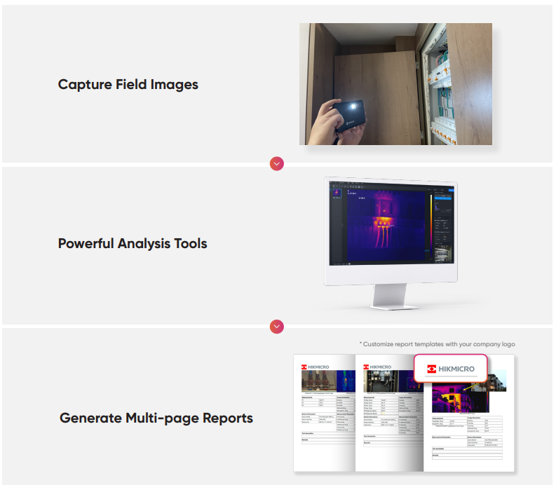
Software - HIKMICRO Analyzer
EFFICIENT, POWERFUL THERMAL ANALYSIS AND REPORTING
HIKMICRO Analyzer is a powerful and free licensed PC software designed to help users manage and analyze thousands of thermal images and videos and quickly create professional reports. Compatible with files from HIKMICRO handheld thermal cameras, providing the features you need to simplify your workflow and increase your productivity.
Free license
Import, edit and manage files
View, edit and analysis radiometric images and videos
Advanced measurement and image analysis
Batch processing with all image and measurement controls
Quick reporting with pre-defined or customized templates

Slide 24

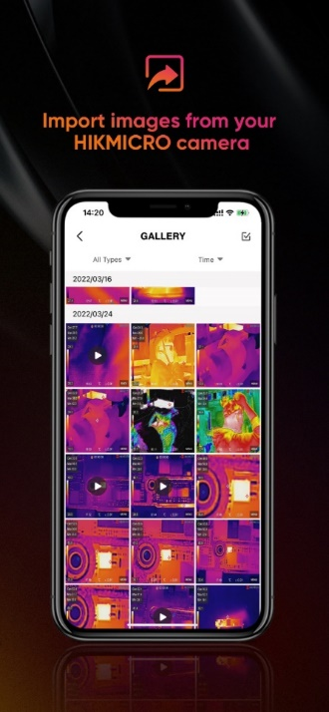
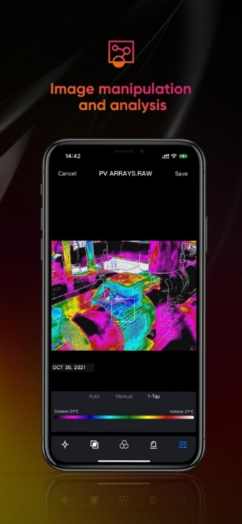
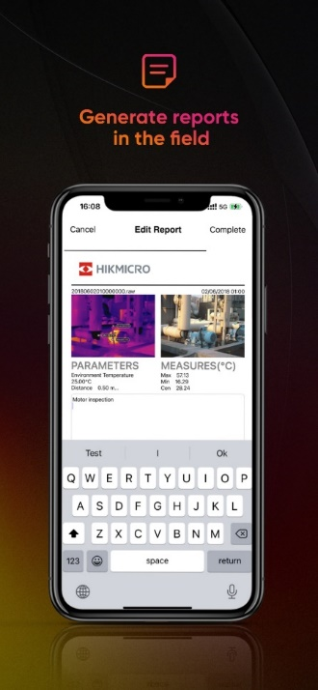



Applications - HIKMICRO Viewer
WIRELESS ANALYSIS, REPORTING AND SHARING
The HIKMICRO Viewer is a powerful and intuitive mobile application designed to help users wirelessly stream video, analyze thermal images and video, quickly create reports and share with customers and coworkers in the field. It allows you to import stored files from the camera to the mobile device. Use the app to thermally adjust levels and spans with one touch, change color palettes, adjust parameters, and more.
Free license
Screen Stream Mirroring
Import images and videos from camera
Advanced measurement and image analysis
Quick reporting and sharing
After-sales contacts and online support services
Download at:
https://www.hikmicrotech.com/en/product-c-detail/19

