Slide 1
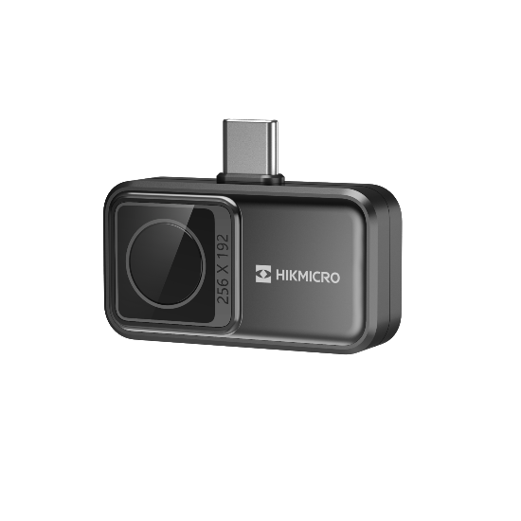
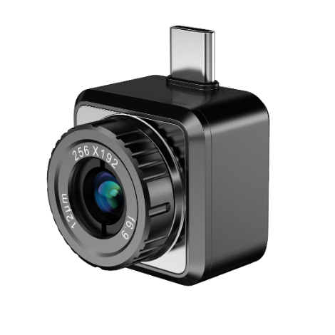

Products Introduction
HIKMICRO Mini2 Series
IR Performance, Surprisingly Affordable, and Absolutely Brilliant
2023.Q2

Slide 2
Mini2 Series – Product Positioning
Smartphone Attachment Thermal Camera
HIKMICRO Mini2 Series
Mini2
Product slogan:
Make your phone smarter with HIKMICRO Thermal
256 x 192 IR Resolution | 25 Hz | ±2 °C or 2% Accuracy | Mini Size
Mini2Plus
Product Positioning：
Best choice for affordable smartphone attachment thermal camera
Users：
Tech Geek, House Owner, Electrician, Mechanical Inspector, Automotive Technician, HVAC Professional, Plumber, etc.
Application Scenarios：
Building inspection, HVAC inspection, Automotive inspection, Electrical inspection, Mechanical inspection, Printed Circuit Board Inspection, outdoor, etc.

Slide 3
Mini2 Series – Form Factor
①
①
③
③
②
②
Mini2
Mini2Plus
① Interface: Android USB-C
② Focus-free thermal lens
③ Aluminum alloy housing
① Interface: Android USB-C
② Manual Focus thermal lens
③ Aluminum alloy housing

Slide 4
Mini2 Series - Naming Rules
Mini 2 Plus
Product Series
Resolution
Extended
Mini: Smartphone Attachment Series
2: 256×192
Default: Fixed focus
Plus: Manual focus

Slide 5
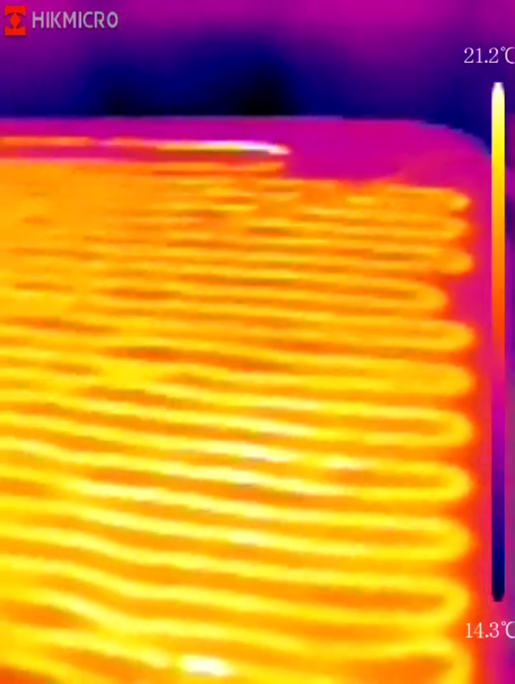
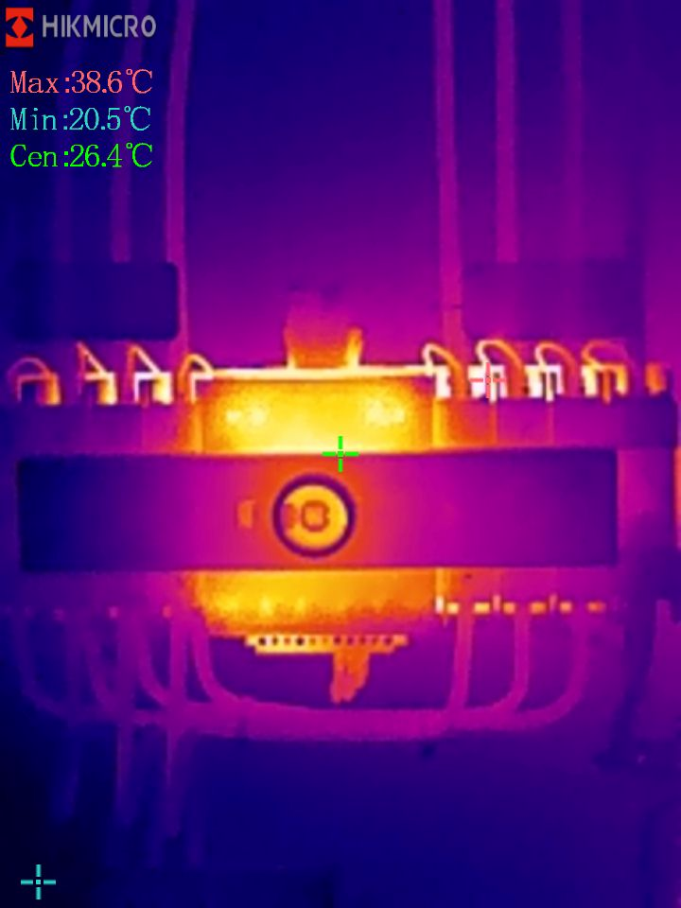
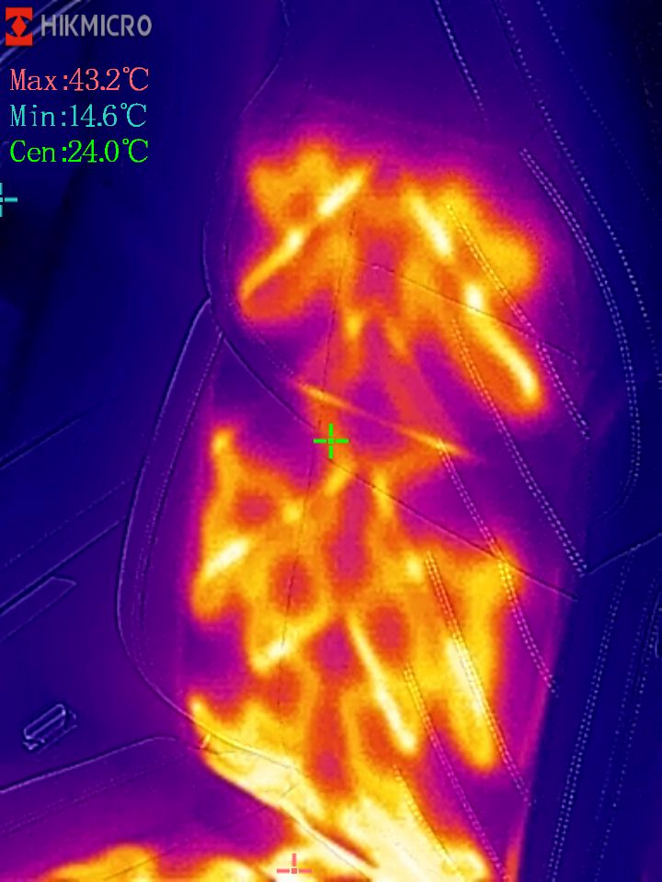
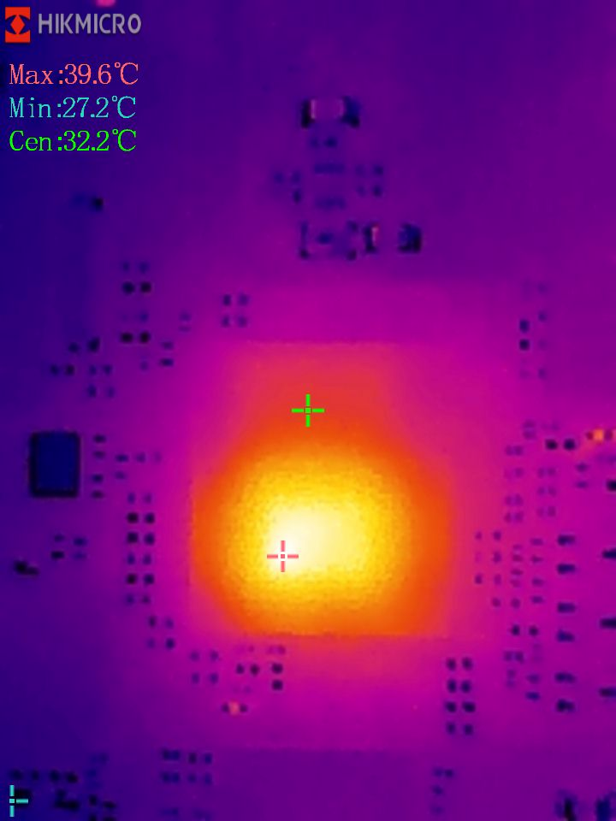
Mini2 Series - Application Scenarios
Users and Benefits
Home
Inspection
Electrical Inspection
Automotive Inspection
PCB Board Detection
House Owner or
Building Inspector
Electrician
Automotive Technician
Electronic Component Designer

Slide 6
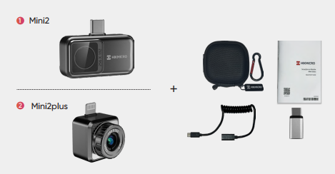
Mini2 Series - What’s in the Box
Accessories | Items | Quantity
Device | Thermal Imager | 1
Brackets | USB Adaptor | 1
Cables | Extension Cord | 1
Cases and Pouches | Storage Case | 1
Manuals | Quick Start Guide (Baseline) User Manual (Amazon or optional) | 1

Slide 7
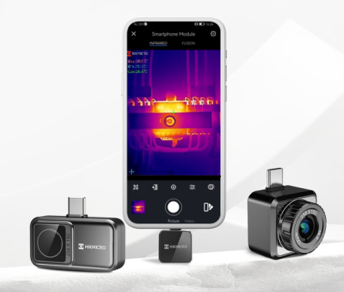

Mini2 Series – Difference
The Mini2 series offers wide-angle and manual focus options.
The Mini2Plus with manual focus lens provides a clear view of small objects such as electronic components or distant larger objects like electrical or mechanical equipment from a safe distance.
The Mini2 with its 50° wide-angle lens is ideal for quickly scanning walls, facades, and large objects.

Slide 8
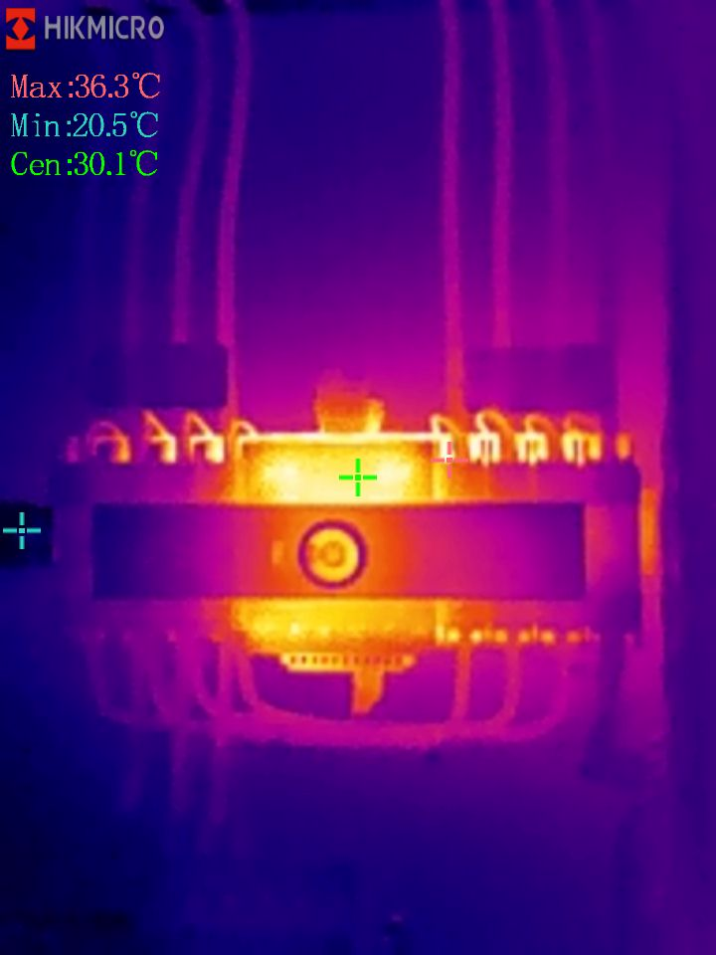
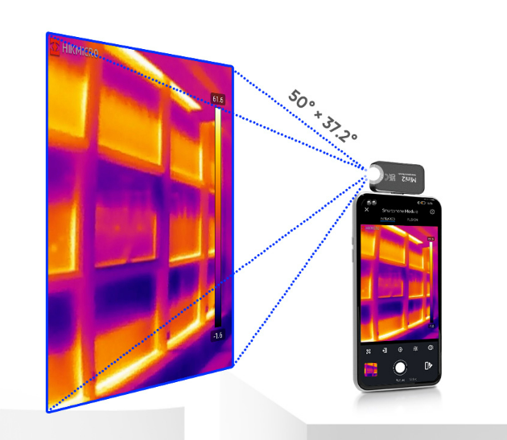
Mini2 Series – Difference
0.5 mm
Mini2: Manual Focus
Equipped with a manual focus lens for inspection at various distances from 7 cm (0.23 ft) to 10 m (32.8ft). Viewing small objects like electronic components as small as 0.5 mm, or viewing more distant objects like electrical or mechanical equipment that require a safe distance.
Mini2PLus: Focus-free Wide Angle
A focus free lens with wide-angle provides a large field of view, which is great for large scale scanning.

Slide 9
Mini2 Series – Common Features
Smartphone Attachment Thermal Camera
HIKMICRO Mini2 Series
Make your phone smarter with HIKMICRO Thermal
256 x 192 IR Resolution | 25 Hz | ±2 °C or 2% Accuracy | Mini Size

Slide 10
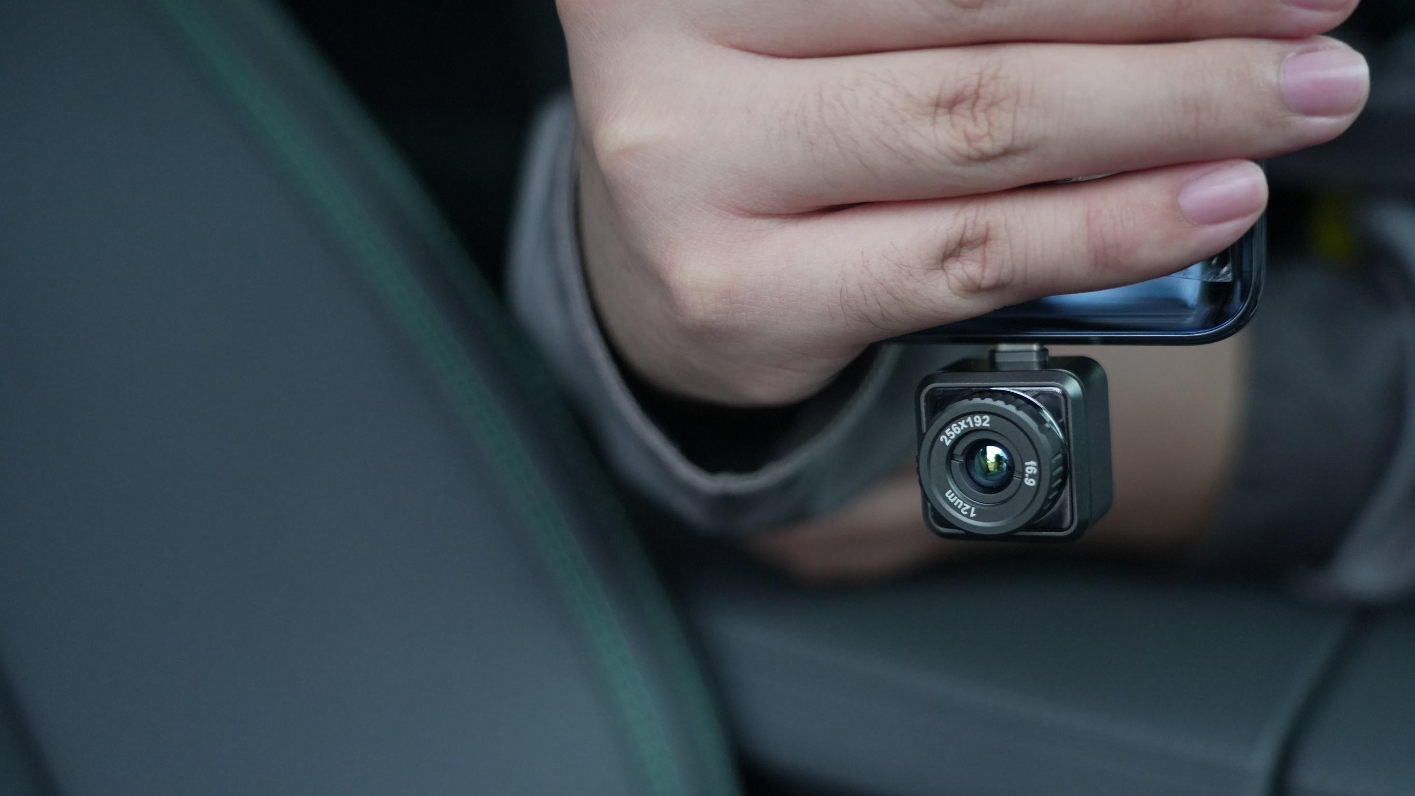
Premium Performance,
Small Package
Explore your world in thermal with high accuracy

Slide 11
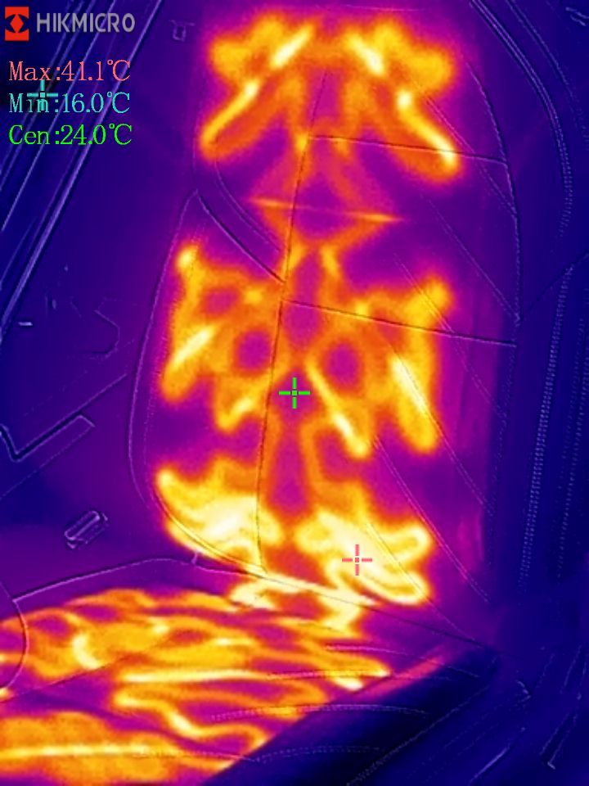
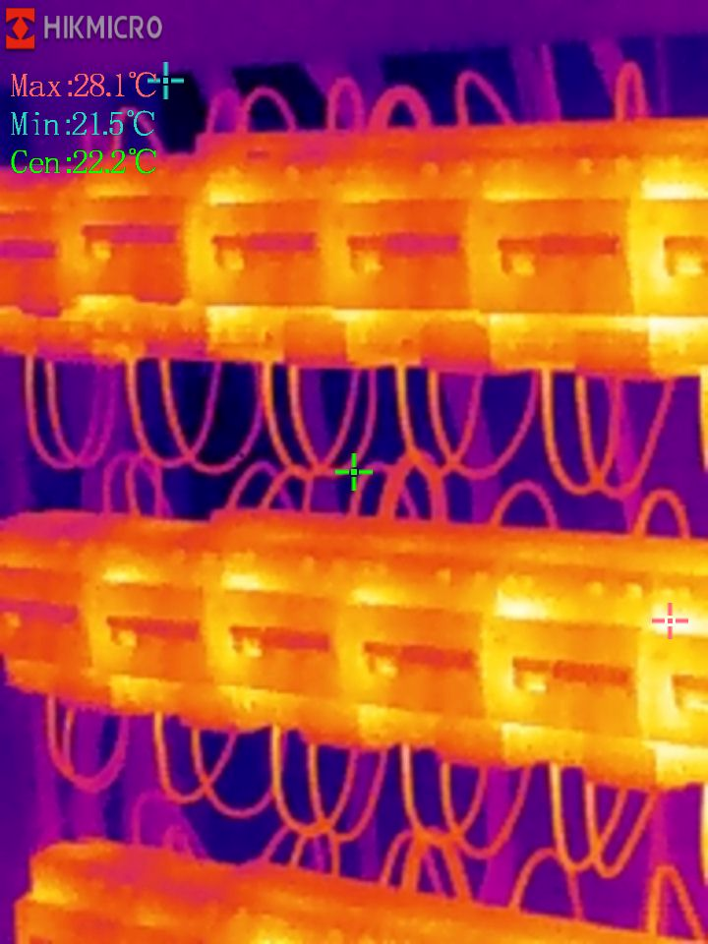
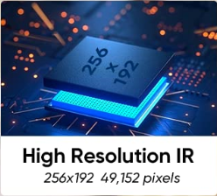
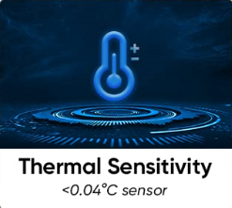
Super Clear Thermal Image
Eco Series features a highly sensitive (NETD < 40 mK) VOx detector with a resolution of 256 x 192 (49,152) pixels, along with optimized image enhancement algorithms to provide clear thermal images.

Slide 12
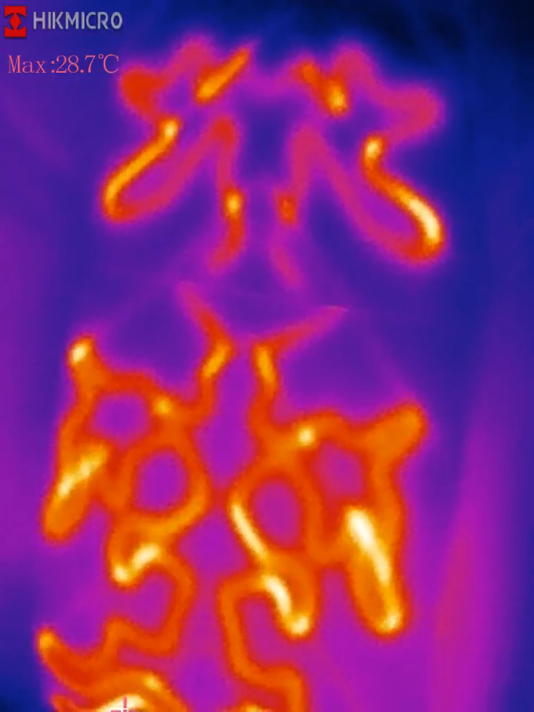
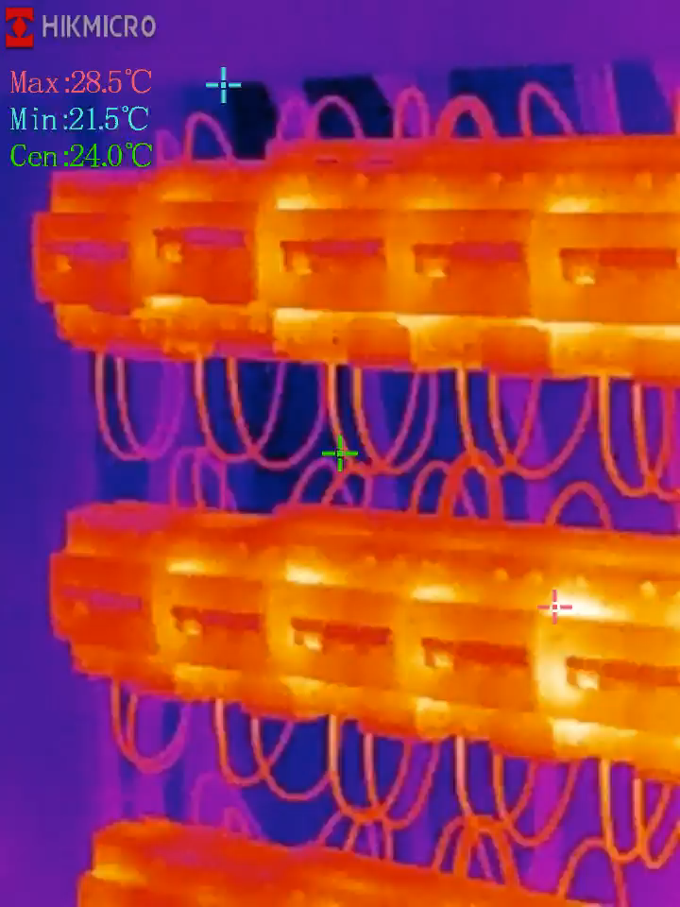


25 Hz Smooth Video
25 Hz image refresh provides a smooth image and video while panning across scenes or viewing moving items

Slide 13
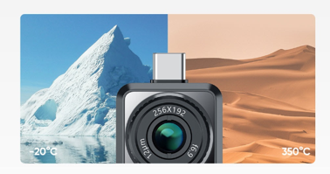
Accurate Temperature
Measurements
Eco Series accurately measures temperatures from -20°C (-4°F) to 350°C (662°F), with a temperature accuracy up to ±2°C (±0.5°F) / ± 2 %.

Slide 14
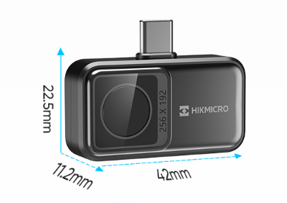
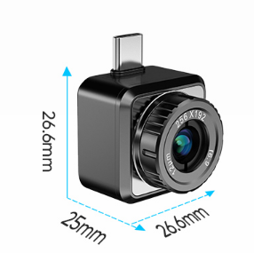
Mini2:
only 26 g (0.92 oz)
Mini Size
It’ll fit in your pocket, tool bag, or anywhere convenient for quick and easy access.
Mini2Plus:
only 24 g (0.85 oz)

Slide 15
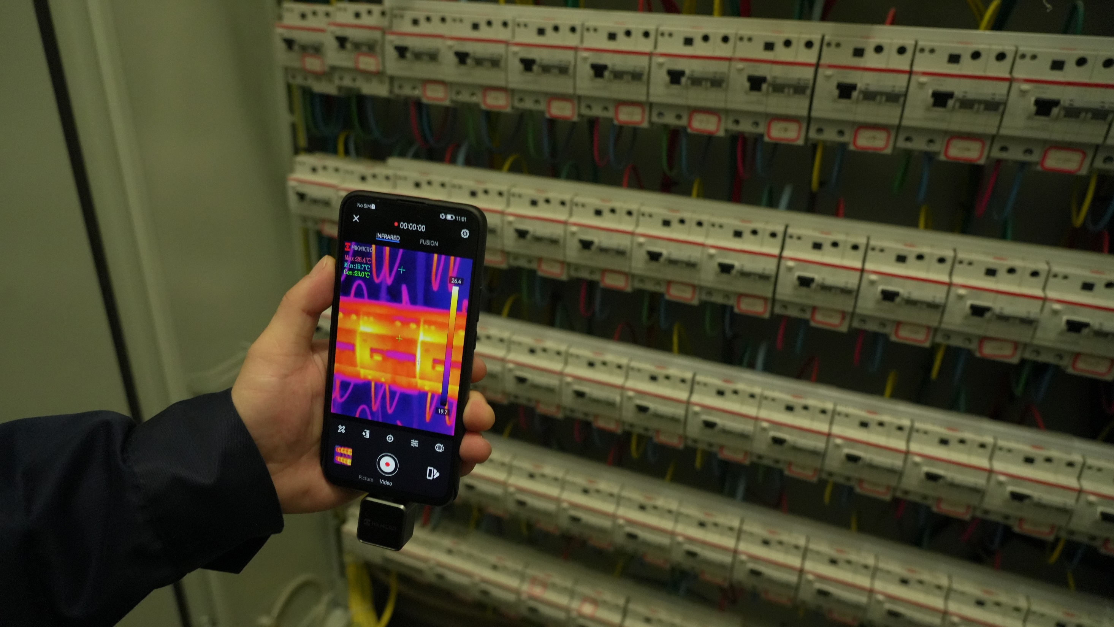
Ready for any job
or just for fun
Small, easy to carry, and ready 24/7 for almost anything

Slide 16
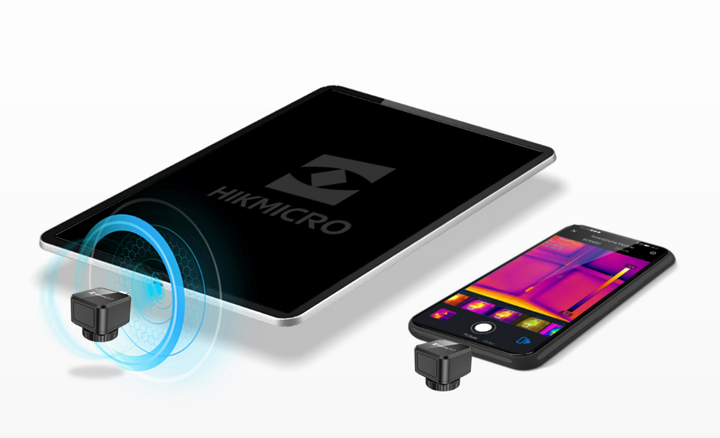
Plug and Play
Instantly attaches to your smart phone or tablet and ready to go in seconds

Slide 17
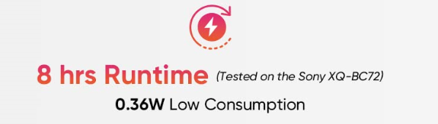
Battery-free
Eco Series is battery-free so you’ll never need to charge it up or find a charger cable. It’s powered by your phone, designed to run on very little power to maximize your mobile device run time, and ready whenever you are.

Slide 18
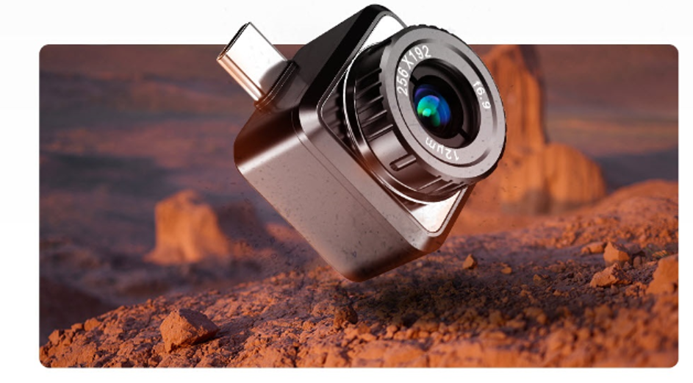

Durable and Rugged
Designed for where you work, live or relax, the Mini2 Series features IP40-rated aluminum alloy housings, passes strict drop tests up to 1 meter (3.3 feet), and comes with a three-year warranty.

Slide 19
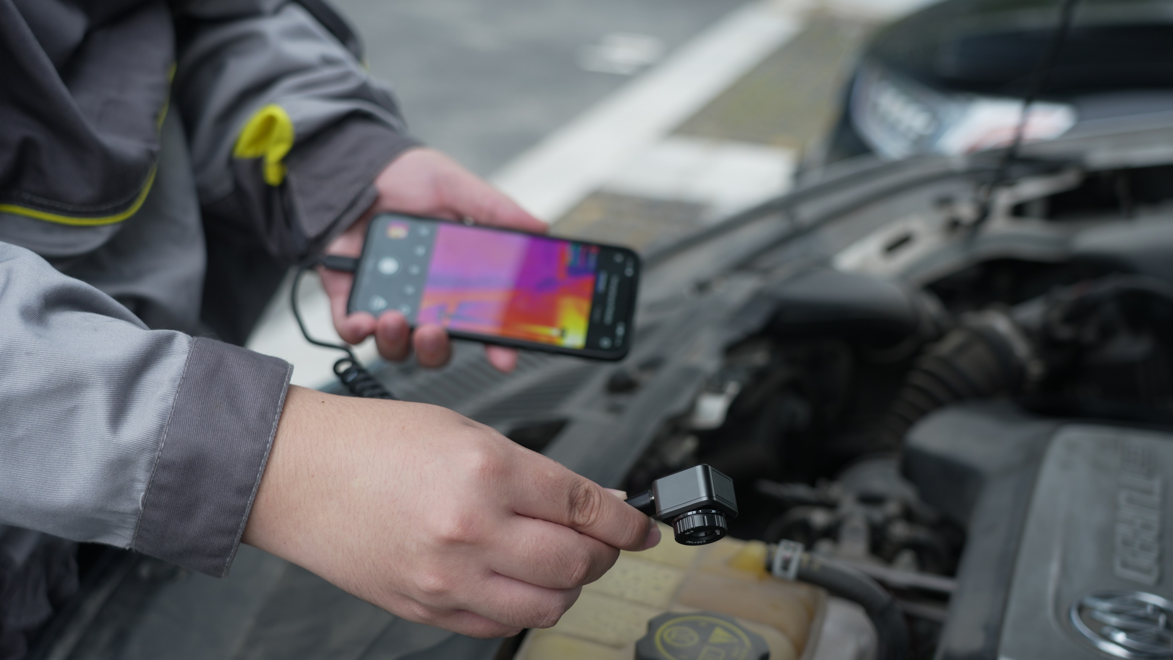
Eco Series
Connecting with you

Slide 20
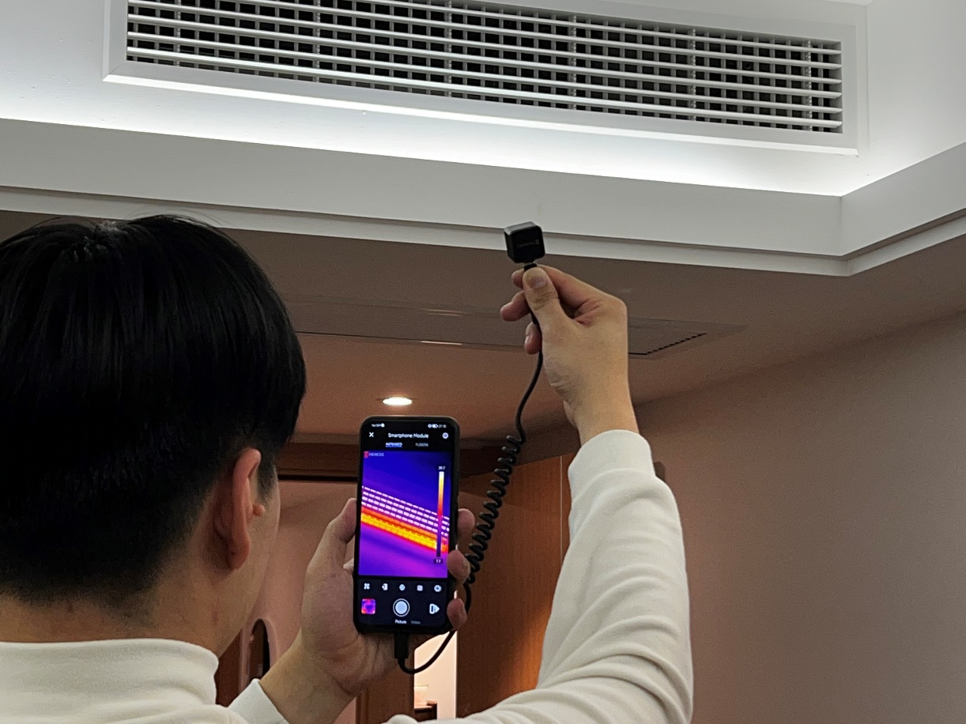

Multiple Practical Accessories
A 40 cm (15.75 in) extending cord connects between your device and the camera allowing remote viewing, inspection through narrow, confined openings, or difficult to reach places. Also included is a 18 mm extended connector to accommodate smartphones or tablets in a protective case. A protective case is provided for storing your camera and keeping it free of scratches.
18 mm

Slide 21
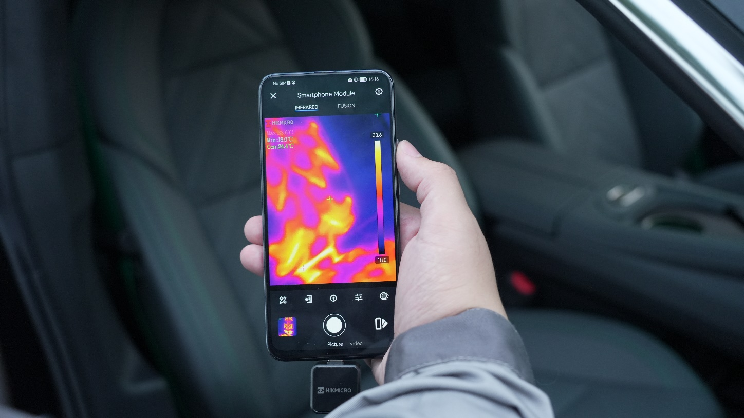



Mini2 Series APP
for smartphone or tablet
Min2 series is compatible with our free HIKMICRO Viewer for smartphones providing a user friendly user interface and the link to operating the camera
HIKMICRO Viewer

Slide 22
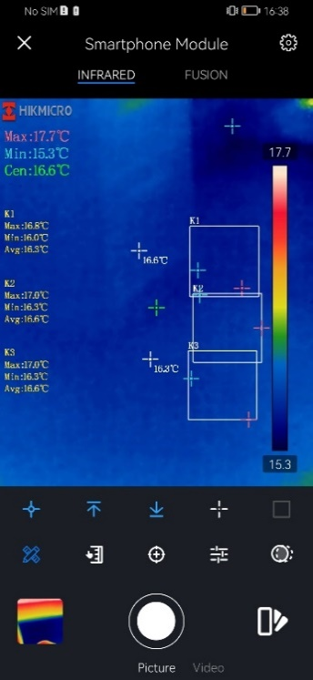
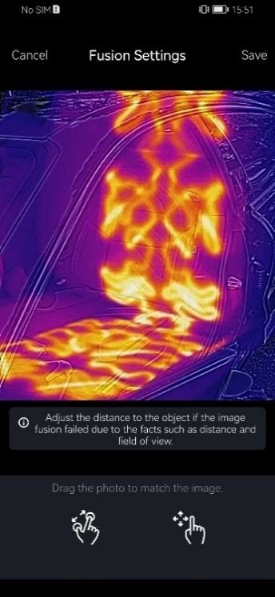
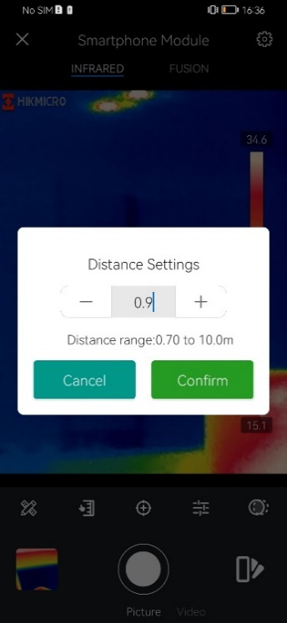
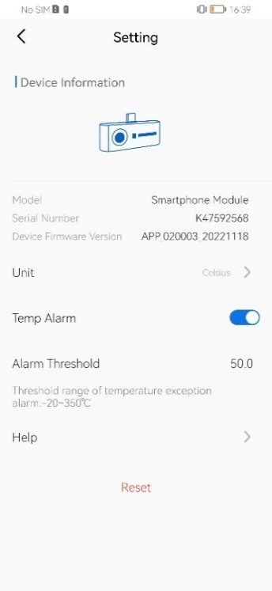
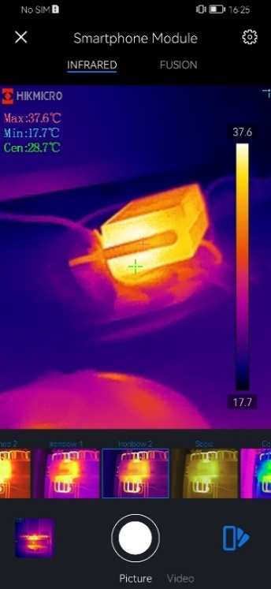
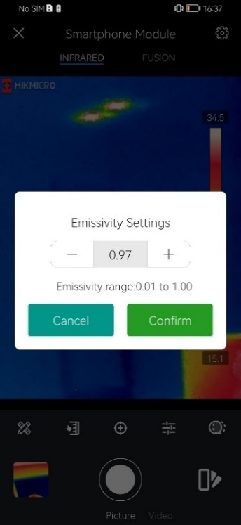
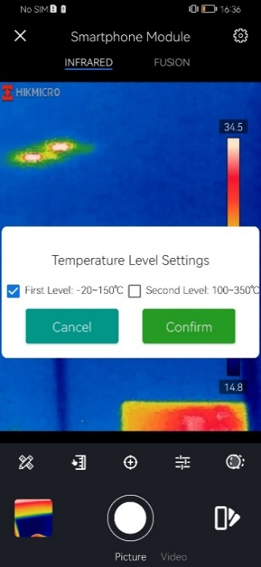
Mini2 Series APP for smartphone or tablet
9 Measurement Rules
Fusion
Distance
Settings
High Temp. Alarm
Settings
15 Color Palettes
Emissivity
Settings
Temp. Level
Settings

Slide 23
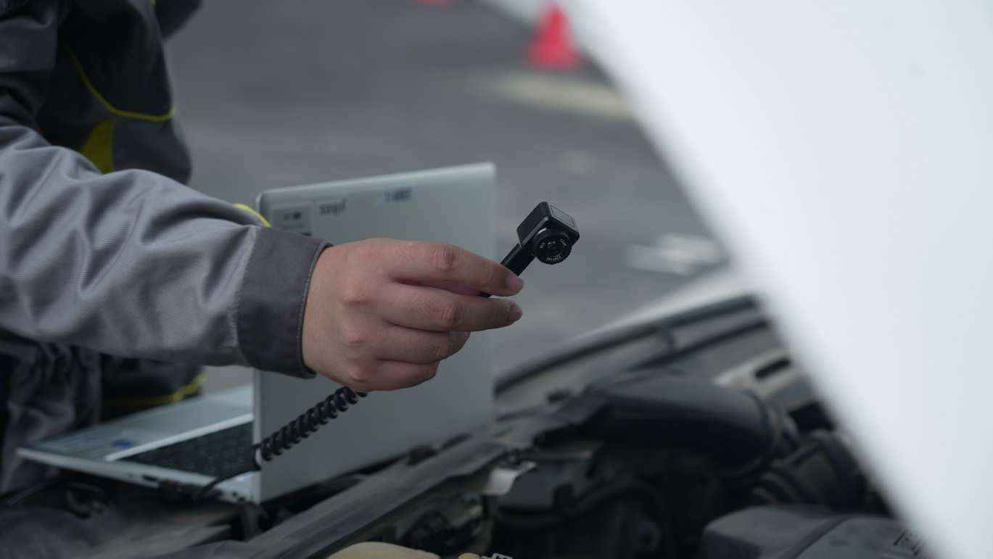
Flexible Analysis Software
Streaming your thermal camera screen to your PC with minimal effort via HIKMICRO Analyzer and the extension cable. It can't be any simpler to conduct your inspection and analytical work on a larger screen.

Slide 24




THANK YOU
See the World in a New Way
HIKMICRO Thermography
hikmicro_thermography
HIKMICRO Thermography
HIKMICRO
Public Email Address: info@hikmicrotech.com
Official Website: www.hikmicrotech.com/en/industrial/

