Slide 1


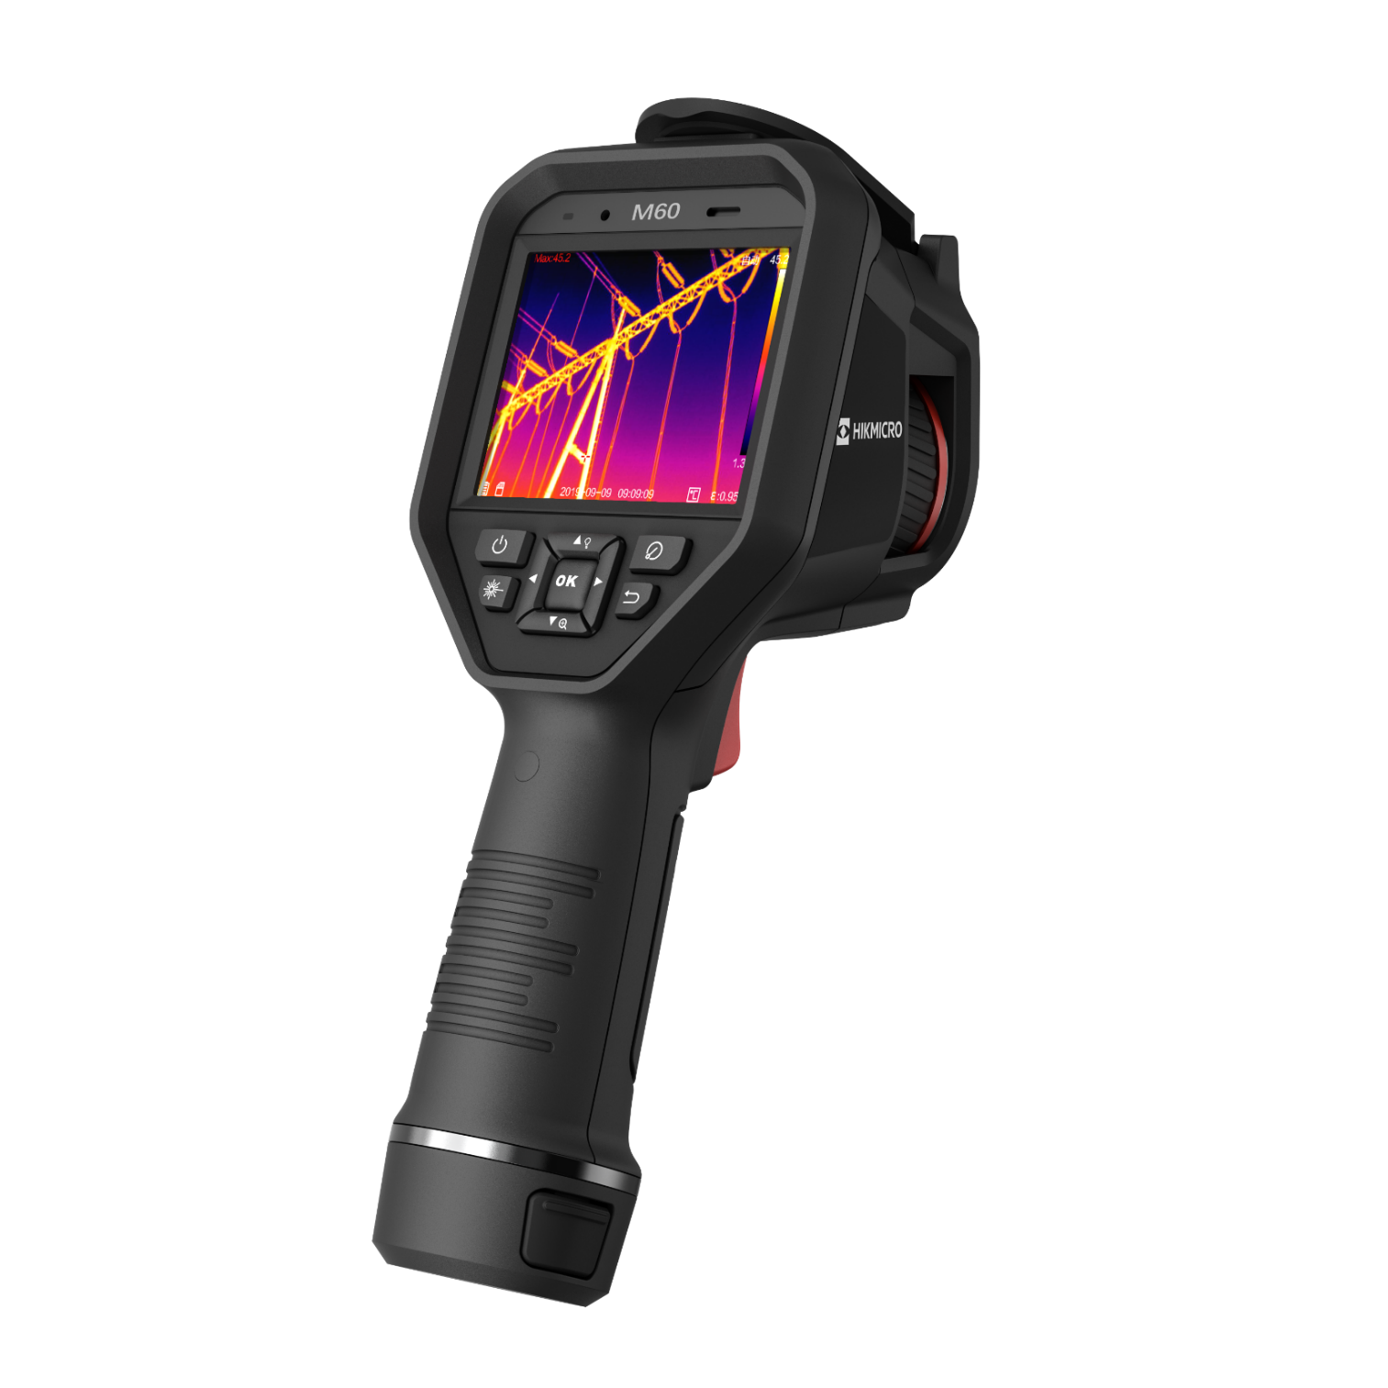

HIKMICRO M SERIES
PRODUCT INTRODUCTION
Advanced thermal imaging camera with full function analysis.
INDUSTRIAL PRODUCT | 2023.Q3
1
Notes:
Compact Explosion Proof Thermal Camera for use in Hazardous Areas

Slide 2
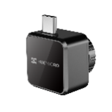
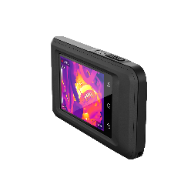
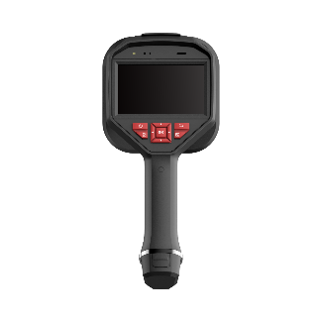
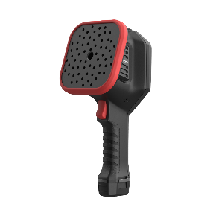
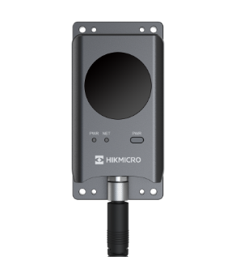

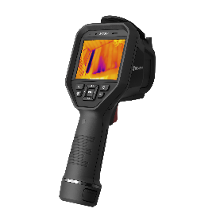
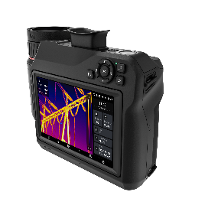
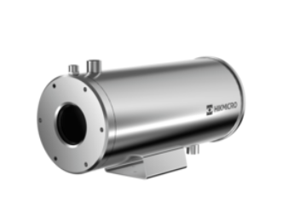
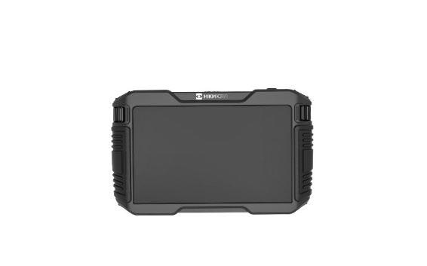
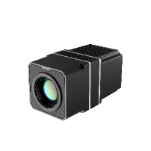

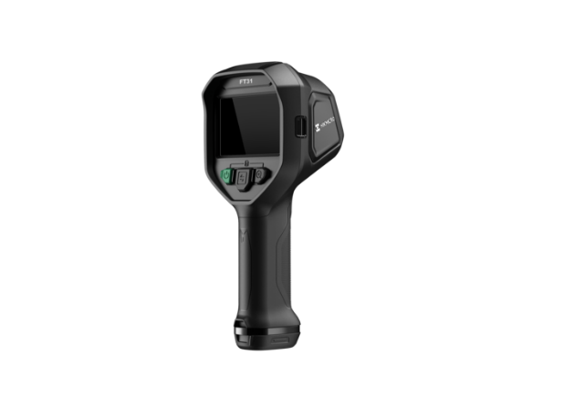


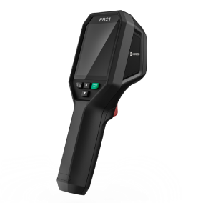
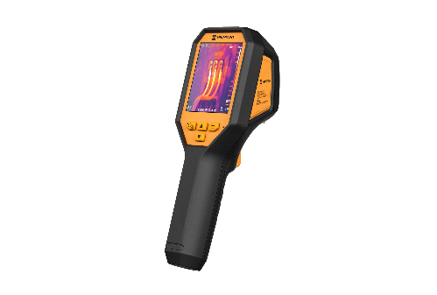


PRODUCT CATEGORY
PRODUCT CATEGORY
Thermal
Handheld
Fixed
Acoustic
New
Acoustic
New
Explosion-proof
New
Firefighting
Software

Slide 3
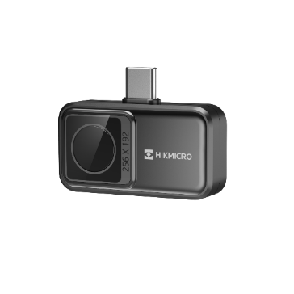
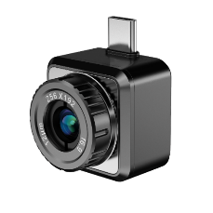
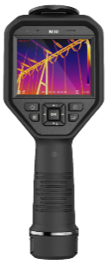
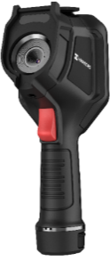
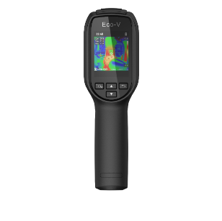
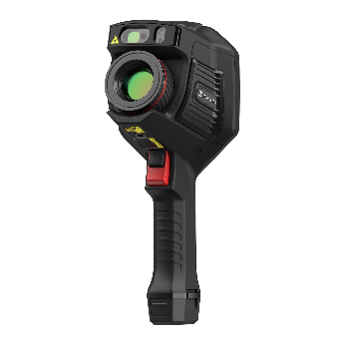
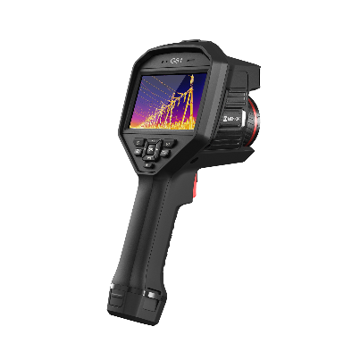
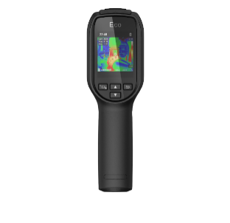
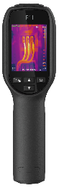
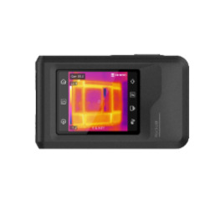

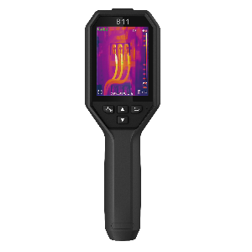
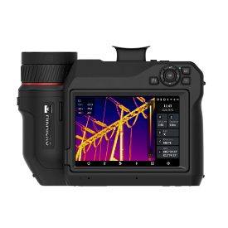
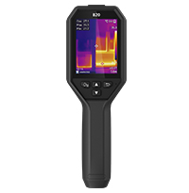
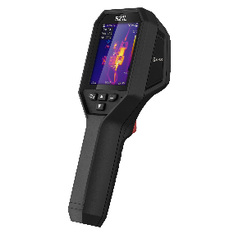
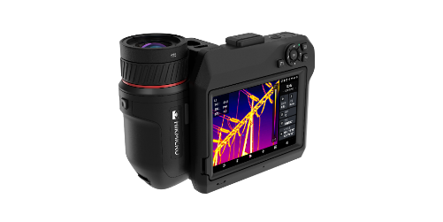

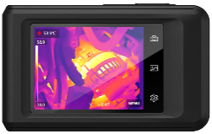
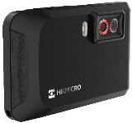
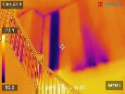
PRODUCT MATRIX - HANDHELD
Entry & Middle level
Middle & High-end Level
256
Smartphone
Attachment for Android
192 / 256 / 384 / 640
Wi-Fi
Manual Focus
Removable Batteries /Memory Card
Mini2Plus:
Manual Focus
Mini2:
Focus Free
Mini Series
M Series
384 / 480 / 640
Wi-Fi
Auto Focus
Removable Batteries /Memory Card
Optional Lenses
96 / 160 / 192
Focus Free
Eco Series
E Series
G Series
480 / 640
Wi-Fi
Auto Focus
Removable Batteries /Memory Card
Optional Lenses
DV Form Factor
192 / 256
Wi-Fi
Focus free
192 / 256
Wi-Fi
Focus free
B Series
Pocket Series
SP Series
B Series

Slide 4

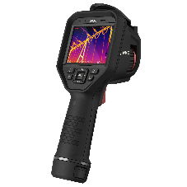
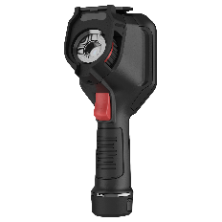
M Series - Product Naming
M 1 1 W
Product Series
Resolution
Generation
Extended Features
M Series
1: 192×144
2: 256×192
3: 384×288
6: 640 x 480
0: 1st Gen.
1: 2st Gen.
W: Wide FOV/ Focus Free
M11 / M11W
M20 / M20W
M30
M60

Slide 5
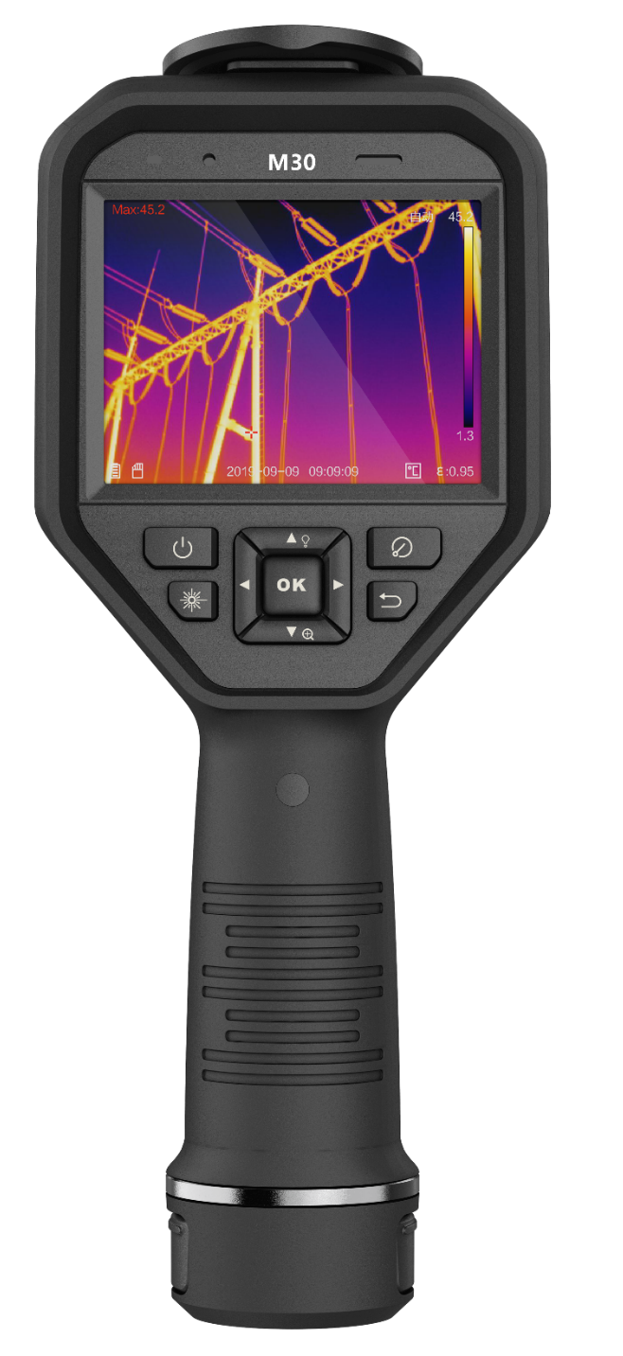
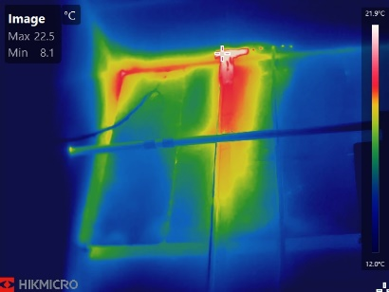
M Series – Form Factor
Microphone & Speaker for voice annotation and playback
3.5” High Resolution Sunlight Viewable Touch Screen
Keypad Controls for use with Gloves or PPE
Rugged Design with 2m Drop Test and IP54 Water & Dust Protection
Interchangeable and Rechargeable Li-ion Battery System for up to 12 hours of runtime

Slide 6
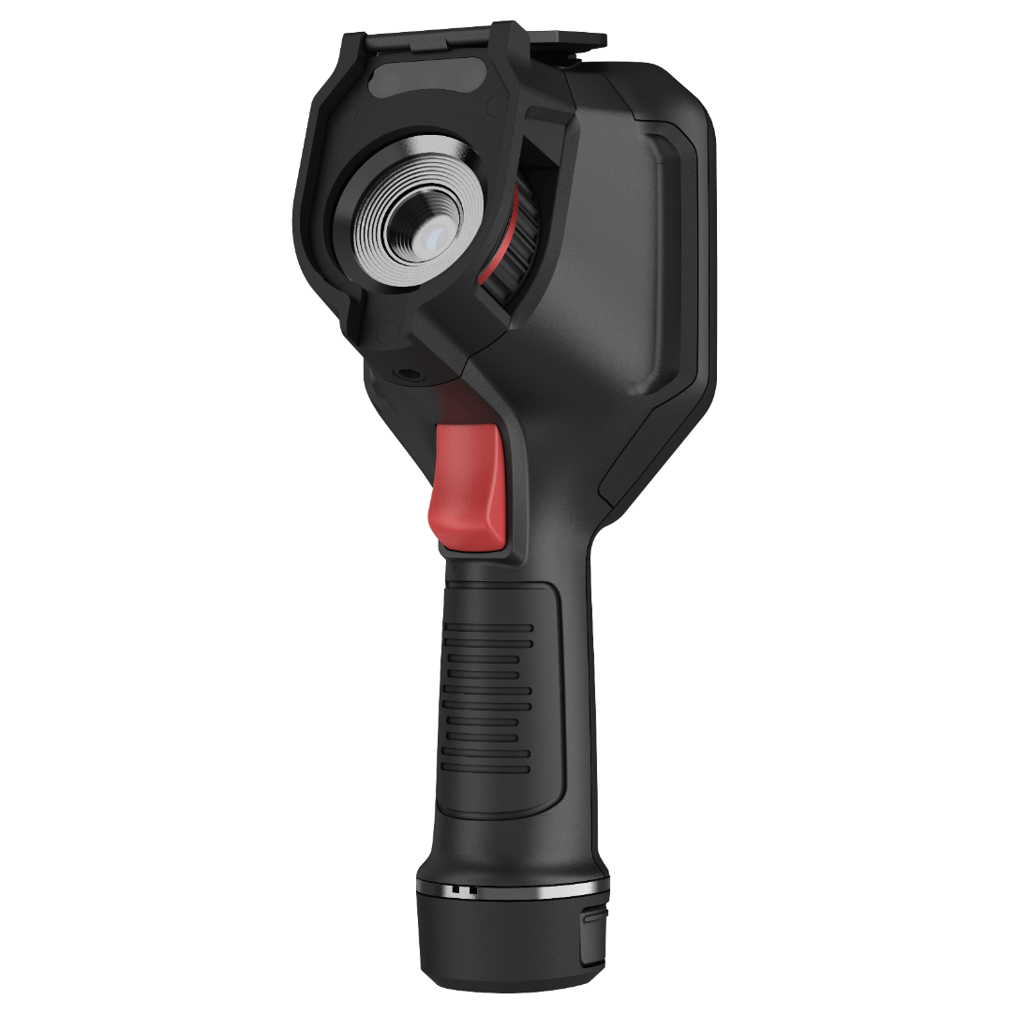
M Series
M Series – Form Factor
Lens Cap, Removable Micro SD Card, and USB-C Connection
8 MP Visual Camera, LED Lamp for lighting dark environments, & Laser Pointer.
Up to 384x288(110,592) Thermal Resolution
Trigger for 1 Click Thermal and Visual Image Storage and Video Start/Stop

Slide 7
M Series - Overview
Basic Parameters | M11 | M11W | M20W | M20 | M30 | M60
IR Resolution | 192 × 144 (27,648 pixels) | 192 × 144 (27,648 pixels) | 256 x 192 (49,152 pixels) | 256 x 192 (49,152 pixels) | 384 x 288 (110,592 pixels) | 640 x 480 (307,200 pixels)
SuperIR | 384 × 288 (110,592 pixels) | 384 × 288 (110,592 pixels) | 512 × 384 （196,608 pixels） | 512 × 384 （196,608 pixels） | 768 x 576 (442,368 pixels) | 1280 x 960 (1,228,800 pixels)
NETD | < 40 mK (@ 25 °C, F#=1.0) |  |  |  | < 35 mK (@ 25 °C, F#=1.0)
Focal Length | 6.9mm | 3.6mm | 3.5 mm | 6.9 mm | 10 mm | 15mm
FOV | 18.8° × 14.1° | 37.2° x 27.8° | 50° x 37.2° | 25° x 18.8° | 37.5° × 28.5 ° | 41.9° × 33.3°
Focus | Manual Focus | Focus Free | Focus Free | Manual Focus | Manual Focus | Manual Focus
Visual Camera | 3264 × 2448 (8 MP)
Min. Focusing Distance | 0.1 m (0.33 ft) | 0.5 m (1.64 ft) | 0.5 m (1.64 ft) | 0.1 m (0.33 ft) | 0.1 m (0.33 ft) | 0.3 m (0.98 ft)
Object Temp. Range | -20 °C to 550 °C (-4 °F to 1022 °F) |  |  |  |  | -20 °C to 650 °C (-4 °F to 1202 °F)
Accuracy | Max. (± 2°C/3.6°F, ± 2%), for ambient temperature 15°C to 35°C (59°F to 95°F) and object temperature above 0°C (32°F)
Display | 640 × 480 Resolution, 3.5″ LCD Touch Screen
Wi-Fi | 802.11 b/g/n (2.4 GHz and 5 GHz)
Storage | Default Storage: Removable SD Card (16 GB) ; Max. Storage Capacity: 128 GB |  |  |  | Default Storage: Removable SD Card (64 GB) ; Max. Storage Capacity: 128 GB
Weight | Approx. 660g (1.46 lb) | Approx. 660g (1.46 lb) | Approx. 660g (1.46 lb) | Approx. 660g (1.46 lb) | Approx. 660g (1.46 lb) | Approx. 686g (1.51 lb)
Battery Life | 6 hours x 2 | 6 hours x 2 | 6 hours x 2 | 6 hours x 2 | 4 hours x2 | 4 hours x2

Slide 8
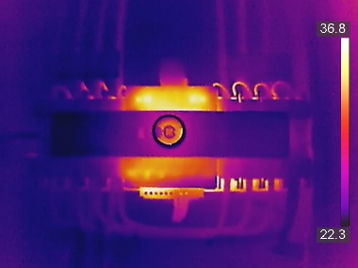
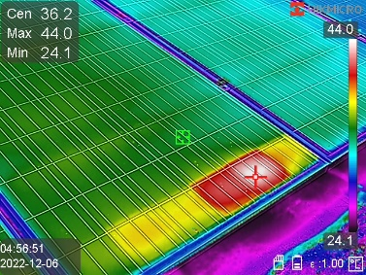
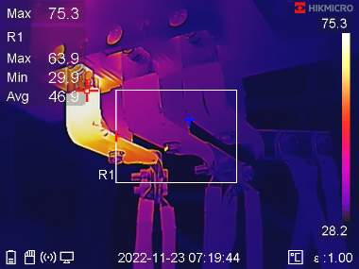
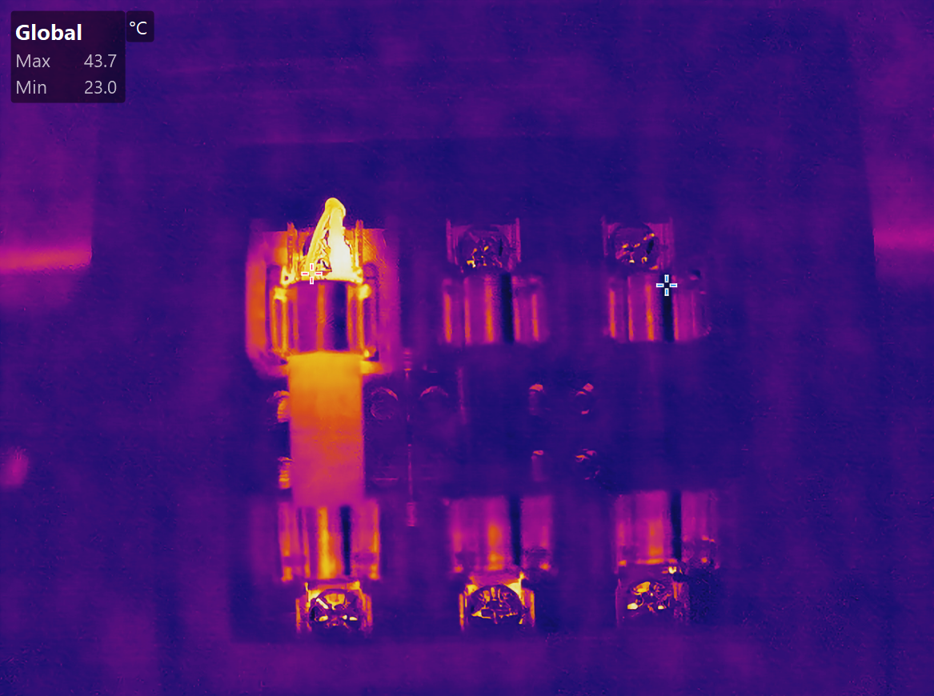
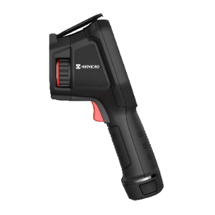
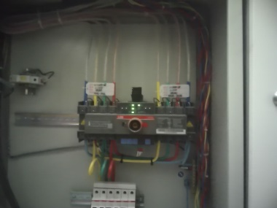
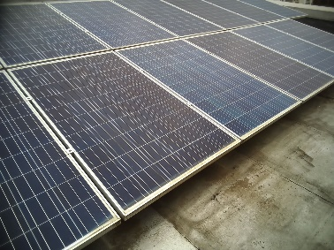
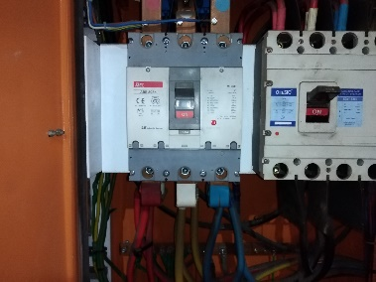
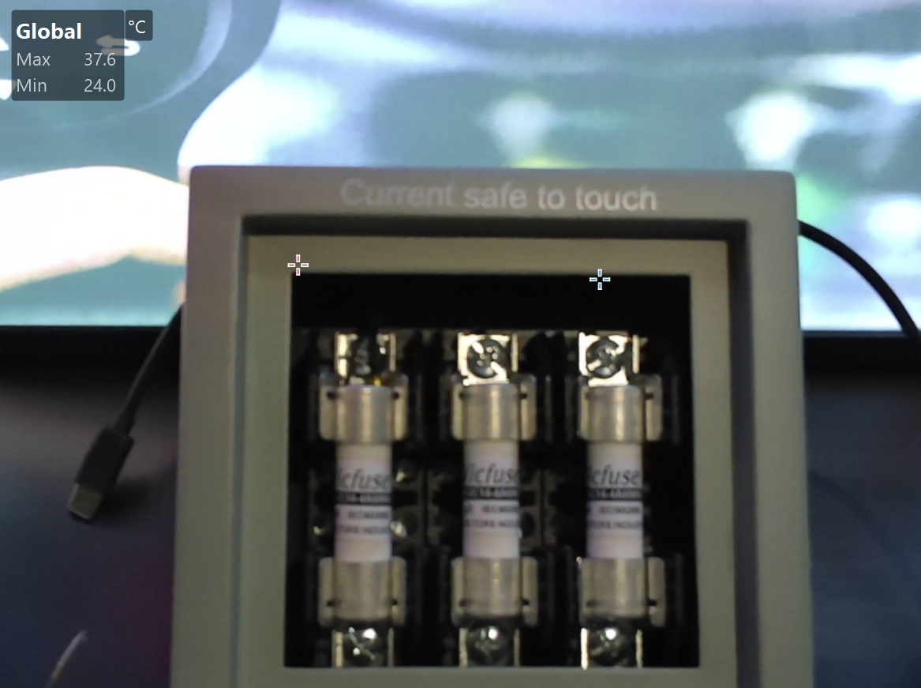
Mxx
Specifications | M11 | M20 | M30 | M60
IR Resolution | 192 × 144 (27,648 pixels) | 256 × 192 (49,152 pixels) | 384 x 288 (110,592 pixels) | 640 x 480 (307,200 pixels)
NETD | < 40 mK (@ 25 °C, F#=1.0) |  | < 35 mK (@ 25 °C, F#=1.0)
Focal Length | 6.9 mm | 6.9 mm | 9.7 mm | 15 mm
FOV (H x V) | 18.8° × 14.1° | 25° × 18.8° | 37.5° × 28.5° | 41.9° × 33.3°
Min. Focusing Distance | 0.1 m (0.33 ft) | 0.1 m (0.33 ft) | 0.2 m (0.65 ft) | 0.3 m (0.98 ft)
IFOV | 1.74 mrad | 1.74 mrad | 1.75 mrad | 1.13 mrad
Application Scenarios
Manual focus is ideal for electrical, HVAC, and mechanical systems that may have small components in tight spaces or maybe in a dangerous area (heat, electric, up high, in/around operating components).
Allow the user to maximize pixel density on small objects where measuring temperature is critical to identify in or out of specification.

Slide 9
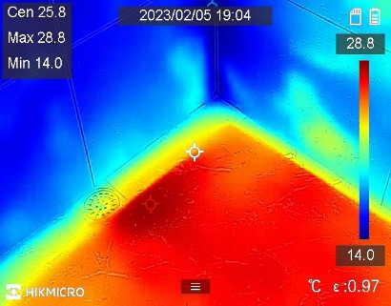
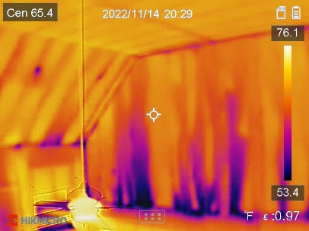
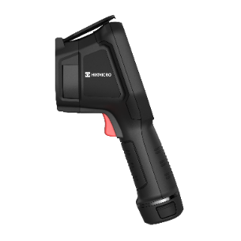
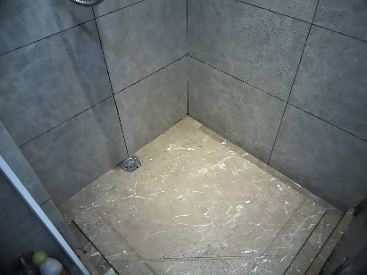

MxxW
Specifications | M11W | M20W
IR Resolution | 192 × 144 (27,648 pixels) | 256 x 192 (49,152 pixels)
NETD | < 40 mK (@ 25 °C, F#=1.0)
Focal Length | 3.6 mm | 3.5 mm
FOV (H x V) | 37.2° x 27.8° | 50° x 37.2°
Min. Focusing Distance | 0.5 m (1.64 ft) | 0.5 m (1.64 ft)
IFOV | 3.33 mrad | 3.33 mrad
Application Scenarios
Fixed Focus and wide FOV cameras
These cameras have the same resolution, sensitivity, and operating frequency as the manual focus models, but the fixed focus with wider angle FOV makes them great for scanning walls, floors, facades for items that typically present themselves on a larger scale including water leaks, insulation issues, air infiltration.

Slide 10



M Series - SuperIR
Powered by HIKMICRO SuperlR image enhancement technology, images are upscaled 4X to deliver highly detailed live and recorded radiometric images for inspection and reporting.
* Above images captured by M60

Slide 11





M Series – Visual Imagery
Visual images provide additional details including:
Part numbers
Component or equipment type
Reference location
Damage to finish materials from underlying issues

Slide 12





M Series - Valuable Visual Image
No need to carry a second traditional camera when performing inspections.
Automatically captured with thermal
Easy to understand file structure
HM2022XXXX.VIS
HM2022XXXX
A LED light illuminates areas in darkness

Slide 13


M Series - 1-Tap Level &Span
Quickly highlights the area of the image you are interested in by narrowing the span with one tap on the 3.5" LCD touchscreen, instantly improving image contrast and highlighting potential problems.
1-Tap

Slide 14


M Series - Complete Image Annotations
Support voice, text, and QR Code Scan annotations, helping to improve inspection efficiency and productivity.

Slide 15


M Series - Laser Pointer
The Laser Pointer helps show the position of the center point on actual object.

Slide 16




M Series - Interchangeable Battery System
Includes 2 interchangeable Li-ion batteries and a dual bay charger to provide you with up to 12 hours of operation. You can stay powered up for even the longest inspections.
2 Interchangeable and Rechargeable Li-ion Batteries
4 International Use Plugs
(US/EU/UK/AU) for Power Supply
Basic Parameters | M11 | M11W | M20W | M20 | M30 | M60
Battery Life | 6 hours x 2 | 6 hours x 2 | 6 hours x 2 | 6 hours x 2 | 4 hours x 2 | 4 hours x 2

Slide 17






M Series - Easy to Download Images
Provide 3 ways to download images (Visual & Thermal) off of the camera for reporting
Wireless via the HIKMICRO Viewer app
USB cable to computer
Remove SD Card

Slide 18

M Series - 5 Image Modes
Thermal, Fusion, PIP, Blending and Optical modes to suit your preferred view

Slide 19




M Series - On-camera Analysis
Offers 17 measurement rules, 7 color alarm palettes and 5 image modes for powerful on-camera analysis.
5 Image Modes
17 Measurement Rules
7 Color Alarm Palettes
With firmware 5.5.45

Slide 20

M Series - Radiometric Video Analysis
Supports recording of radiometric video in camera SD card storage, including all temperature data, for post analysis on PC software. Works seamlessly with HIKMICRO Analyzer software for intuitive viewing, advanced analysis and processing of thermal data.
HIKMICRO Analyzer
Only M30

Slide 21
M Series - Key Features
Rugged & Durable Design
IP54 rated for protection against water and dust. Featuring 2-meter (6.6ft) drop protection, suitable for industrial use.
LED Flashlight
The LED flashlight allows you to work safely in dim or dark environments.
Conveniently Share Images and Reports
Connect HIKMICRO Viewer App via Wi-Fi to transfer photos or videos from camera to mobile device. Analyze, share images, and generate reports in real-time on-site.
High Capacity Storage
Provides a standard memory SD card up to 64 GB (expandable up to 128 GB) that can store at least 100,000 images or 54 hours of video recording.
Basic Parameters | M11 | M11W | M20 | M20W | M30 | M60
Storage | Default Storage: Removable SD Card (16 GB) ; Max. Storage Capacity: 128 GB |  |  |  | Default Storage: Removable SD Card (64 GB) ; Max. Storage Capacity: 128 GB
Image Storage Capacity | Approx. 60,000 Images |  |  |  | Approx. 100,000 Images | Approx. 35,000 Images
Video Storage Capacity | Approx. 15 hours |  |  |  | Approx. 54 hours

Slide 22




M Series - Application
Users and Benefits
Check Electrical
Check Insulation Condition
Predictive Maintenance Technicians
Building Maintenance
Technicians
Check Underfloor Heating
Check Mechanical Status
Building Maintenance
Technicians
First Level Maintenance

Slide 23



M Series - Application
HVAC
Mechanical Predictive Maintenance
With thermal imaging technology, technicians and heating engineers can make doubly sure that a central heating system has been thoroughly maintained. Not only does this provide peace of mind for the operator themselves, and it also allows them to show clients the results of their work and even help convince them of the need for maintenance in the first place. Thermal technology stands out as the only way to provide a comprehensive, visual, and quantitative assessment of the efficacy of maintaining HVAC Radiators.
Thermal imaging is great for spotting a lack of uniformity in equipment by indicating hot and cold spots in surface temperature, through infrared image capture. Heat is often an early symptom of equipment damage or malfunction, making it important to monitor preventive maintenance programs. Monitoring equipment performance with thermal imaging cameras can reduce the likelihood of unplanned downtime due to equipment failure, reduce reactive maintenance fees and equipment repair costs, and extend the lifespan of machine assets.
Building Inspection
Electrical Inspection
In building inspections, missing or damaged insulation, building envelope air leaks, and moisture intrusion can be very difficult to find before they become serious enough to damage or destroy building contents. Thermal cameras can and have been utilized in the discovery of otherwise undetectable heat, air, and moisture anomalies in all types of structures.
Electrical problems can relate to problems such as loose or over-tight connections, shorted or overloaded circuits, load imbalances, and components that have failed or are fatigued, such as fuses, circuit breakers, transformers, etc. Most electrical problems exhibit a gradual rise in temperature prior to their failure. And thermal imaging can recognize this heat. By detecting these early, you can prevent the possibility of fire.

Slide 24


M Series - Application
HVAC Inspection
A handheld thermal imager can be used to troubleshoot HVAC problems effectively and efficiently. It can find blocked registers, broken junctions, condenser units, electrical problems, radiant floor heating, and coil temps in a flash.
Water Leak Inspection
Find Air Leakage
Hidden water can wreak havoc on insulation, wood, electrical components and, eventually, finishes when it does reveal itself. As long as the conditions are right, thermal imaging will find the leakage area though showing the temperature variances between water and surrounding materials.
When insulation is missing in walls or rafters, it can cause energy loss and increase heating and cooling costs. As long as the conditions are right, a thermal imaging camera can help identify areas with energy loss, especially those in hard-to-reach locations or behind walls.

Slide 25

M Series - Scope Of Delivery
Accessories | Items | Quantity
Device | Thermal Imager | 1
Straps | Wrist Strap for Thermal Imager | 1
 | Shoulder Strap for Hard Carrying Case | 1
Batteries and Power | Interchangeable and Rechargeable Li-ion Batteries | 2
 | Power Supply for Battery Charger | 1
 | Two-bay Battery Charger | 1
 | International Use Plugs (US/EU/UK/AU) for Power Supply | 4
Cables | USB 2.0 A to USB Type-C Cable | 1
Cases and Pouches | Hard Carrying Case | 1
Manuals | Calibration Certificate | 1
 | Quick Start Guide (Baseline) User Manual | 1
Storage | 16 GB Micro SD card (M11/M11W/M20/M20W) 64 GB Micro SD card(M30/M60) | 1

Slide 26



M Series - Optional Accessories
M Series Power
All Series
Replacement Battery
（ E097-13-1S1P26650 ）
5000 mAh, 3.7 V
Replacement 2-Bay Battery Charger
( HM-5202ZC )
Input 100~240 V / 0.7 A
Output 12 V / 2 A
Pouch
( HM-SP01-POUCH )
100% Polyester
27.5 cm c 13 cm × 21 cm
(10.8” × 5.1” × 8.3”)
The M series comes with two batteries in the box, and optional batteries are also available

Slide 27








Applications - HIKMICRO Viewer
WIRELESS ANALYSIS, REPORTING AND SHARING
HIKMICRO Viewer App is A powerful and intuitive APP designed for industrial thermal cameras. It allows thermal inspector to view and capture live streaming infrared video and still images from select HIKMICRO thermal imaging cameras using a mobile device. With the HIKMICRO Viewer, the thermal camera can be placed in an area and operated wirelessly from a distance - helping infrared detection work safely in hard-to-reach locations and harsh work environments. Streaming video and remote access also provide opportunities for decision-makers and others on the team to observe and collaborate during IR surveys. With a powerful reports function, you can efficiently generate reports for your clients in the field.
Free license
Scan and Connect Easily
Download On-Device Images and Video to share
Live View and Remote Control
Advanced measurement and image analysis
Quick reporting and sharing
Firmware Upgrade
After-sales contacts and online support services
Turn screen rotation on and off
Learn more:
https://www.hikmicrotech.com/en/industrial-products/hikmicro-viewer-software/

Slide 28

Software - HIKMICRO Analyzer
EFFICIENT, POWERFUL THERMAL ANALYSIS AND REPORTING
HIKMICRO Analyzer is a powerful and free licensed PC software designed to help users manage and analyze thousands of thermal images and videos and quickly create professional reports. Compatible with files from HIKMICRO handheld thermal cameras, providing the features you need to simplify your workflow and increase your productivity.
Free license
Import, edit and manage files
View, edit and analysis radiometric images and videos
Advanced measurement and image analysis
Batch processing with all image and measurement controls
Quick reporting with pre-defined or customized templates

Slide 29




THANK YOU
See the World in a New Way
HIKMICRO Thermography
hikmicro_thermography
HIKMICRO Thermography
HIKMICRO
Public Email Address: info@hikmicrotech.com
Official Website: www.hikmicrotech.com/en/industrial/

