Slide 1


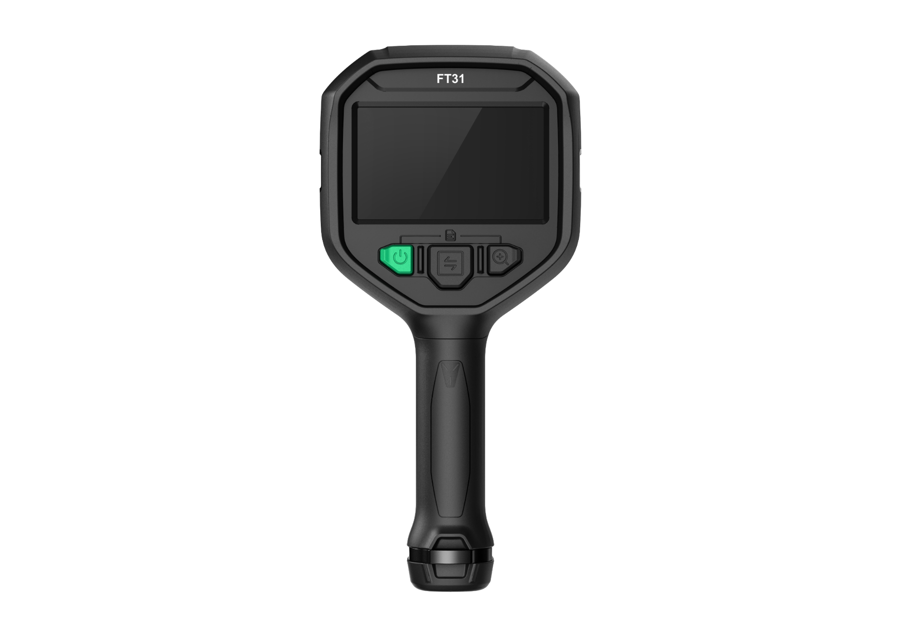
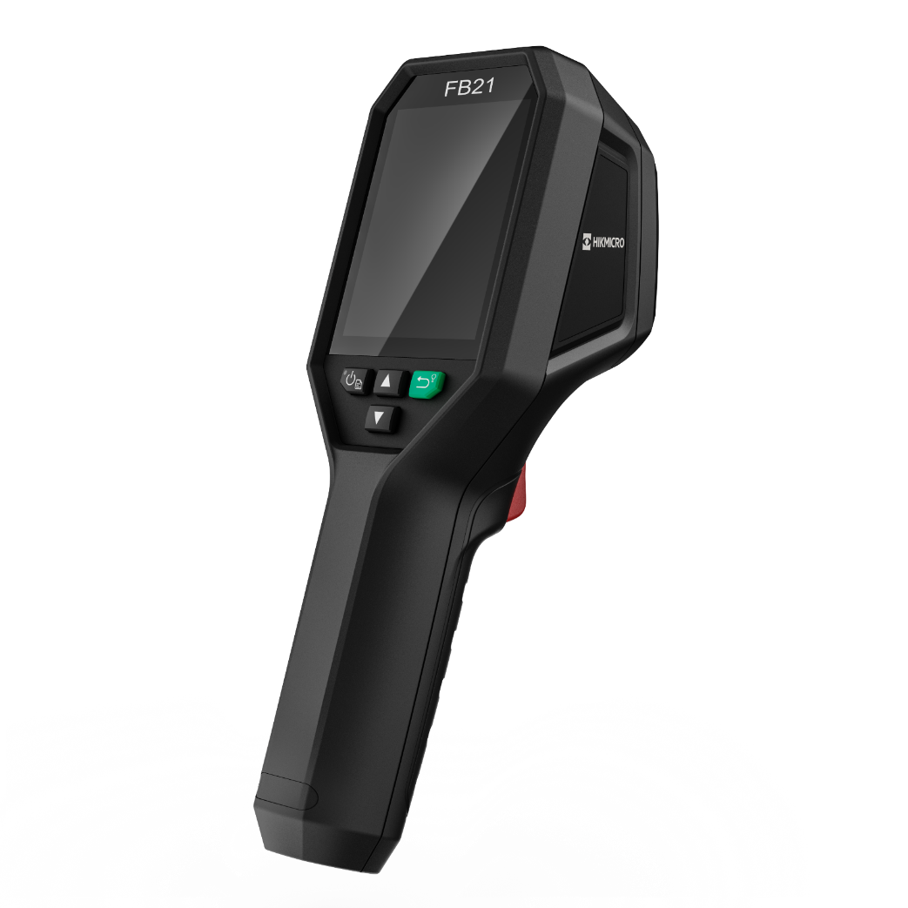

HIKMICRO FIREFIGHTING
THERMAL CAMERAS
INTRODUCTION
Thermal camera for observing in total darkness and smoke.
INDUSTRIAL PRODUCT | 2023.Q3
1
Notes:
Compact Explosion Proof Thermal Camera for use in Hazardous Areas

Slide 2
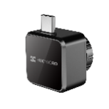
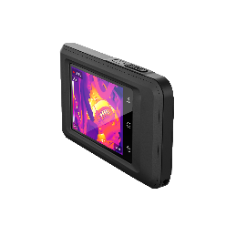
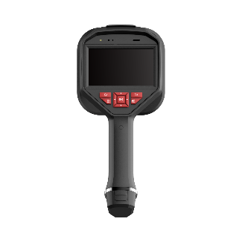
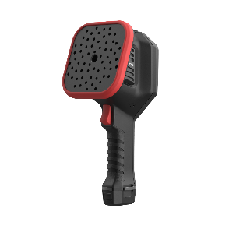
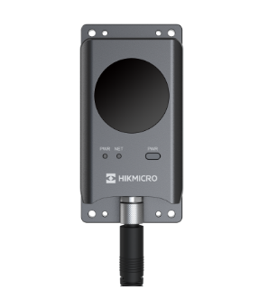

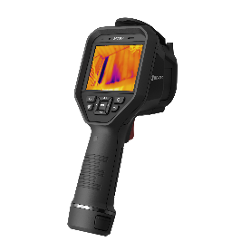
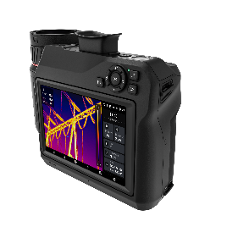
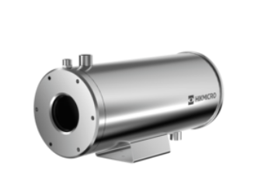
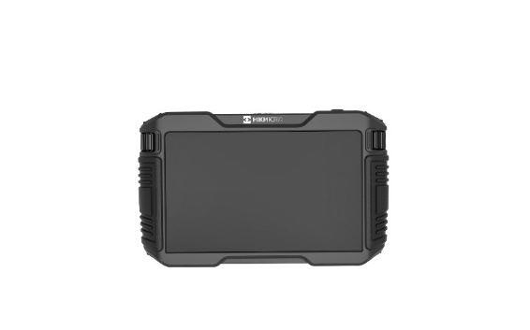
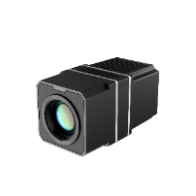
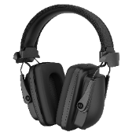
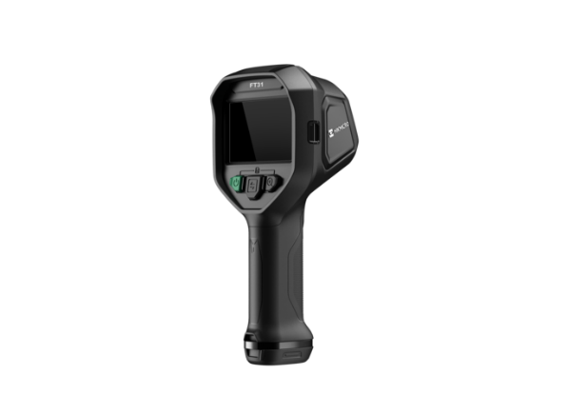


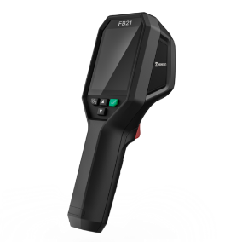
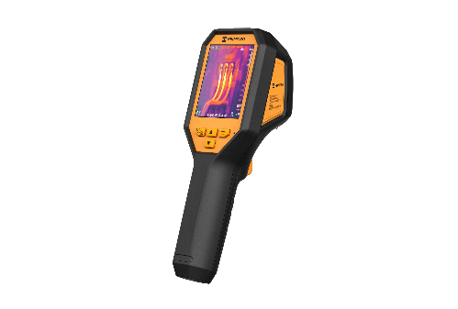


PRODUCT CATEGORY
PRODUCT CATEGORY
Thermal
Handheld
Fixed
Acoustic
New
Acoustic
New
Explosion-proof
New
Firefighting
Software

Slide 3
CONTENTS
01 FB21
Compact And Reliable Thermal Camera For Observing In Total Darkness And Smoke.
02 FT31

Slide 4
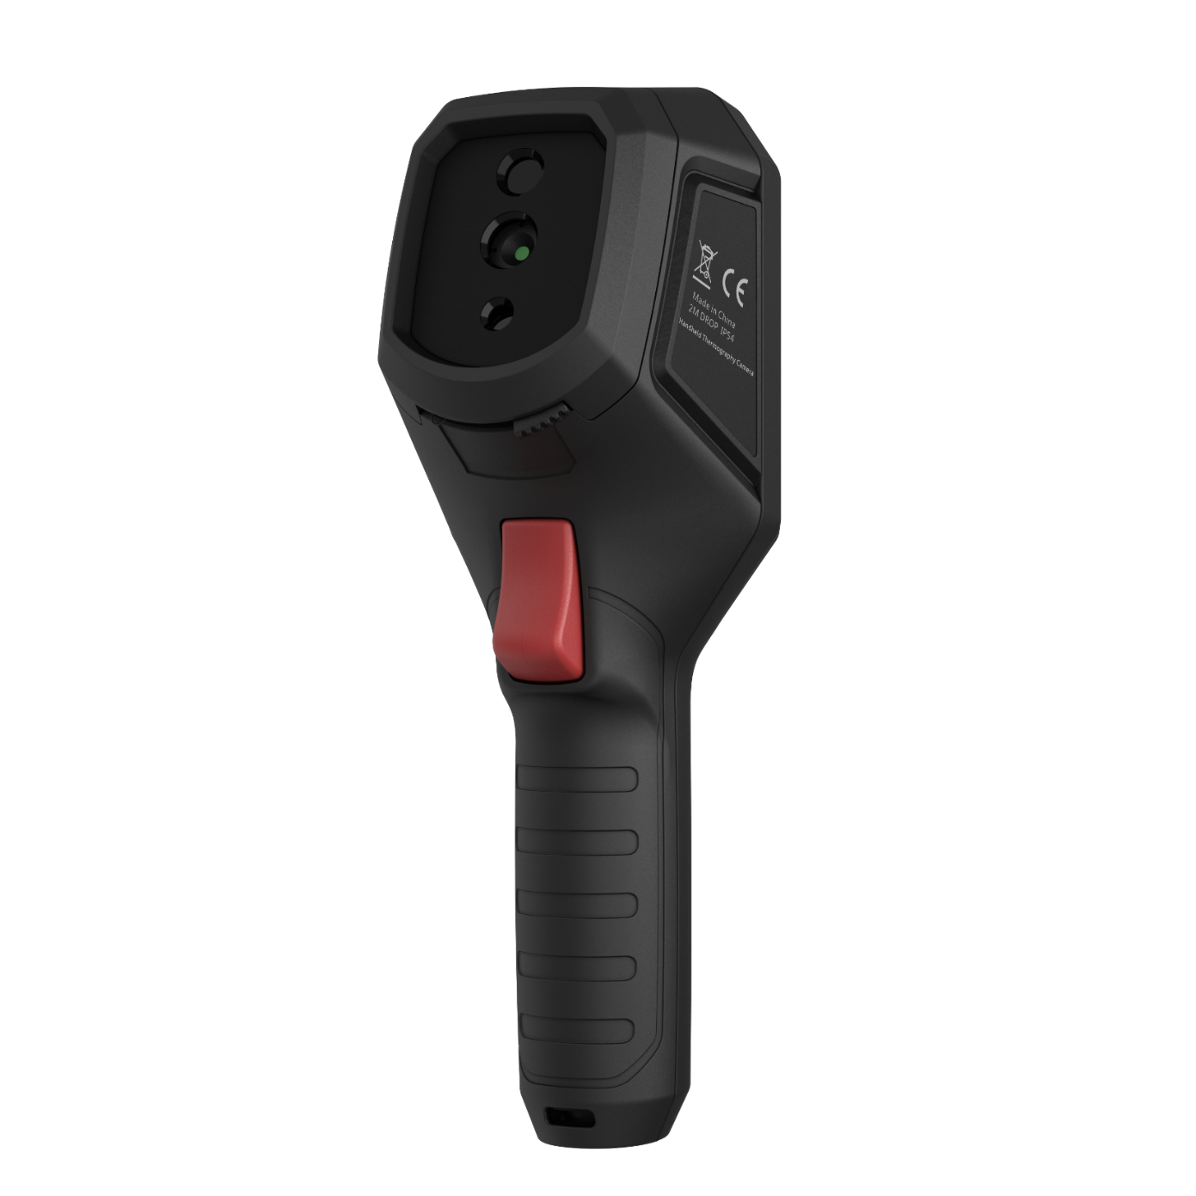

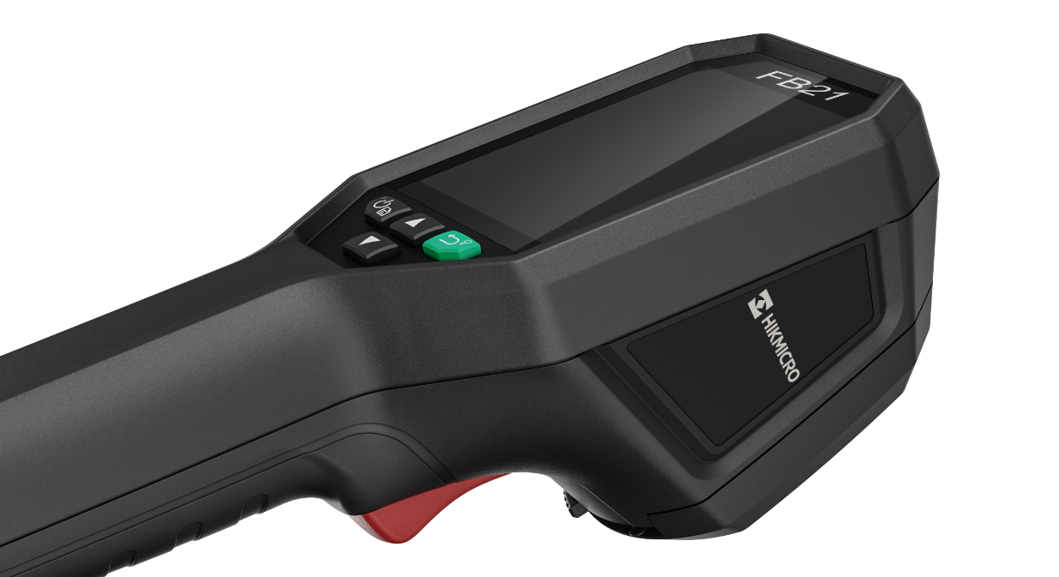
FB21- Overview
The HIKMICRO FB21 is a compact, reliable, firefighting thermal camera designed for firefighters to observe in total darkness and smoke, helping to save lives, protect property, and keep firefighters safe.
Features like dual cameras, LED flashlights, easy-to-navigate buttons, and a temperature range of up to 550°C (1022°F) help you work effortlessly in harsh environments. 8 color palettes for you to choose from, which satisfy most application scenarios.
Basic Parameters |  | FB21
Infrared Image | IR Resolution | 256 × 192 (49,152 pixels)
 | NETD | < 40 mK (@ 25 °C, F#=1.0)
 | Image Frequency | 25 Hz
 | Field of View (FOV) | 37.2° × 50.0°
 | Min. Focusing Distance | 0.3 m (0.98 ft)
 | Focus Mode | Focus Free
Image Display | Visual Camera | 1600 × 1200 (2 MP)
 | Display | 240 × 320 Resolution, 3.2”LCD Screen
 | Color Palettes | Basic, Black Hot, White Hot, Fire Detection, Rescue, Hot Area, Cold Area, Building
Measurement and Analysis | Object Temperature Rang | -20°C to 550°C (-4°F to 1022°F)
 | Accuracy | Max. (± 2°C/3.6°F, ± 2%), for ambient temperature -20°C to 50°C (-4°F to 122°F) and object temperature above 0°C (32°F)
General | LED Light | Yes
 | Battery Type | Rechargeable Li-ion battery
 | Protection Level | IP65
 | Drop Test Height | 2 m (6.56 ft)
 | Working Temperature Range | Up to 10 minutes for ambient temperature -10°C to 90°C (14°F to 194°F); up to 2 minutes for ambient temperature -10°C to 115°C (14°F to 239°F)
 | Weight | Approx. 380 g (0.84 lb)

Slide 5


FB21– Form Factor
240 × 320 Resolution, 3.2”LCD Screen
Visual Lens, View the optical image
Thermal Lens， View the thermal image
LED Light
Wrist Strap Attachment Point and Tripod Mount
Trigger

Slide 6
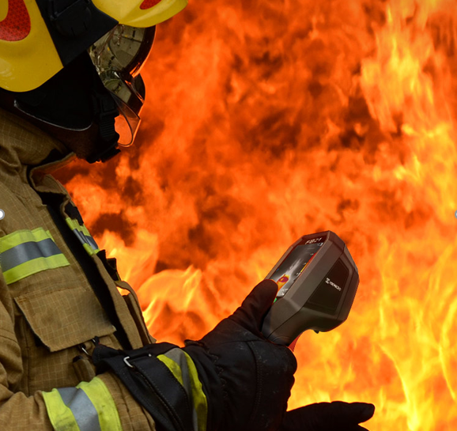
FB21- Compact And Reliable
The HIKMICRO FB21 is a rugged, compact, high-quality thermal imaging camera designed for firefighters to observe in total darkness and smoke, helping to save lives, protect property, and keep firefighters safe.
256
High Image Quality
Features a highly sensitive (NETD < 40 mK) VOx detector, along with optimized image enhancement algorithms to provide clear thermal images.
3.2”
3.2” Color LCD
View the details of your images on the large, class-leading LCD screen
IP65
Rugged & Durable Design
IP65 rated for protection against water and dust.
Featuring 2-meter (6.56ft)drop protection, suitable for harsh environment.

Slide 7
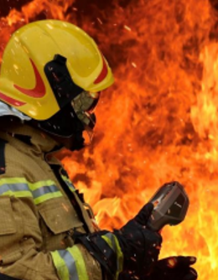
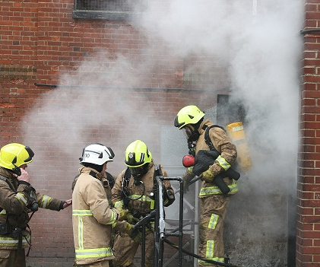
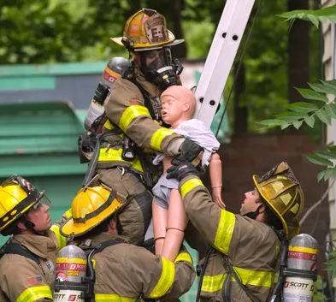
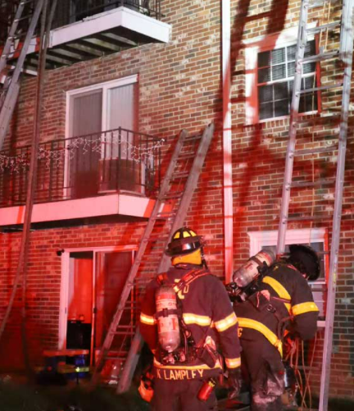
FB21- For Observing In Total Darkness And Smoke
Working Temperature Range:
Up to 10 minutes for ambient temperature -10°C to 90°C (14°F to 194°F)
up to 2 minutes for ambient temperature -10°C to 115°C (14°F to 239°F)
Object Temperature Range: -20°C to 550°C (-4°F to 1022°F)
FB21
For Smoke Systems
For Fire Rescue
For Building
Notes:
工作温度范围
检测物体温度范围

Slide 8
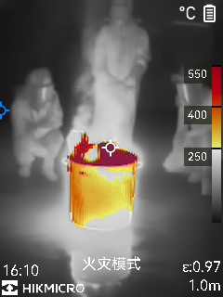
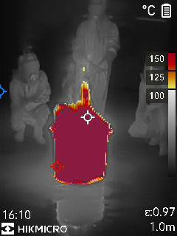
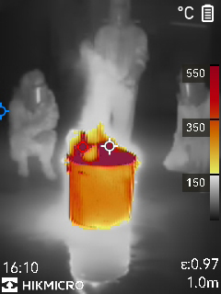
FB21- For Observing In Total Darkness And Smoke
8 color palettes give different image display options.
Among the palettes designed for firefighting, it allows you to make quick inspections in harsh environments.
Fire Detection
Rescue
Basic
For scenes with higher background temps where open flames are present, particularly in structural fires.
For use with lower temperature situations, such as initial rescue efforts after traffic accidents, searches in wooded areas, etc.
For initial fire attack and rescue operations; colors represent temperature.
Different palettes, corresponding to different Isotherm, with colors varying from yellow, orange, to red, help to quickly target temperature zones.
For example in basic mode:
Yellow coloring 150°C to 350°C;
Orange coloring 350°C to 550°C;
Red coloring >550°C
Notes:
用于在漆黑和浓烟中观测

Slide 9
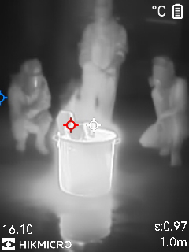
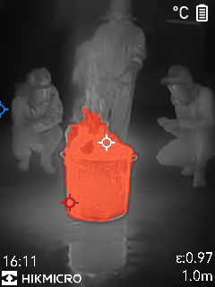
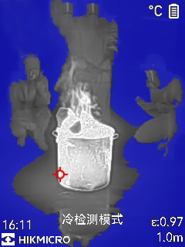
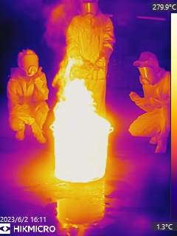
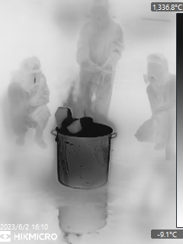
FB21- For Observing In Total Darkness And Smoke
8 color palettes give different image display options.
Among the palettes designed for firefighting, it allows you to make quick inspections in harsh environments.
Black &White
Hot Area
Cold Area
Building
Same representations of temperature as the Basic mode, but in grayscale.
Used for finding hotspots. The hottest 20% of the scene is colored red.
Used to detect temperatures in buildings such as mechanical, plumbing and electrical structures,etc.
Used for finding cold spots. The coldest 20% of the scene is colored blue.

Slide 10
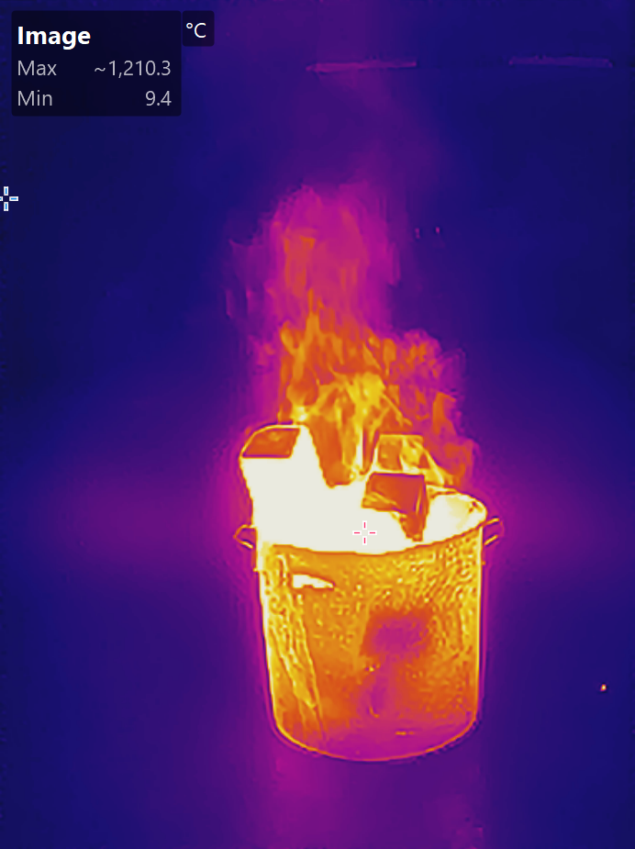
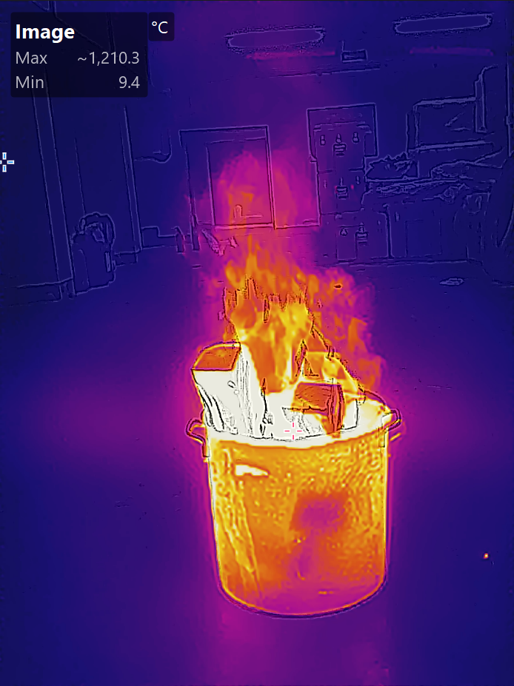
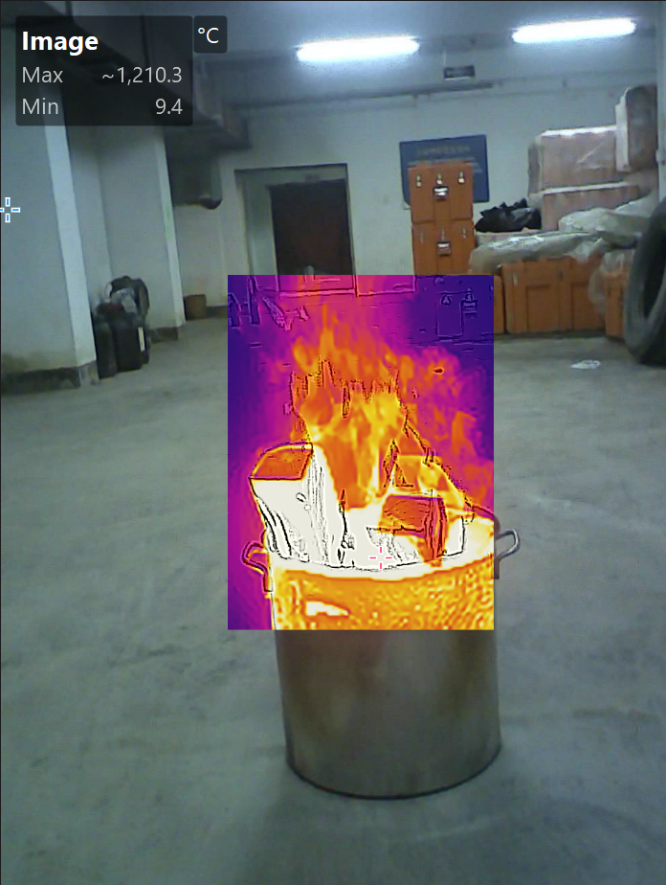
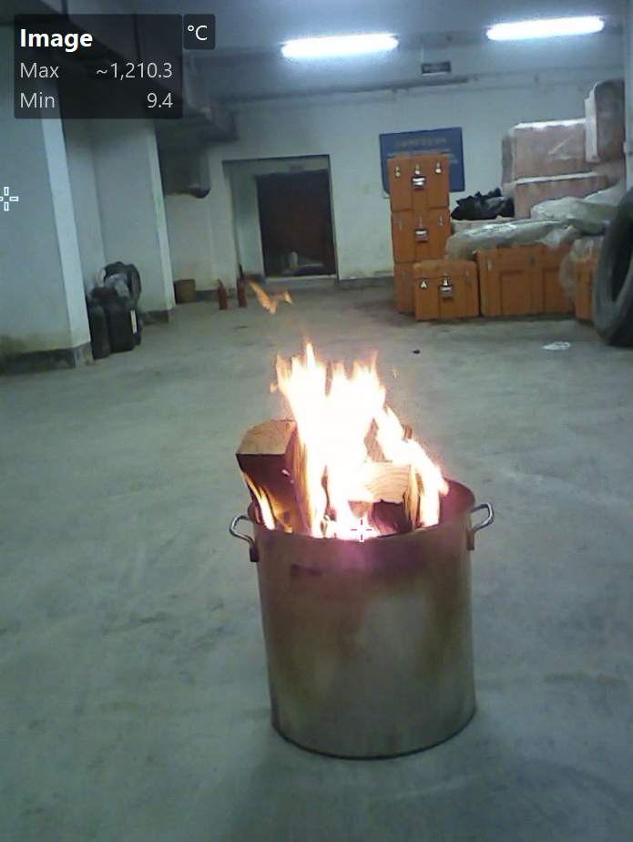
FB21- More Features
The HIKMICRO FB21 is a rugged, compact, high-quality thermal imaging camera designed for firefighters to observe in total darkness and smoke, helping to save lives, protect property, and keep firefighters safe.
4 Images Modes
Thermal, Fusion, PIP and Optical modes to suit your preferred view.
Durable and Rechargeable Batteries
Built-in 3350mAh Li-Ion rechargeable battery allow the camera up to 6 hours of continuous operation.
25 Hz Fast Image Frequency
25 Hz fast image frequency delivers smooth video while panning across scenes or viewing moving targets.
LED Flashlight
The LED flashlight allows you to work safely in dim or dark environments.
Thermal
Fusion
PIP
Visual

Slide 11
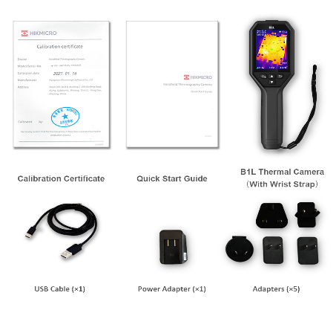

FB21- Scope Of Delivery
Compact thermal camera for observing in total darkness and smoke.
Thermal Camera with Wrist Strap
Power Supply
International Use Plugs (US/EU/UK/AU/CN) for Power Supply
USB 2.0 A to USB Type-C Cable
Calibration Certificate
Quick Start Guide
Calibration Certificate
Quick Start Guide
Thermal Camera with Wrist Strap
USB Cable
Charger and International Adapters

Slide 12

FT31 - Overview
The HIKMICRO FT31 is a high-performance firefighting thermal camera designed for firefighters to observe in total darkness and smoke, helping to save lives, protect property, and keep firefighters safe. Features like object details enhancement, easy-to-navigate buttons and a working temperature range of up to 260°C(500°F) help you work effortlessly in harsh environments. 8 color palettes for you to choose from satisfy most application scenarios.
Basic Parameters |  | FT31
Infrared Image | IR Resolution | 384 x 288 (110,592 pixels)
 | NETD | < 35 mK (@ 25°C, F#=1.0)
 | Image Frequency | 60 Hz
 | Field of View (FOV) | 54.1°×40.2°
 | Min. Focusing Distance | 1 m (3.28 ft)
 | Focus Mode | Focus Free
Image Display | Display | 800 × 480 Resolution, 4.3" LCD Screen
 | Digital Zoom | N/A
 | Color Palettes | Basic, Black Hot, White Hot, Fire Detection, Rescue, Hot Area, Cold Area, Building
Measurement and Analysis | Object Temperature Rang | -20°C to 1200°C (-4°F to 2192°F)
 | Accuracy | Max. (± 2°C/3.6°F, ± 2%), for ambient temperature 15°C to 35°C (59°F to 95°F) and object temperature above 0°C (32°F)
Data Storage and Communication | Storage Media | Built-in 32 GB flash memory
 | Video File Format | MP4 video
General | Battery Type | Interchangeable and rechargeable Li-ion battery
 | Protection Level | IP67
 | Drop Test Height | 2 m (6.56 ft)
 | Working Temperature Range | -20°C to 50°C (-4°F to 122°F) 80°C(176°F)，40min 150°C(302°F)，15min 260°C(500°F)，7min
 | Weight | Approx. 1022g (2.25 lb)

Slide 13
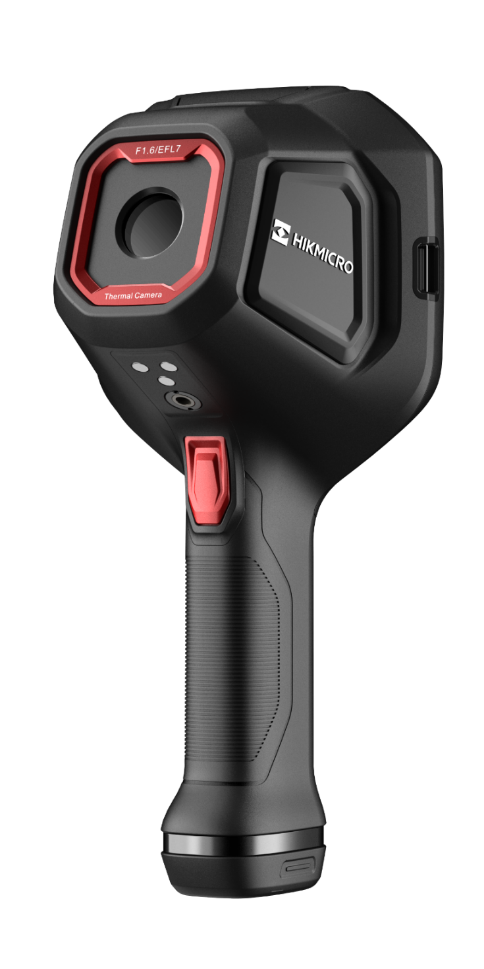
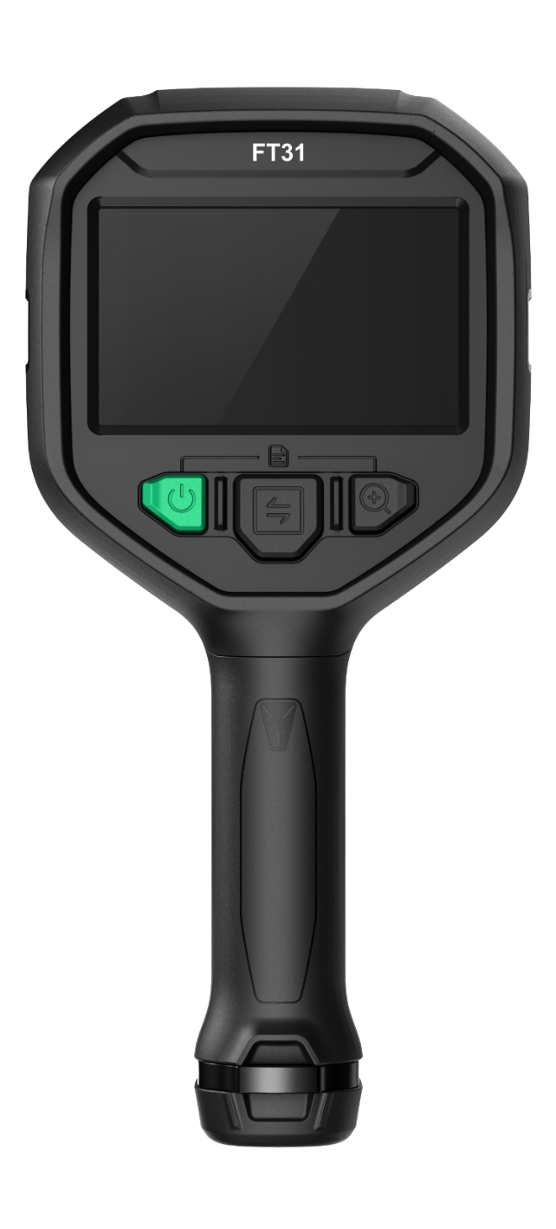
FT31– Form Factor
Interface Cover For USB Type-C
800 × 480 Resolution, 4.3" LCD Screen
Neck Strap Mounting Points
Thermal Lens
In-truck Charger Contacts
Keypad Controls for use with Gloves or PPE
Trigger
Lanyard Mounting Points
Interchangeable and Rechargeable Li-ion Battery System for up to 12 hours of runtime

Slide 14
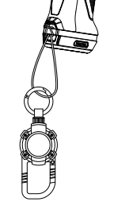
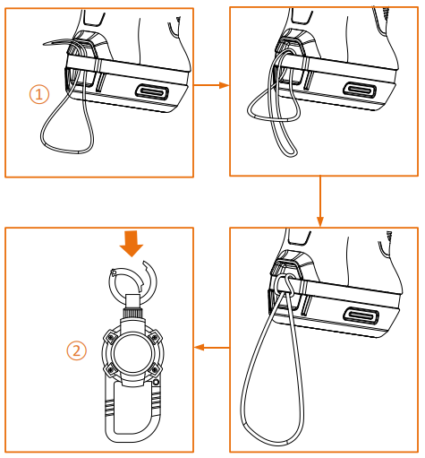
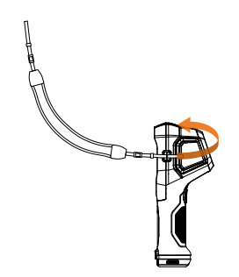
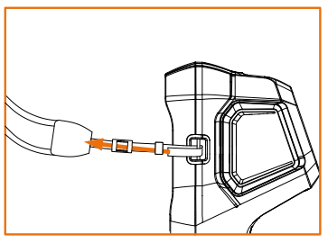
FT31– Form Factor
Accessory Installation
Neck Strap
Lanyards
①Lanyard ②Retractable Lanyard

Slide 15
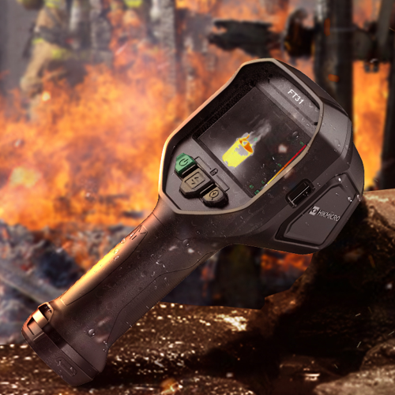
FT31 – High-performance Thermal Camera
The HIKMICRO FT31 is a high-performance thermal imaging camera designed for firefighters to observe in total darkness and smoke, helping to save lives, protect property and keep firefighters safe.
384
High Image Quality
Features a highly sensitive (NETD < 35 mK) VOx detector, along with ODE(Object Details Enhancement) to provide clear thermal images.
60Hz
60 Hz Fast Image Frequency
60 Hz fast image frequency delivers smooth video while panning across scenes or viewing moving targets.
IP67
Rugged & Durable Design
IP67 rated for protection against water and dust.
Featuring 2-meter (6.56ft)drop protection, suitable for harsh environment.

Slide 16
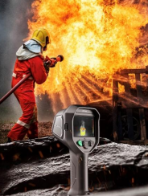
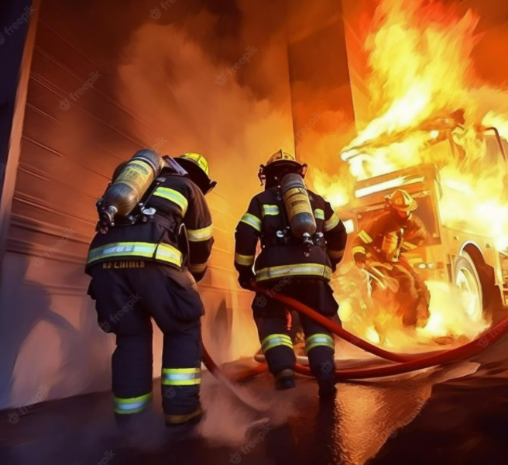
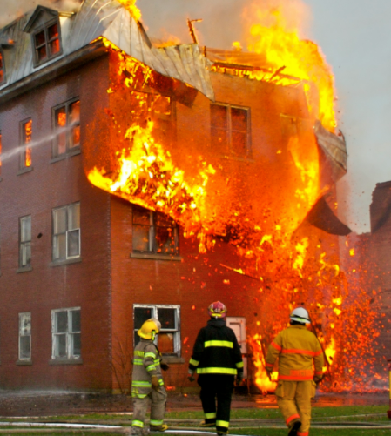
FT31- For Observing In Total Darkness And Smoke
Working Temperature Range:
-20°C to 50°C (-4°F to 122°F); 80°C(176°F)，40min; 150°C(302°F)，15min; 260°C(500°F)，7min
Object Temperature Range: -20°C to 1200°C (-4°F to 2192°F)
FT31
For Firefighting/ Smoke Systems
For Fire Rescue
For Building Construction

Slide 17
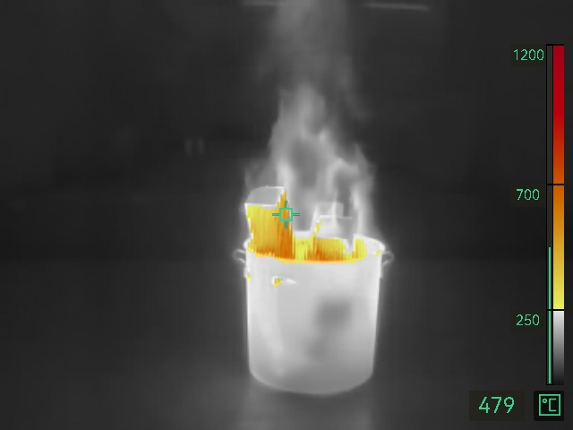
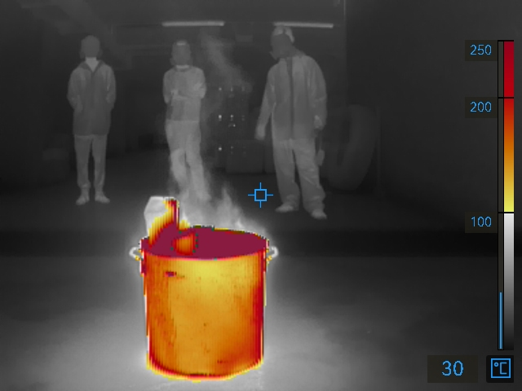
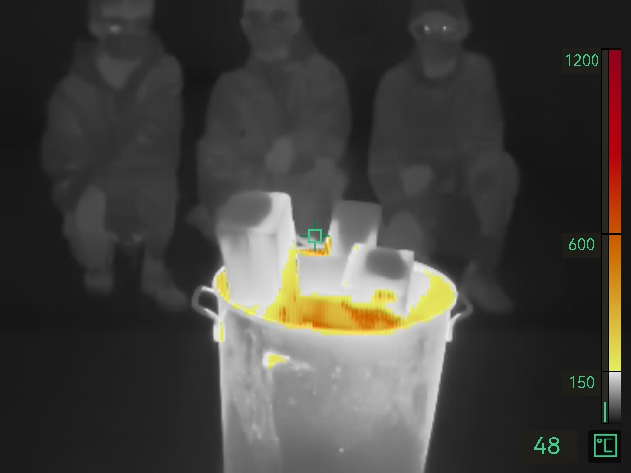
FT31- For Observing In Total Darkness And Smoke
8 color palettes give different image display options.
Among the palettes designed for firefighting, it allows you to make quick inspections in harsh environments.
Fire Detection
Rescue
Basic
For scenes with higher background temps where open flames are present, particularly in structural fires.
For use with lower temperature situations, such as initial rescue efforts after traffic accidents, searches in wooded areas, etc.
For initial fire attack and rescue operations; colors represent temperature.
Different palettes, corresponding to different Isotherm, with colors varying from yellow, orange, to red, help to quickly target temperature zones.
For example in basic mode:
Yellow coloring 150°C to 600°C;
Orange coloring 600°C to 1200°C;
Red coloring >1200°C

Slide 18
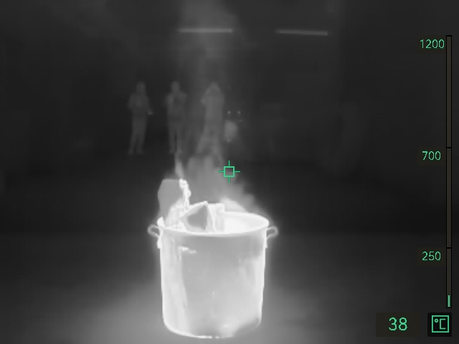



FT31- For Observing In Total Darkness And Smoke
8 color palettes give different image display options.
Among the palettes designed for firefighting, it allows you to make quick inspections in harsh environments.
Black &White
Hot Area
Cold Area
Building
Same representations of temperature as the Basic mode, but in grayscale.
Used for finding hotspots. The hottest 20% of the scene is colored red.
Used for finding cold spots. The coldest 20% of the scene is colored blue.
Used to detect temperatures in buildings such as mechanical, plumbing and electrical structures,etc.

Slide 19


FT31 – More Features
Interchangeable Battery System
Includes 2 interchangeable Li-ion batteries and a dual bay charger to provide you with up to 12 hours of operation.
Fast Startup
Start-up time: 5 seconds (with IR image), 10 seconds (with OSD)
4.3" LCD Screen
View the details of your images on the large, LCD screen. With 1x, 2x, 4x digital zoom provides more image details.
High Capacity Storage
Built-in 32 GB flash memory it can store at least 100,000 images.

Slide 20

FT31 - Scope Of Delivery
Accessories | Items | Quantity
Device | Thermal Imager | 1
Straps | Neck Strap | 1
 | Lanyard | 1
 | Retractable Lanyard | 1
Batteries and Power | Interchangeable and Rechargeable Li-ion Batteries | 2
 | Power Supply for Battery Charger | 1
 | Two-bay Battery Charger | 1
 | International Use Plugs (US/EU/UK/AU) for Power Supply | 4
Cables | USB 2.0 A to USB Type-C Cable | 1
Cases and Pouches | Hard Carrying Case | 1
Manuals | Calibration Certificate | 1
 | Quick Start Guide | 1

Slide 21




THANK YOU
See the World in a New Way
HIKMICRO Thermography
hikmicro_thermography
HIKMICRO Thermography
HIKMICRO
Public Email Address: info@hikmicrotech.com
Official Website: www.hikmicrotech.com/en/industrial/

