Slide 1
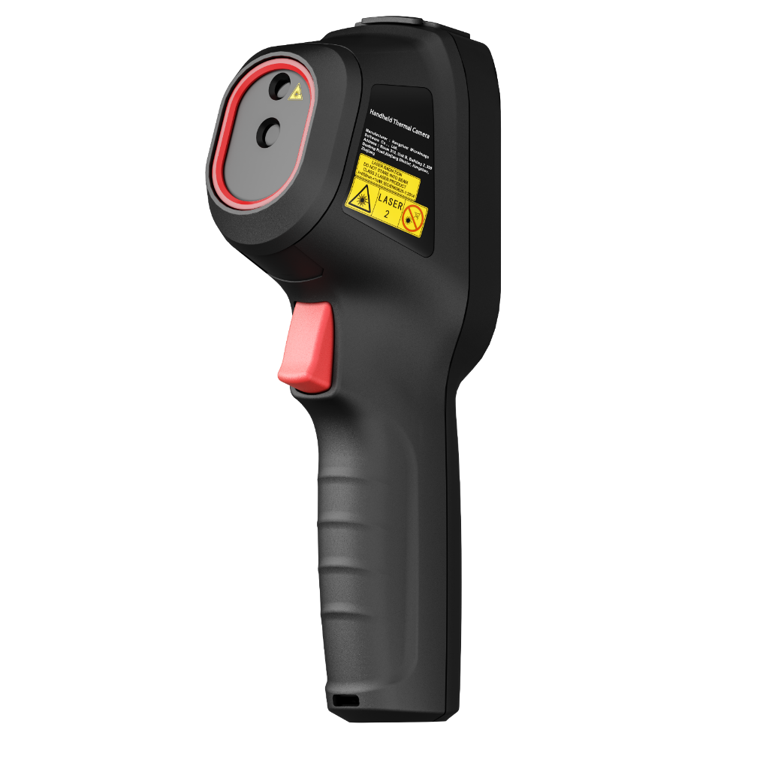
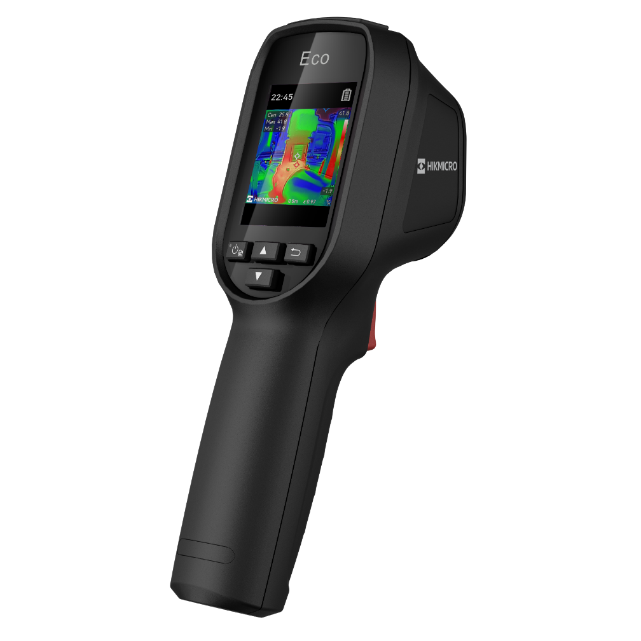

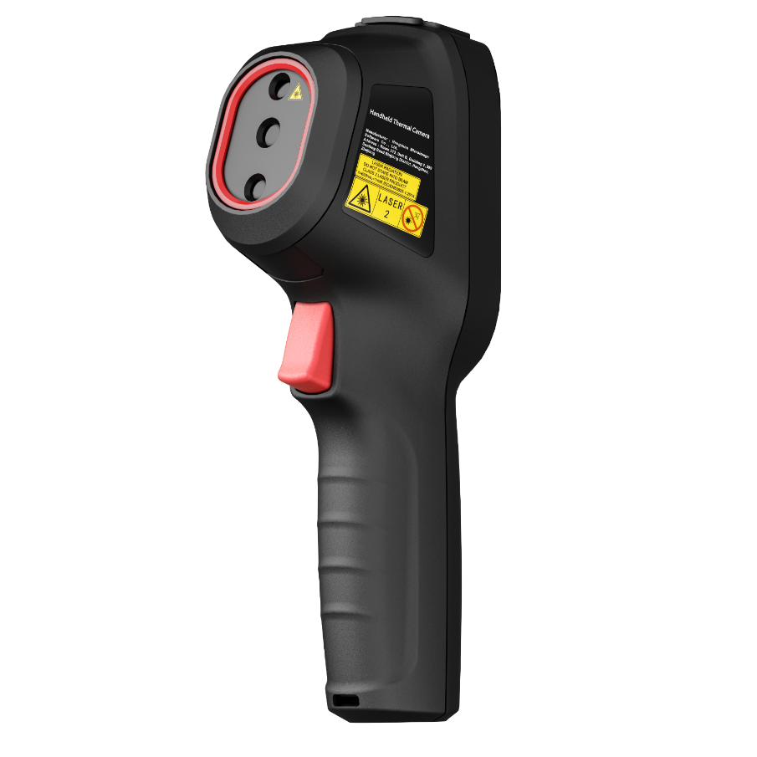

Eco Series
Comparison of images
Eco, Eco-V, E1L

Slide 2
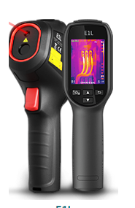
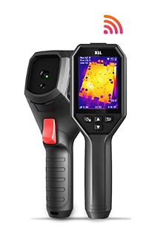



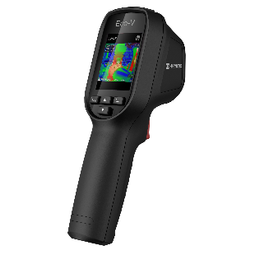
Eco Series VS E1L – Spec Comparison
 | Eco-V | Eco | E1L | B1L
IR Resolution | 96×96/9,216 Pixels | 96×96/9,216 Pixels | 160×120/19,200 Pixels | 160×120/19,200 Pixels
SuperIR | 240 × 240/57,600 Pixels | 240 × 240/57,600 Pixels | × | ×
FOV | 50° × 50° | 50° × 50° | 37.5° × 50° | 32.9° × 44.4°
Visual Light | 640 × 480/307,200 Pixels | × | × | ×
Image Mode | Thermal/Fusion/Visual | Thermal | Thermal | Thermal
Palettes | 7 | 7 | 4 | 5
Image Resolution | 240 × 240 | 240 × 240 | 240 × 320 | 240 × 320
Wi-Fi | × | × | × | ✓
Display | 2.4’’ LCD Screen | 2.4’’ LCD Screen | 2.4’’ LCD Screen | 3.2’’ LCD Screen
High Temperature Alarm | × | × | × | Audio alarm & Warning light
Image Frequency | 25Hz | 25Hz | 25Hz | 25Hz
Thermal Sensitivity: | <0.04°C / NETD< 40mK | <0.04°C / NETD< 40mK | <0.04°C / NETD< 40mK | <0.04°C / NETD< 40mK
Laser Pointer | ✓ | ✓ | ✓ | ×
LED Flashlight | × | × | × | ✓

Slide 3
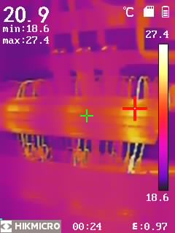
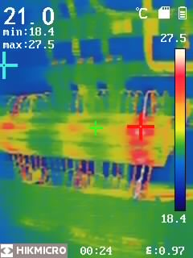
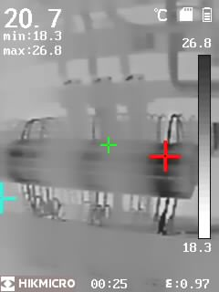
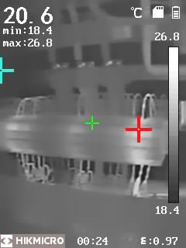
E1L
4 Color Palettes

Slide 4
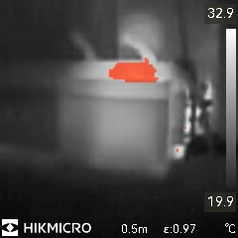
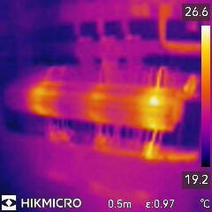
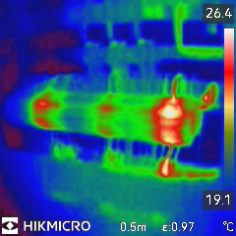
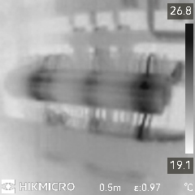
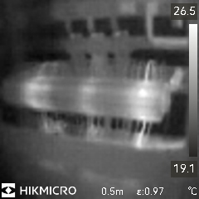
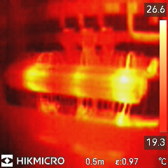
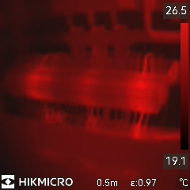
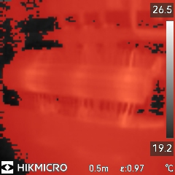
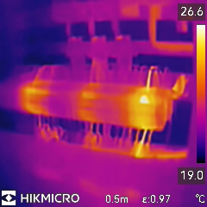
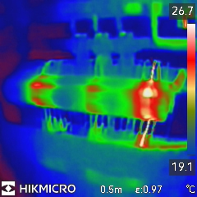
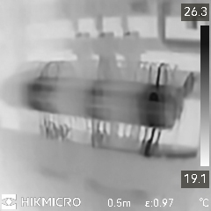
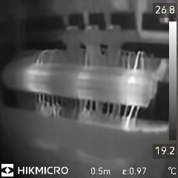
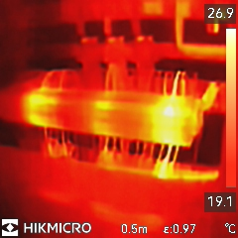
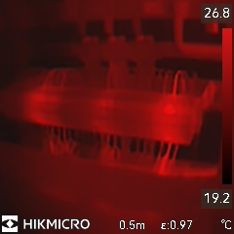
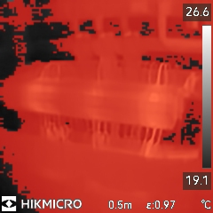
Eco & Eco-V – Thermal Mode
7 Color Palettes
Disabled
SuperIR
Enabled
SuperIR

Slide 5
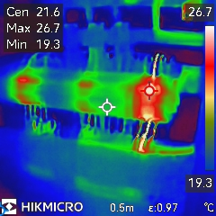
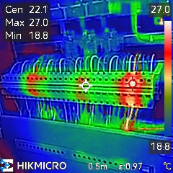
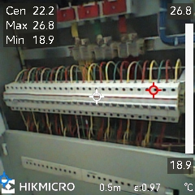
Eco-V – 3 Images Modes
Enabled
SuperIR

Slide 6
Eco & Eco-V VS E1L – Disabled SuperIR
E1L
Eco
&
Eco-V

Slide 7
Eco & Eco-V VS E1L – Enabled SuperIR
E1L
Eco
&
Eco-V

Slide 8
THANK YOU
See the World in a New Way

