Slide 1
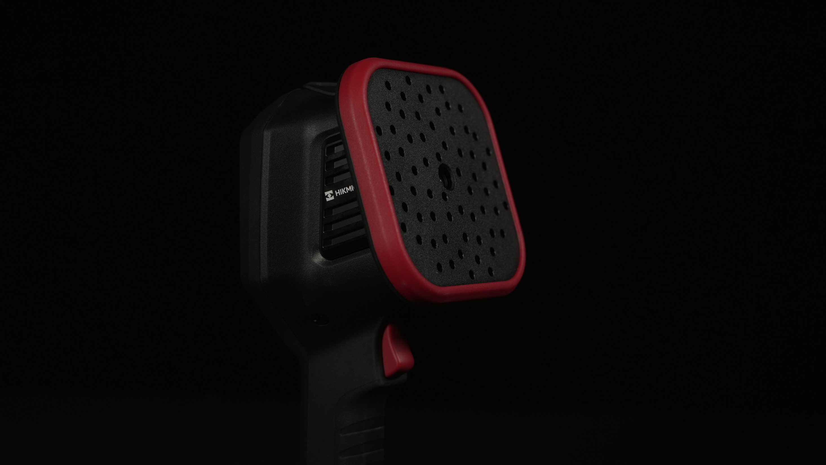

Acoustic SERIES
ACOUSTIC Imaging Camera
AI SERIES Introduction
2024.Q3
1

Slide 2
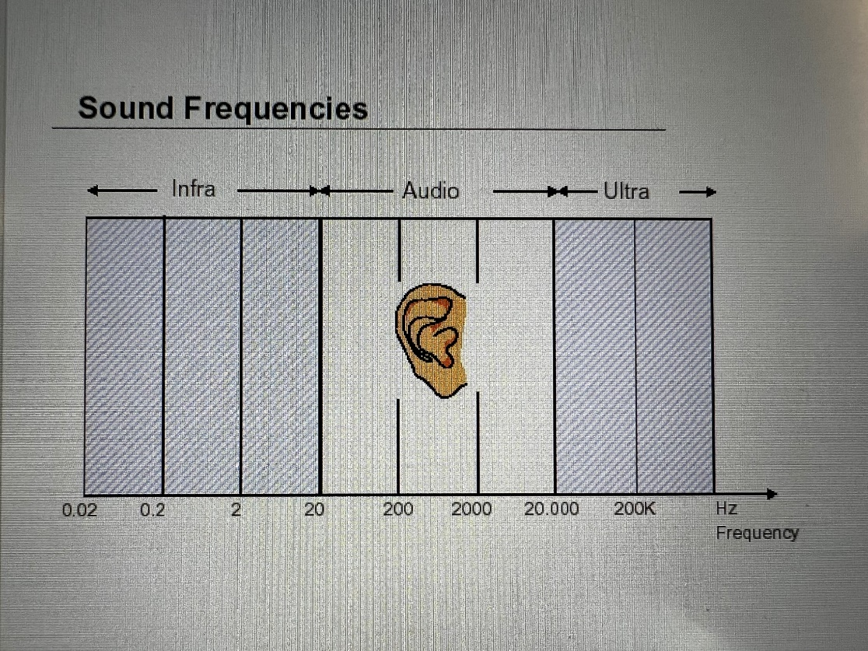
Sound Waves
The vibration of the object causes the fluctuation of the surrounding medium mass from near to far, called sound waves.
When a speaker makes a sound, it causes the surrounding air to vibrate and produce sound waves.
Objects that cause sound waves -sound source
The substance that transmits sound waves - the medium
Sound source: speaker
Medium: air
infrasonic
Sound waves
Ultrasound
20Hz
20kHz
100kHz
1MHz
The human ear can theoretically hear in the field of 20Hz-20kHz.
However, most adults over 25 cannot hear sounds above 16K.
Acoustic cameras are used to detect sounds that are inaudible to the human ear, thus providing preventive maintenance and troubleshooting of equipment.
Notes:
物体的振动引起周围媒质质点由近到远的波动，是声波。
扬声器发声时，引起周围空气的振动而产生声波。
引起声波的物体是声源；传播声波的物质是媒质。
声源——扬声器；媒质——空气。
下图是声波的频段：次声波-声波-超声波频率
右图是人耳能听到的频率范围，理论上是20-20000Hz。
【声像仪用于检测人耳无法听见的声音，从而对设备进行预防性维护和故障的排查。及时发现问题，降低成本，规避危险。

Slide 3
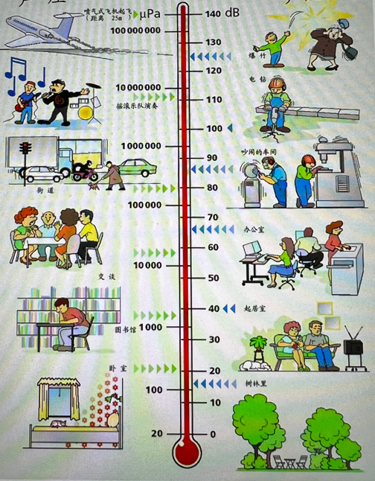
Sound Pressure in life
sound source | Sound pressure（Pa） | pressure level（dB）
Human ears (weakest) | 0.00002 | 0
Suburban Night | 0.0002 | 20
Whisper | 0.002 | 40
1 meter social distance | 0.02 | 60
Speaking out loud | 0.2 | 80
Factory | 2 | 100
Diesel engine | 20 | 120
Aircraft take-off | 200 | 140
Missile launch | 2000 | 160
Nuclear explosion | 20000 | 180
Notes:
声压在不同环境中的数值体现，和信噪比可以共同理解。80dB时，其对应值就是大声说话的声音。
信噪比Signal-to-noise ratio/rexio ：电子设备或电子系统中的信号与噪声的比率，信噪比的测量单位是dB。该值越大表明链路中的噪声相对于有效信号来说越小。

Slide 4
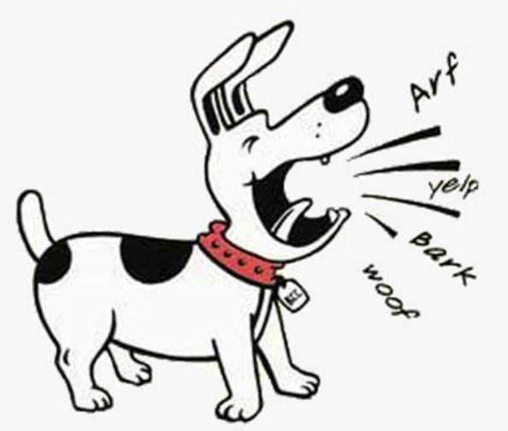
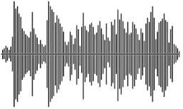
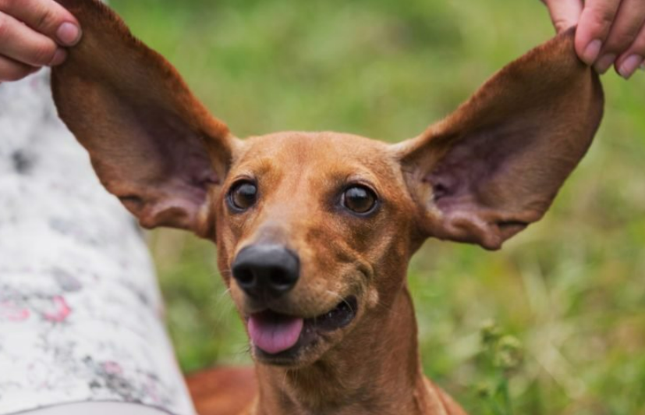
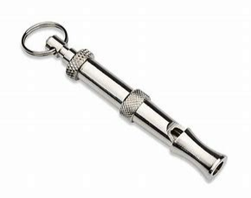
Sound/Acoustic
Sounds are all around us. Most around us produce sound. What we can’t hear, doesn’t mean there isn’t any sound produced.
We measure Sound in Bandwidth.
The unit that we use for Bandwidth is Hz
A dog’s hearing range is from 67 Hz to 45 kHz.
When you blow the dog whistle, you cannot hear any whistle at all, but dogs can and will come running to you when you blow the dog whistle.
That is because the dog whistle emits a pitch of 23 kHz to 55 kHz when blown.
In many industrial and electric power utilities, it is necessary to detect potential leakage risks in time, and these leakages are usually inaudible to human ears, and the acoustic imaging camera can help you quickly find these sounds.
Notes:
我们把声音理解为带宽，单位是Hz

Slide 5
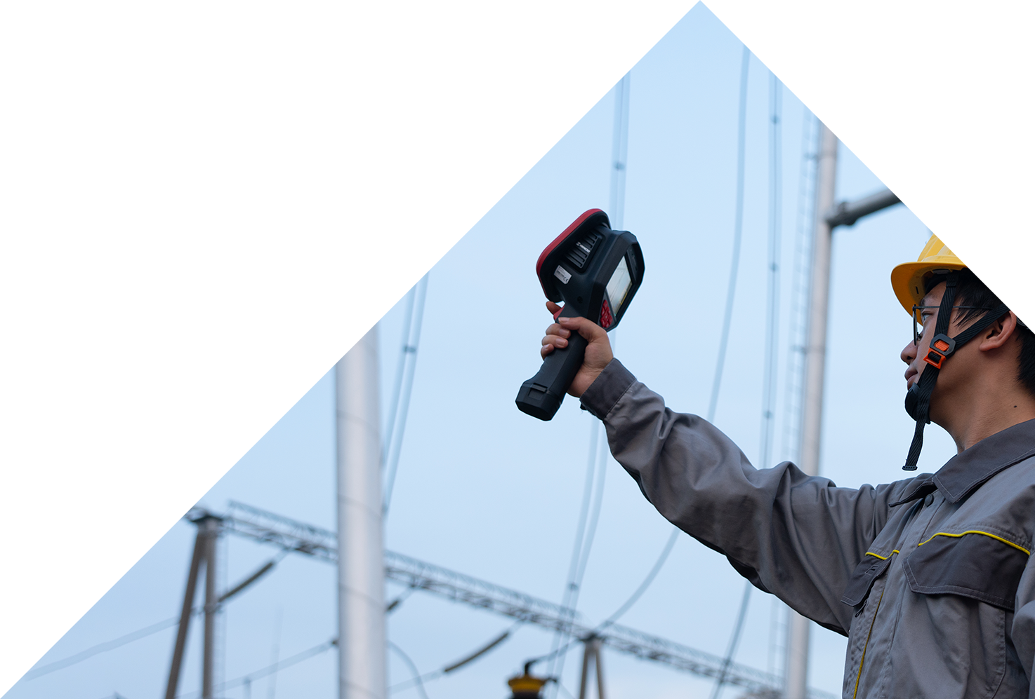
PART 02.
PRODUCT
OVERVIEW
01 APPLICATIONS
02 PRODUCT OVERVIEW
03 KEY FEATURES

Slide 6
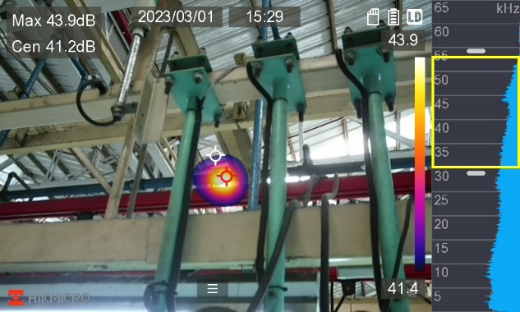
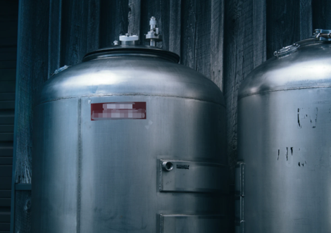
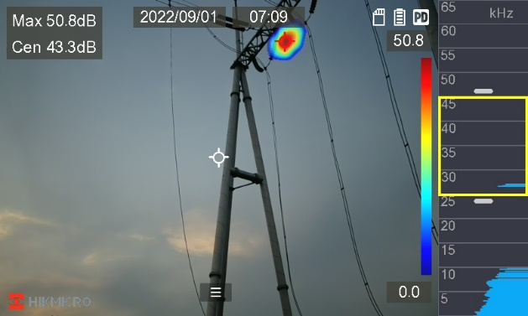
Application Scenario & Target Market
Acoustic imaging cameras can be used in scenarios with gas leaks and partial discharges as a tool to quickly locate sound sources and find leaks.
Inspections for:
Manufacturing
Oil & Gas
Electric Power Utility
Automotive
Pulp & Paper
Metals
Food & Beverage
Chemical
Upstream
Refining
Petro-Chemical
Generation
T&D
Substation
Sub-Markets
Maintenance Manager
Reliability Specialist
NDT Technician
Maintenance Manager
Electrical Engineer
NDT Technician
Reliability Specialist
Maintenance Manager
Substation Manager
Reliability Specialist
Thermographer
Personas

Slide 7

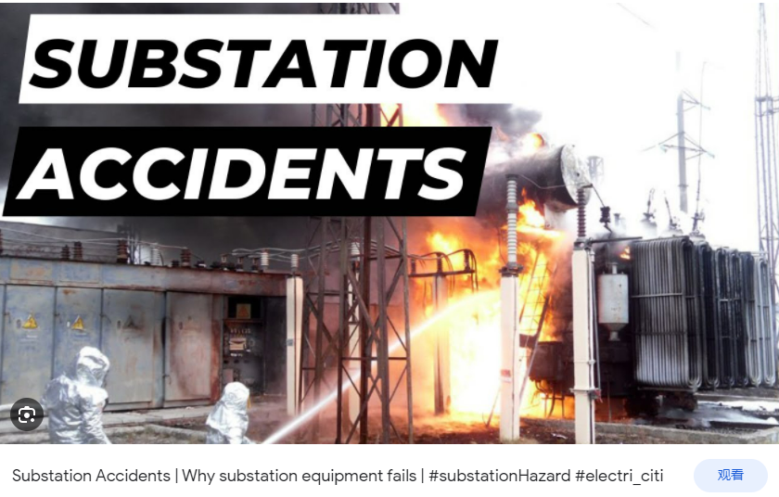
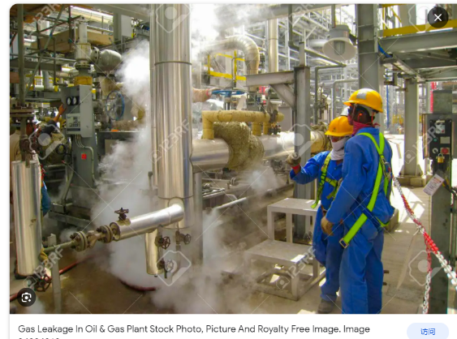
Product Application Scenario
Quickly discover potential risks with the AI Series
Inspectors and maintenance personnel working in industrial or electrical environments can utilize the AI56 to quickly find compressed gas leaks or electrical partial discharge issues before a potentially catastrophic issue happens.

Slide 8
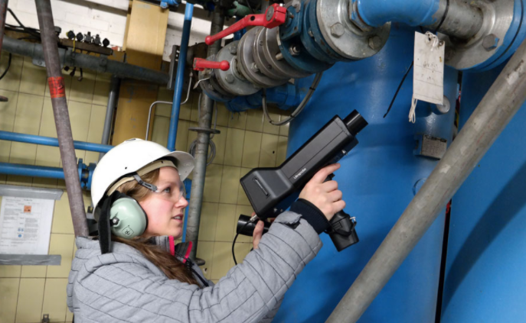
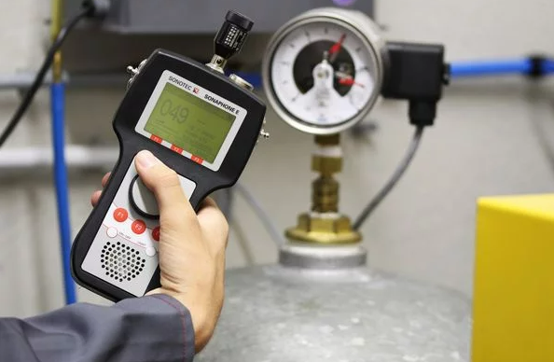
Product Application Scenario
Accurate analysis of leaks with the AI series
The AI series supports compressed gas leak data analysis and partial discharge type detection, providing analytical data to help fix problems faster.
Traditional Inspection Tools
Single microphone
Operator sound signal interpretation
Accessories for specific uses
Effective but time-consuming and training-intensive
With traditional detection tools like Ultrasonic Testing Devices, Leak Detection devices it can find leaks, but it takes more time. Also, traditional detection tools are not able to analyze the leaks quickly.
Notes:
用传统的检测工具及时可以找到泄露，但是无法快速的进行分析。同时使用传统的检测工具比如Ultrasonic Testing Device，Leak detector device及时可以找到泄露，但是会花费更多的时间。同时传统的检测工具并不能快速进行分析。

Slide 9
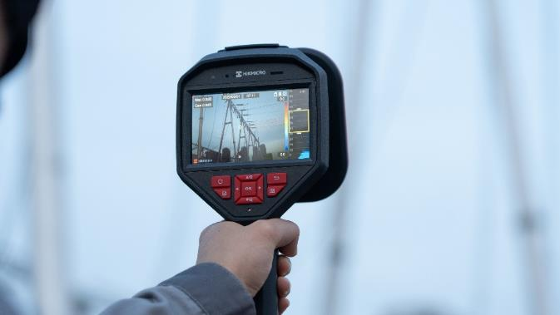

Advantages Of The Acoustic Imaging Camera
Easy To Use： A single tool capable of measuring both PD and LD, designed for 1 handed operation, with large easy to read display that visualizes the leak, and a simple intuitive interface.
Safety: Working range 0.3m~150m, no need to be close to the dangerous environment, the microphone can collect the sound in real-time
High Efficiency: Compared with the traditional gas leak and partial discharge detection tools, an acoustic imaging camera typically provide a 90% reduction in inspection time, also relatively easy to learn. It will make your detection efficiency higher, and more cost can be saved.
Notes:
用传统的检测工具及时可以找到泄露，但是无法快速的进行分析。同时使用传统的检测工具比如Ultrasonic Testing Device，Leak detector device及时可以找到泄露，但是会花费更多的时间。同时传统的检测工具并不能快速进行分析。

Slide 10
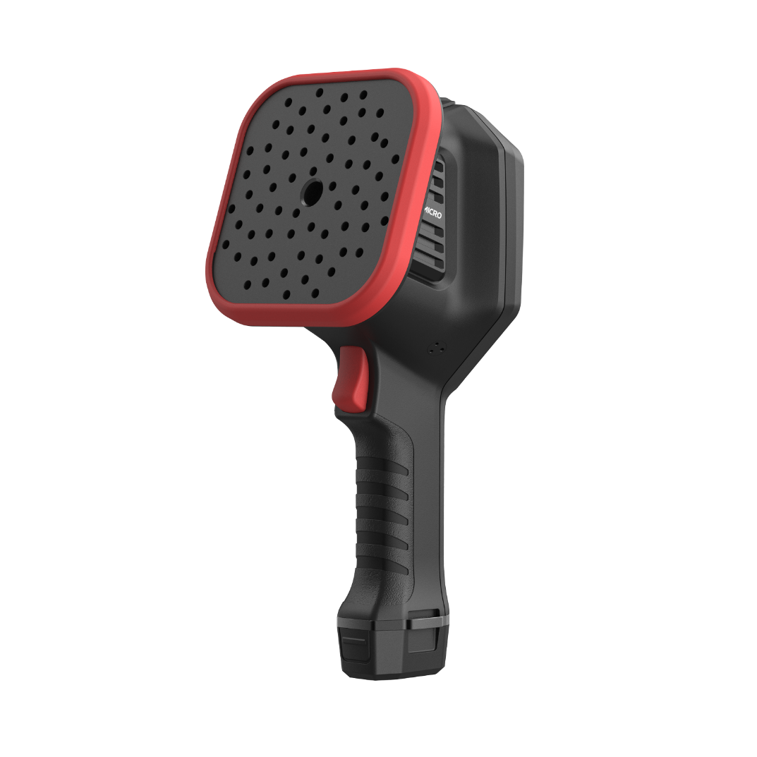
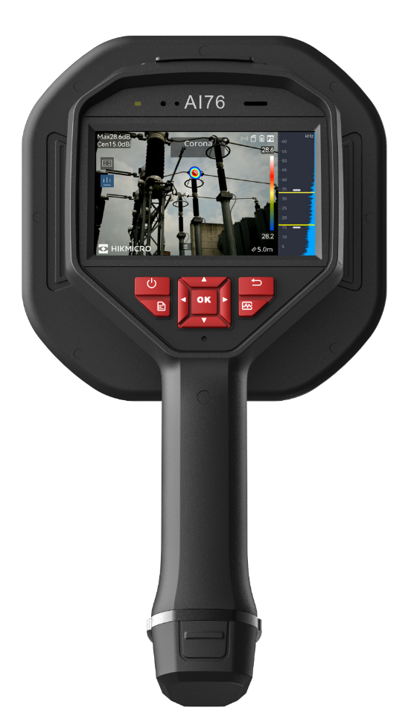
AI Series - Overview
The AI series is an acoustic imaging camera capable of measuring gas leaks and Partial discharge
The AI series adds powerful features for gas leak detection（LD） and partial discharge detection（PD).
Analyzer Acoustic software allows you to analyze data and export reports
Specifications | AI56 | AI76
Number of Microphones | 64 | 136
Bandwidth | 0 kHz to 96 kHz, adjustable range MEMS sampling frequency: 192 kHz
Distance | 0.3m~150m
Camera FOV | 50.2°× 35.4°
Sound Intensity Display | Peak Point
Acoustic Image Frame Rate | 25 fps
Acoustic Image Resolution | 800 × 480
Leak Rate | >0.008 l/min @ 6 bar from 0.5 m (1.64 ft) >0.013 l/min @ 5 bar from 1 m (3.28 ft) | >0.0047 l/min @ 6 bar from 0.5 m (1.64 ft) >0.0073 l/min @ 5 bar from 1 m (3.28 ft)
Dynamic Range | Low Limit: <-15dB High Limit: >120dB
Discharge Detection | Automatic detection 50 / 60 Hz
Discharge Type | Corona Discharge, Particle Discharge, Floating Discharge, Surface Discharge
Display | 800 × 480 Resolution, 4.3” LCD Touch Screen
Digital Zoom | 1.0x to 16.0x continuous
AI56
AI76

Slide 11
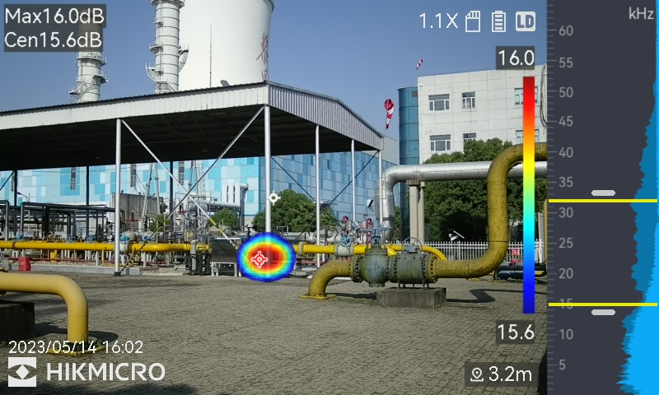
AI Series - Questions to Ask
Questions to Ask
The bandwidth of AI Series is 0kHz~96kHz, does it meet the detection requirements of the scene?
Compressed gas operates in the 35-45 kHz range and the AI series is perfectly aligned to measure that range.
What is the meaning of the dB value in the upper left of the AI Series interface?
The dB value is the unit of sound intensity, the greater the sound intensity, the louder the sound.
The dB value of Max displayed in the interface is the peak sound intensity within the yellow spectrum box on the screen, where the longer the length of the blue stripe, the greater the sound intensity.
What is the meaning of the kHz value on the right side of the AI series interface?
kHz value is the frequency of sound vibration, the higher the frequency, the sharper the sound, and the ultrasonic segment will be beyond the hearing range of the human ear.
Acoustic palette
The opacity ranges from 0% to 100%. The lower the value is, the more transparent the acoustic palette is. You can adjust the opacity of the acoustic images, and view the acoustic images and the optical images at the same time.

Slide 12
Advantages Of The Acoustic Imaging Camera
Leak Detection Capability
Different brands have varying capabilities in detecting leak rates. HIKMICRO excels in this area, detecting leaks as low as >0.0047 l/min @ 6 bar from 0.5 m (1.64 ft). In comparison, FLIR SI2Pro and Fluke ii910 detect at >0,032 l/min @ 3 bar from 3 =m (9.8 ft)andDetects a 0.005 CFM leak at 100PSI from up to 32.8 feet, respectively, and Crysound at 0.5m 5bar 0.55ml/s
Device Sensitivity and Stability
The HIKMICRO acoustic camera shows excellent sensitivity, detecting sound signals as low as Negative15 dB. In comparison, the FLIR SI2Pro and Fluke ii910 have sensitivities of Negative10 dB and Negative12 dB, respectively, while Crysound is at Negative13 dB.
Number of Microphones
he HIKMICRO acoustic camera is equipped with 136 microphones. In comparison, the FLIR SI2Pro and Fluke ii910 have 124 and 64 microphones respectively, while Crysound has 128. More microphones give HIKMICRO higher sensitivity in sound capture and localization.
These points highlight the strengths of HIKMICRO's acoustic camera in terms of microphone sensitivity, leak detection capability, and overall device sensitivity and stability.

Slide 13
Advantages Of The Acoustic Imaging Camera
Easy To Use： A single tool capable of measuring both PD and LD, designed for 1 handed operation, with large easy to read display that visualizes the leak, and a simple intuitive interface.
High Efficiency: Compared with the traditional gas leak and partial discharge detection tools, an acoustic imaging camera typically provide a 90% reduction in inspection time, also relatively easy to learn. It will make your detection efficiency higher, and more cost can be saved.
One-handed
Push-button Control
Better Heat Removal
Interchangeable Batteries

Slide 14
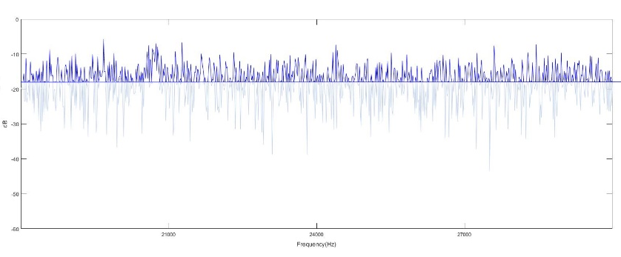
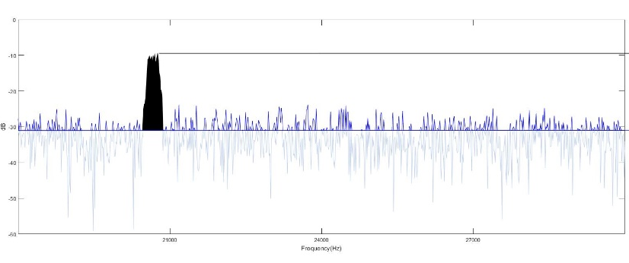
AI Series - Questions to Ask
1
microphone
32
microphone
20kHz signal Detected
Microphone Noise
Microphone Noise reduced
By 15.1dB
The difference in the number of microphones
The difference in the number of microphones significantly impacts the acoustic performance of the acoustic imaging camera, making the quantity of microphones a crucial factor in acoustic imaging equipment. Generally, a higher number of microphones leads to improved acoustic performance.
The AI series utilizes MEMS-type microphones, providing outstanding performance, stability, lower power consumption, and a smaller form factor. MEMS microphones can typically capture loud sounds exceeding 120 dB(A), but they also come with higher self-noise levels, making it challenging for a single microphone to detect the faintest sound levels. However, this self-noise can be mitigated by combining signals from multiple microphones. Therefore, maximizing the number of microphones enhances sensitivity for detecting low-level sounds.

Slide 15
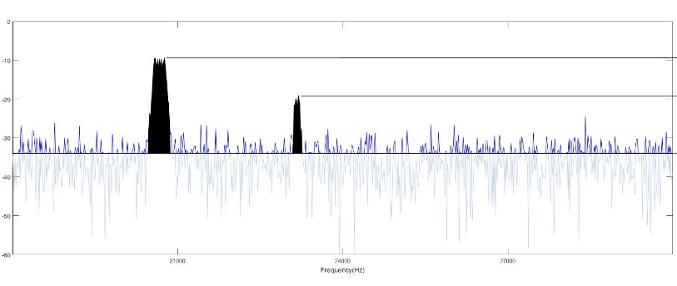
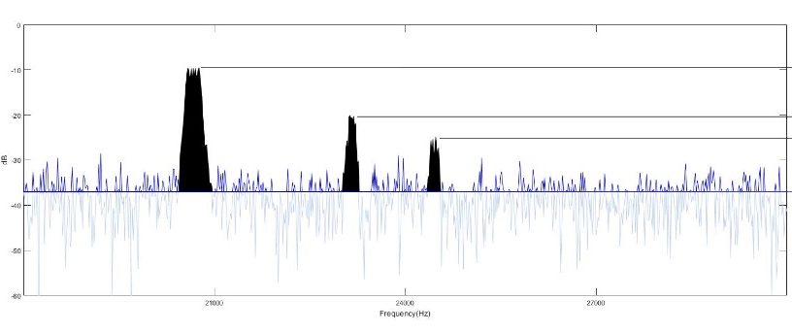
AI Series - Questions to Ask
64
microphone
136
microphone
20kHz signal Detected
20kHz signal Detected
23kHz signal Detected
23kHz signal Detected
25kHz signal Detected
Microphone Noise reduced
By 18.1dB
Microphone Noise reduced
By 21.1dB
The difference in the number of microphones
This chart illustrates how the number of microphones affects the ability to "see" issues. With 136 microphones, the AI76 can easily identify three noise peaks generated by a leak, while the AI56, with 64 microphones, can detect two noise peaks. In contrast, a camera with only 32 microphones can observe just one peak.
The AI56 is equipped with 64 microphones, allowing it to perform detection in most typical environments. In contrast, the AI76 boasts 136 microphones, enabling its unrestricted use in a wide range of scenarios

Slide 16
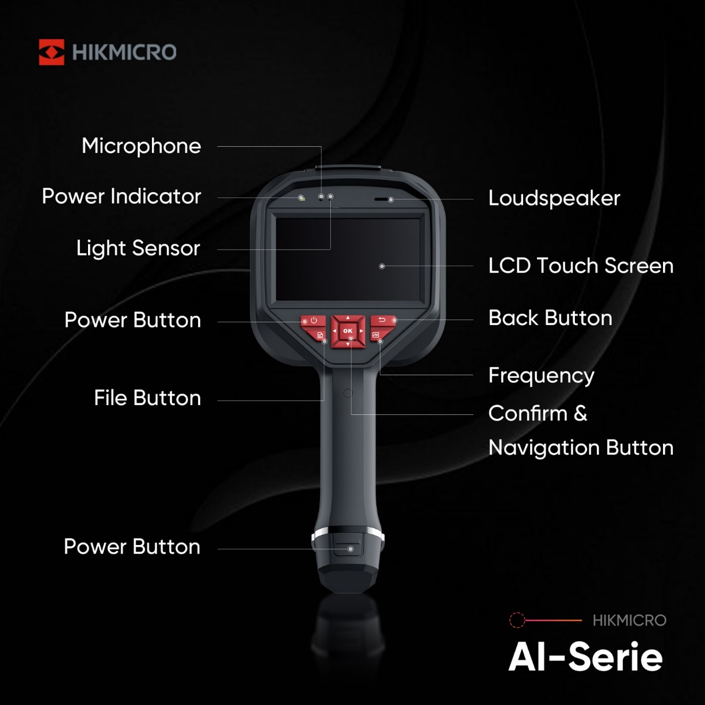
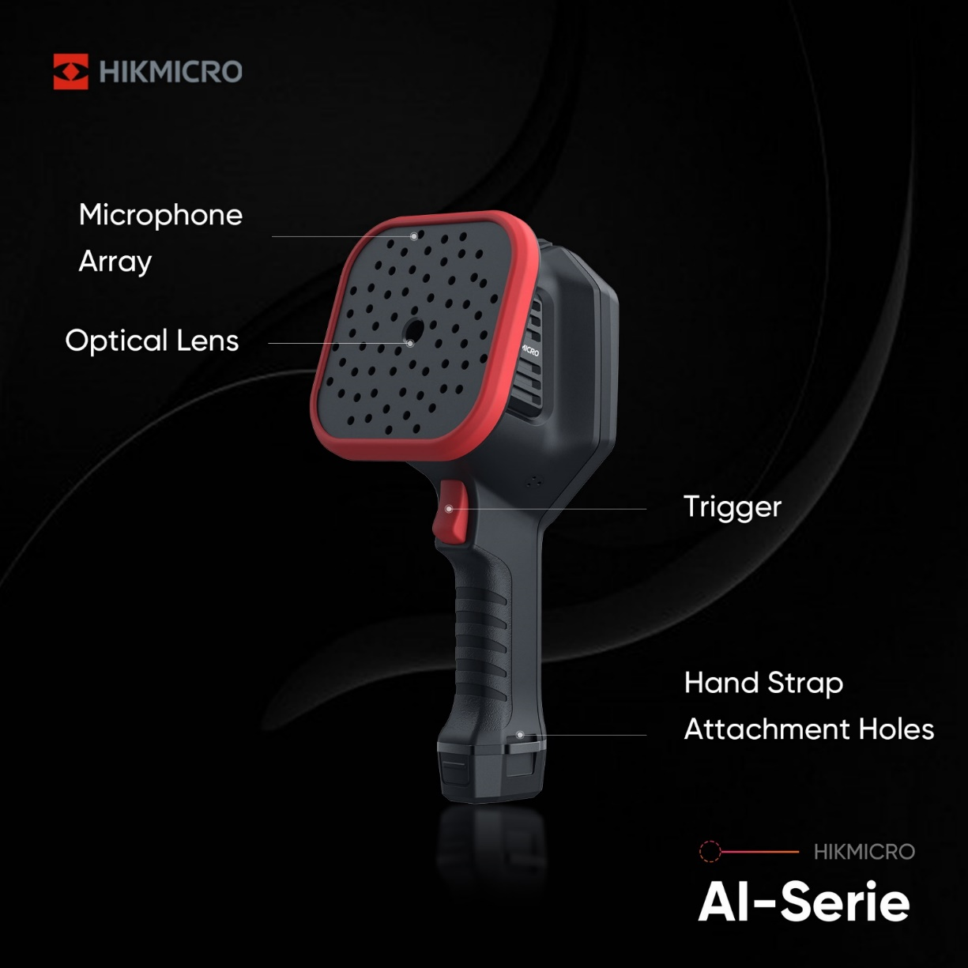

AI Series - Overview
Call outs
Visiual lens
Interchangeable Battery
AI Series
AI Series

Slide 17
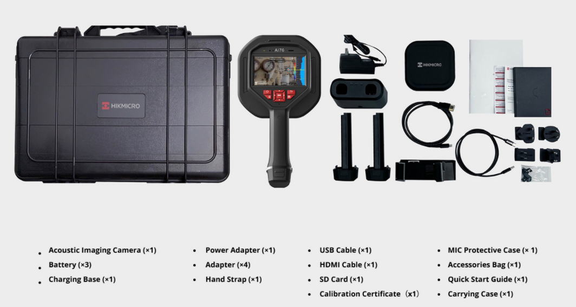
AI Series - Overview
What’s in the box

Slide 18
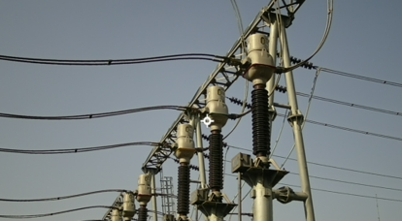
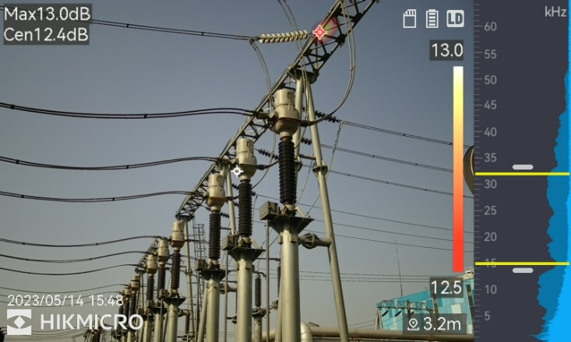

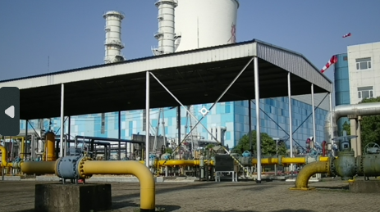

AI Series - Low-noise MEMS Microphones And Adjustable Bandwidth
With Low-noise MEMS microphones and an adjustable bandwidth range from 2 kHz to 96 kHz.
The HIKMICRO AI series provides an easy and effective way to instantly locate gas leak detection and partial discharge from high-voltage systems.
Partial Discharge Inspection
Convert
Into
VISUAL
DISPLAY
“Hear”
“Identify”
SOUND
Compressed Gas Leak Inspection

Slide 19
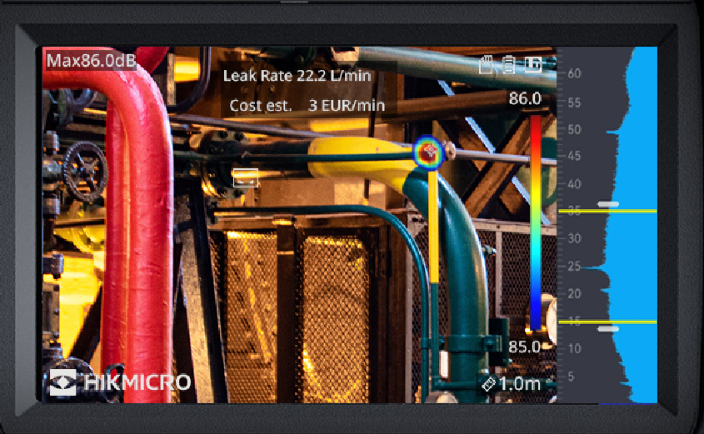
AI Series - Real-time Display Of Leakage Data
The HIKMICRO AI series offers real-time estimated leak rate, and leak cost for gas leak detection. Even in noisy environments, the AI series can filter the noise to “visualize” sound with a large 4.3" LCD touch screen.
What is the minimum pressure requirement for gas leak detection?
Subject to the datasheet, if lower than nominal pressure, actual field measurement is required.
Specifications | AI56 | AI76
Leak Rate | >0.008 l/min @ 6 bar from 0.5 m (1.64 ft) >0.013 l/min @ 5 bar from 1 m (3.28 ft) | >0.0047 l/min @ 6 bar from 0.5 m (1.64 ft) >0.0073 l/min @ 5 bar from 1 m (3.28 ft)
Dynamic Range | Low Limit: <-15dB High Limit: >120dB

Slide 20
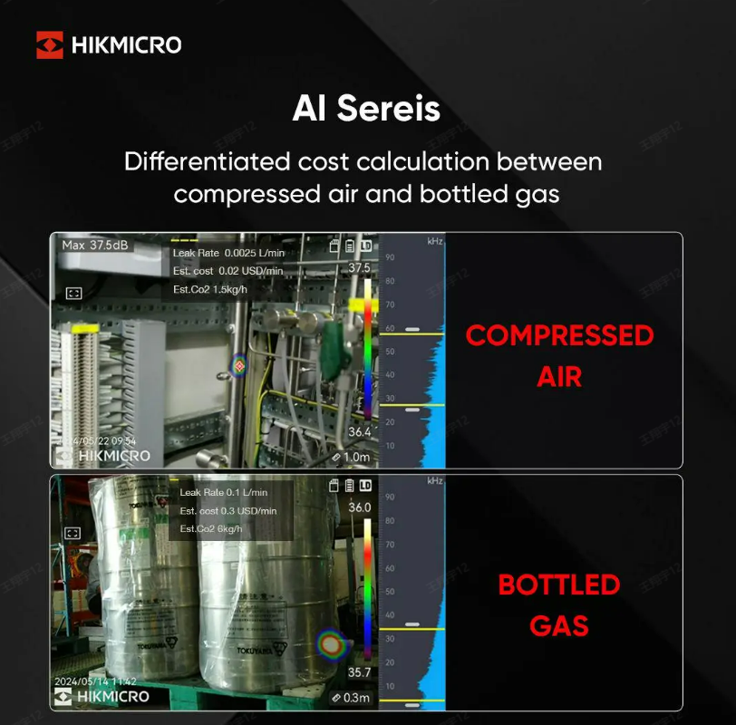
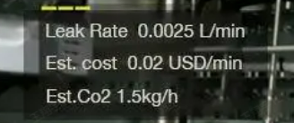
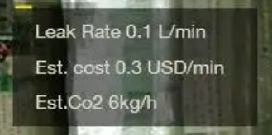
AI Series – V5.5.79
Introducing the Newly Upgraded AI Series
Enhanced with cost calculation and result display features for gas leak detection, making the AI Series more powerful than ever!
Save money and energy

Slide 21
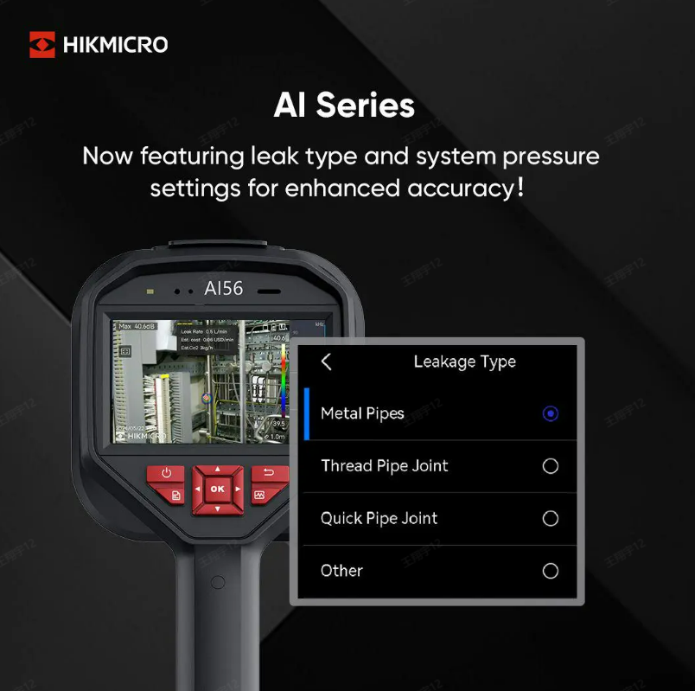

AI Series – V5.5.79
Introducing the Newly Upgraded AI Series
Now featuring leak type and system pressure settings for enhanced accuracy.
With V5.5.79, AI series now can configure according to target type:
metal pipes, threaded pipes, quick pipe joints, and more.
Specific algo's are used for each target type to improve accuracy.

Slide 22
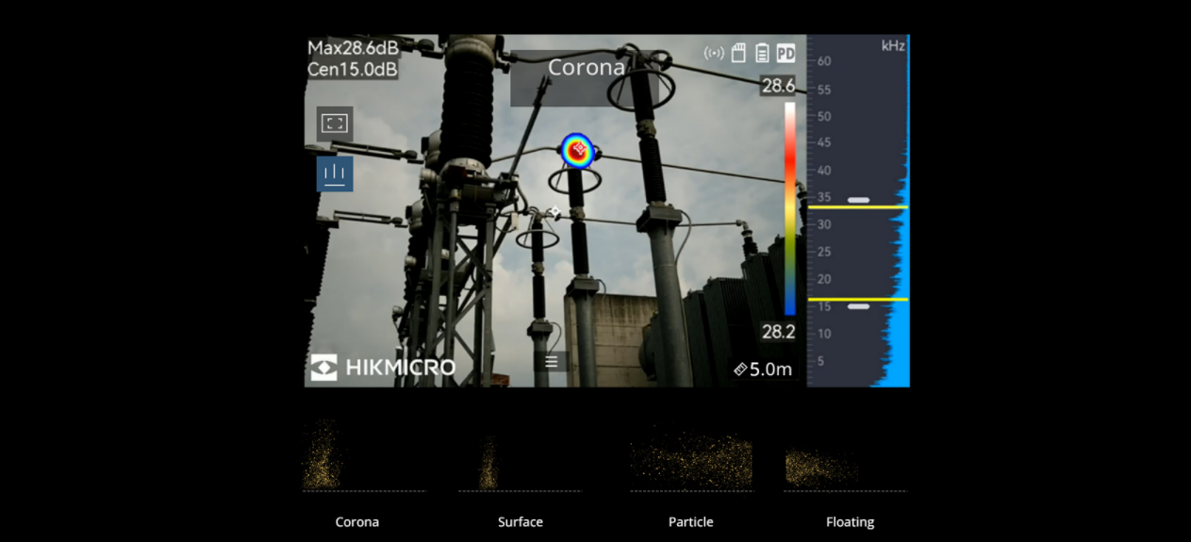
AI Series - Smart Partial Discharge Detection
When placed in Partial Discharge mode, the AI series identifies corona, floating, surface, or particle discharge on high voltage systems that can lead to equipment failure. This is instantly displayed onscreen and can be saved for documentation and reporting.

Slide 23
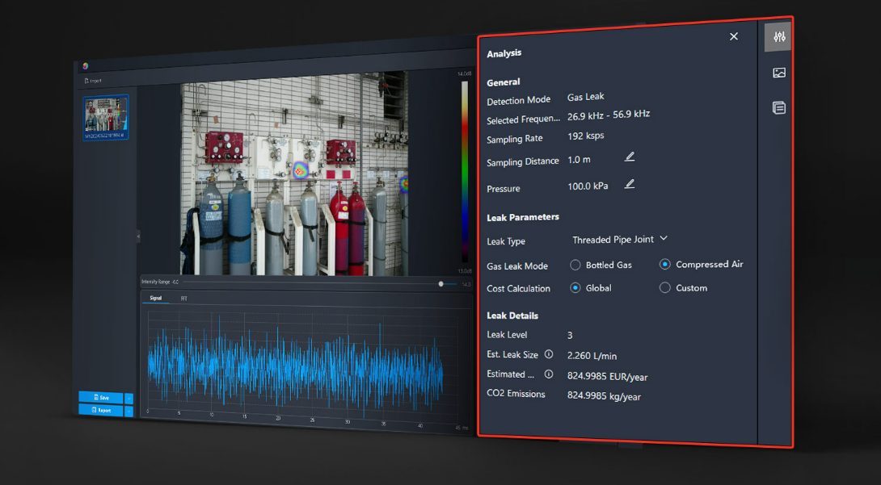
AI Series - Analyzer Acoustic
Gas Leak Analysis
Adjustable detection parameters, cost calculation and result display, and more adjustable detection parameters for better accuracy.

Slide 24
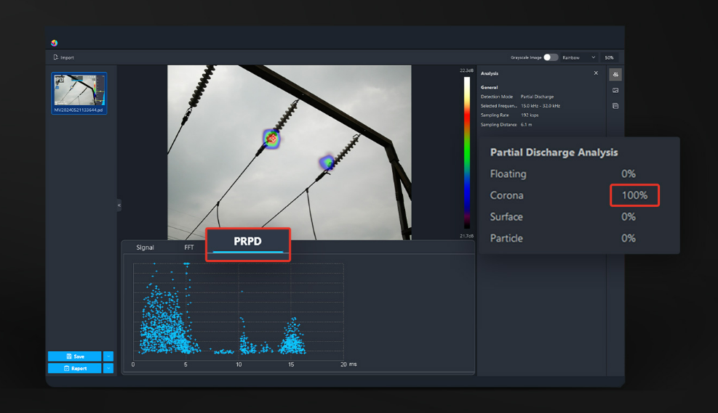
AI Series - Analyzer Acoustic
Partial Discharge Analysis
Analyzer Acoustic software utilizes field images and data to classify the type and severity of the partial discharge.

Slide 25
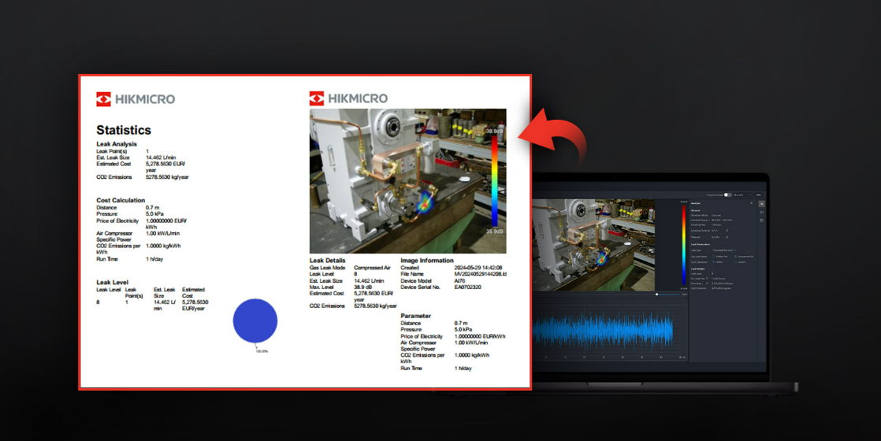
AI Series - Analyzer Acoustic
Quickly Generate Reports
Simply import images from the camera to quantify issues, analyze field images, highlight concerns, and create reports for repairs, field audits, or energy rebate programs.

Slide 26
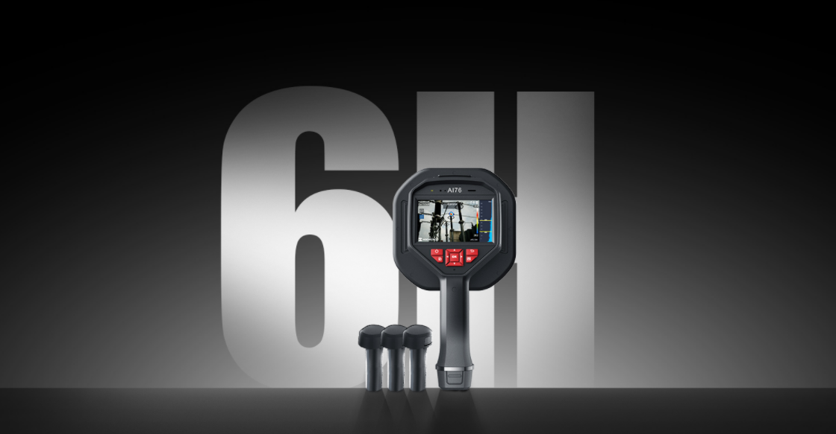
AI Series - Interchangeable Battery System
Includes 3 interchangeable Li-ion batteries and a dual bay charger to provide you with up to 10 hours with AI56, and 6 hours with AI76 of operation. You can stay powered up for even the longest inspections.

Slide 27
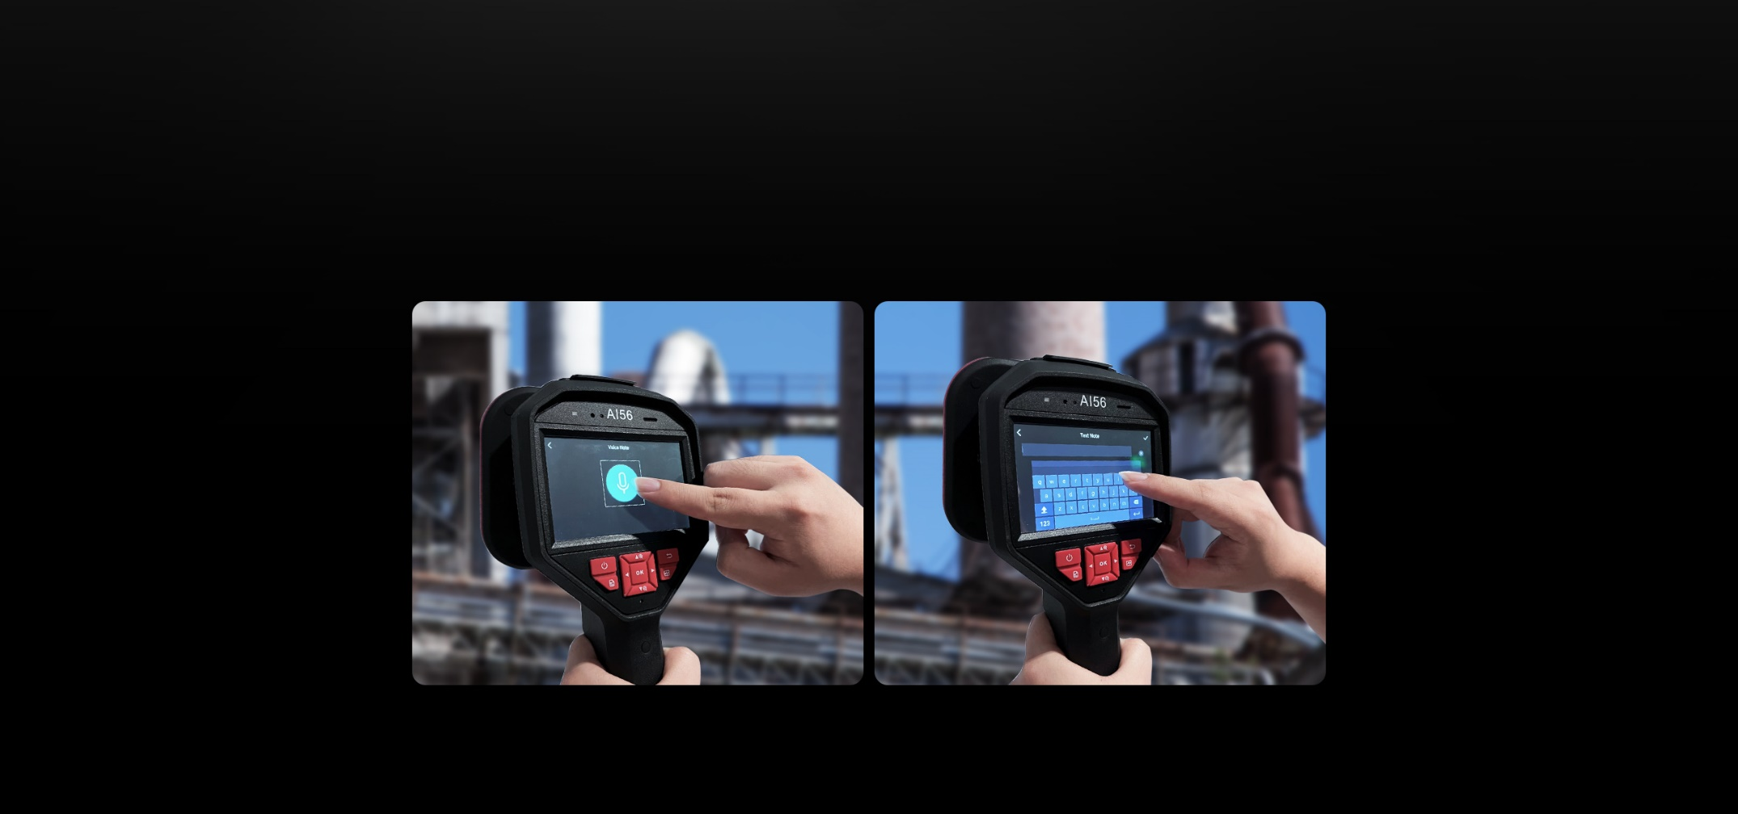
AI Series - Voice & Text Annotations
In addition to supporting voice, text annotations to the image helps to improve inspection efficiency and productivity.

Slide 28
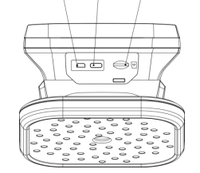
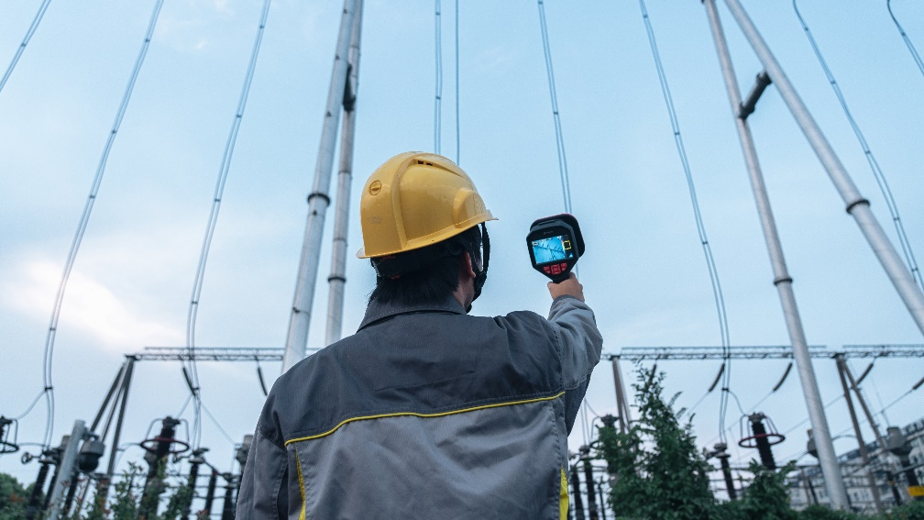
AI Series – More Features
Micro HDMI Interface
Display the image and menu interface via HDMI output.
Type-C Interface
Charge the device or export files with supplied cable.
SD Card Slot
Insert SD card in it.
4.3" LCD Touch Screen
By using a 4.3" LCD touch screen, the results presented on top of a digital picture allows you to quickly find the source of the problems.
Light Weight
One-handed operation, more convenient to use, you can complete the detection work by yourself, a device is a professional team.
Light.
8 Color Palettes
View 8 color palettes give different image display options: White Black, Black White, Rainbow, Fusion, Ironbow, Red Black, Rain, Blue Red
Maximize Energy Savings
Adopting this lightweight and easy-to-use tool, you can discover the potential safety risks, minimize troubleshooting, and save extra costs of equipment failures and downtime.

Slide 29
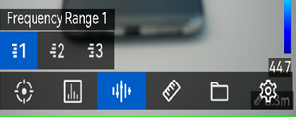

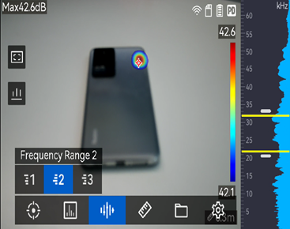
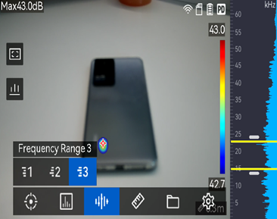
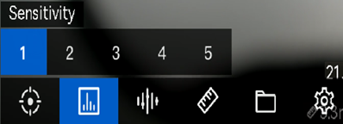
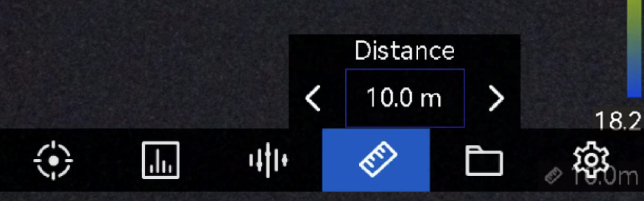
AI Series - Acoustic Spectrum Of Detection
Frequency Range
3 options. (Preset & Changeable)
Press or hold to change x kHz.
Max. span of the frequency range is 24 kHz.
Using Touch Screen/Buttons to adjust the frequency range.
The AI56 offers 3 options for LD/PD to help you do the detection quickly, and you can also be self-adjusted.
Range 1
Range 2
Range 3
Sensitivity
5 options.
The higher the level, the more sensitive it will be and the faster the acoustic palette will move around.
Distance
Adjust the distance value by pressing/holding and or tapping the left/right arrow.
You need to set this as accurately as possible and adjust as needed during the inspection if measuring LD values.

Slide 30
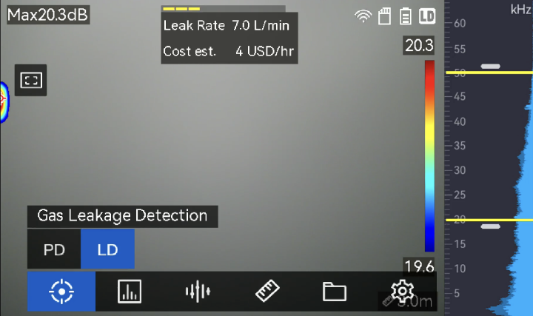
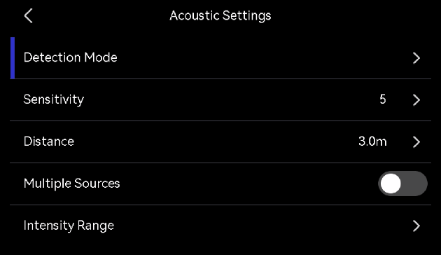
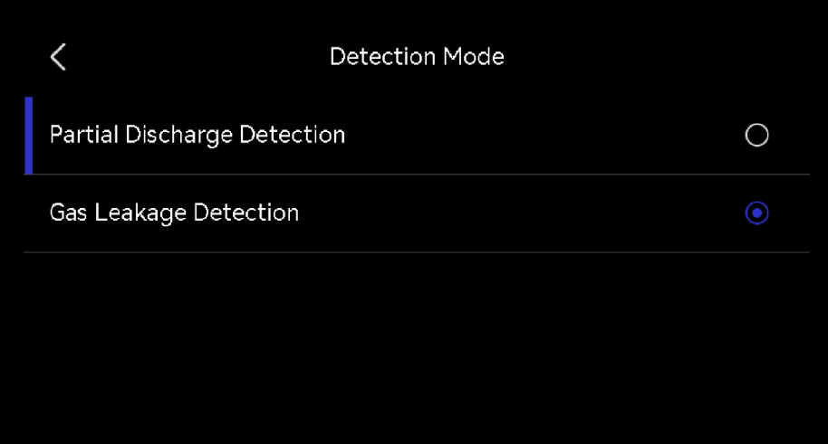



AI Series – Leak Calculation Value Settings
Settings >>Acoustic Settings >> Gas Leak Settings: Unit Price, Time Unit and Currency.
>>
>>
>>
>>
>>
Unit Price:
The price of the target gas per unit
Enter any required price from 0 to 9, 999, 999.
Time Unit:
The preferred unit time range for leak cost estimation
Tap to select the unit.
Currency:
The preferred currency for leak cost estimation
Tap to select the currency.

Slide 31


AI Series - Gas Leak Detection Cost Analysis
The AI56 offers real-time estimated leak rate, leak cost, and leak level for gas leak detection.
AI56 can filter noise, to “visualize” sound with large 4.3" LCD touch screens even in noisy environments.
What is the minimum pressure requirement for gas leak detection?
Subject to datasheet, if lower than nominal pressure, actual field measurement is required
The adjustment of the distance will not make the acoustic image disappear, but it will affect the leak rate.

Slide 32



AI Series - Partial Discharge Detection
Tap to choose PD.
Estimate partial discharge types based on sound frequency, and displaying the real-time estimation in live view for your reference.
Tap on the left to turn on/off the estimation display.
The PD type is displayed on the upper middle of live view.
PRPD: shows the amplitude of the detected partial discharges plotted against the phase angle (x-axis).
Tap the diagram to turn on/off.

Slide 33


AI Series - Analyzer Acoustic Software
Analyzer Acoustic software allows you to analyze and create reports based on field inspection images. These reports can then be exported providing interested parties with in-depth analysis such as the size and energy cost of a compressed gas leak, or the partial discharge classification.
Export to PDF
Analyzer Acoustic
Calculated discharge type and degree of certainty

Slide 34




AI Series - Analyzer Acoustic LD
Analyzer Acoustic software utilizes field images and data to classify the severity and cost of the gas leak.
This information can then be used to generate a report for documentation or corrective action.
The signal is the signal strength received by the microphone during the capture time
The FFT is the bandwidth you select during the inspection.

Slide 35





AI Series - Analyzer Acoustic PD
Analyzer Acoustic software utilizes field images and data to classify the type and severity of the partial discharge.
This information can then be used to generate a report for documentation or corrective action.
The signal is the signal strength received by the microphone during
the capture time.
The FFT is the bandwidth you select during the inspection.
The PRPD shows the types of partial discharges, and we currently support four types of local discharge detection.

Slide 36



AI Series - Analyzer Acoustic Report PD/LD
Analyzer Acoustic software analyzes images captured by acoustic imaging camera and exporting reports.
This provides the user with in-depth information such as the size and energy cost of a compressed gas leak, or the partial discharge classification.
Currently supports English language only.
Multi-language will be added in Q3
AI56 is supported in Viewer 2.1

Slide 37




Case Study - Canyon Coal in Bronkhorstspruit, South Africa.
Detect and localize leaks in Plant Pipes & Valves
Canyon Coal Plant Pipes & Valves' periodic inspection is essential to maintain the plant's smooth operation.
The maintenance team requires the ability to quickly and effectively scan large areas from a safe distance with the certainty of reliability and accuracy.
With traditional detection tools like Ultrasonic Testing Devices, Leak Detection devices it can find leaks, but it takes more time. Also, traditional detection tools are not able to analyze the leaks quickly.
Inspect and analyze the air leak with AI56
By using a large 4.3" LCD touch screen, the results presented on top of a digital picture allow you to quickly find the source of the problems. Analyzer Acoustic software can analyze images captured by acoustic imaging cameras and export reports.
Advantages Of AI56
Easy To Use: A single tool capable of measuring both PD and LD, designed for one-handed operation, with a large easy-to-read display that visualizes the leak, and a simple intuitive interface.
Safety: Working range 0.3m~100m, no need to be close to the dangerous environment, the microphone can collect the sound in real-time.
High Efficiency: AI56 typically provides a 90% reduction in inspection time, also relatively easy to learn.
It will make your detection efficiency higher, and more cost can be saved.

Slide 38
PART 05.
COMPETITION

Slide 39
THANK YOU
See the World in a New Way

